Slide 1
Learning journeys and success: perspectives on conceptual threshold crossings for graduate students and supervisors – particular focus on the literature review
Gina Wisker

Slide 2
Some thoughts
The best masters or doctorate is the one you finish and hand in.

Slide 3
This research and these ideas arise from working at postgraduate level, then with postgraduates
Asking
What makes good research learning?
How do you know you are working at a conceptual critical and creative enough level for successful postgraduate work?
What are the signs of this and how do they relate to the stages of the research learning?
How do you move beyond stuck places?
How can supervisors, communities and your own behaviours nudge the learning development and recognition of it?
Notes:
Moments when I was stuck, students were stuck
Moments when I and they made learning leaps -What are the signs? What helps?
How can supervisors and postgraduate students work together to enable students’ crossing of masters and doctoral conceptual thresholds to achieve conceptual, critical and creative enough research outcomes?

Slide 4
Overview
Threshold concepts (Meyer and Land 2006)
Conceptual threshold crossings (Wisker, Kiley, Robinson 2008--)
Early work (Wisker, Kiley, Trafford & Leshem) has started to identify threshold concepts and conceptual thresholds at the research education level (EARLI 2007, QPR 2006, 2008, Threshold concepts conferences 2006,2008, 2010, 2012; EARLI 2009)
Postgraduates’ experiences with threshold concepts and conceptual threshold crossing
Supervisors’ experiences of identifying students’ conceptual threshold crossing and ‘nudging’ them across.

Slide 5
Conceptual Threshold Crossing in Doctoral Learning Journeys
We developed the notion of conceptual threshold crossings to identify moments when postgraduate students make learning leaps and begin to work at a more conceptual critical and creative fashion-
Developed from threshold concepts in the disciplines

Slide 6

Threshold concept
The absolutely essential concepts for understanding how knowledge is constructed and the world is seen in a discipline
‘Akin to a portal, opening up a new and previously inaccessible way of thinking about something. It represents a transformed way of understanding, or interpreting, or viewing something without which the learner cannot progress….’ (Meyer & Land, 2003)

Slide 7
Threshold concept & conceptual threshold crossing
Threshold concept
Transformative
Irreversible
Integrative
Troublesome Knowledge
Conceptual threshold crossing - ‘learning leaps’
Ontological change
Epistemological contribution
Notes:
Threshold concepts
Distinct from core concepts –more than a building block, leads to a qualitatively different view of the subject matter
Likely to be
Troublesome-Difficult because they shake established beliefs
Transformative-once understood likely to lead to perceived shift in perception on subject –can shift identity and personal subjectivity--- parallels with Mezirow’s (1978) work on perspective transformation
Integrative –exposes the previously hidden interrelatedness of something
Probably irreversible

Slide 8
Early work and DLJ
Wisker, Kiley, Robinson, Trafford & Leshem identified threshold concepts and conceptual thresholds at the research education level (EARLI 2007, QPR 2006, 2008, Threshold Concepts conferences 2006, 2008)
Doctoral learning journeys 2007-2010
Survey (350 doc students)
Journalling and narrative interviews 30 down to 20 students over 3 yrs
Interviewing 20 supervisors
11 examiners
Parallel project
Interviewing students , supervisors and examiners internationally
Swedish project- interviewing 40 postgraduate students and supervisors (including medical scientists)

Slide 9
Research questions
How do doctoral students signify their awareness of working conceptually?
How do students’ conceptual grasp and comments display crossing of subject-specific and generic doctoral thresholds?
How do supervisors recognise students’ conceptual grasp of research?
What strategies and activities do supervisors use to encourage or ‘nudge’ conceptual grasp by doctoral students?
How do examiners identify and assess conceptually-robust research outcomes and skills developments?
Notes:
Does the theory of threshold concepts describe and appreciate the kinds of learning research candidates can/must make in their work for it to achieve a masters or doctoral standard?
Are there generic conceptual thresholds and how might we identify the crossing of such generic doctoral thresholds?
Are there discipline-specific conceptual thresholds at the research level?
How can we identify when a candidate has crossed a threshold?

Slide 10
Research learning journeys: multi-dimensional
The Journey
Intellectual / cognitive
Personal / Emotional
Professional
Instrumental:
meeting course requirements
Ontological

Slide 11
Ontology / Identity
We argue that when a candidate’s behaviour changes it suggests that they have crossed a particular conceptual threshold and that this indicates an ontological shift, a change in identity
Behaviours such as:
  Working conceptually, critically and creatively rather than just busily
  Production of an abstract and a conclusions chapter which deal with concepts not merely facts
  Being able to put forward an argument supported by evidence

Slide 12
Question Please consider
Does the idea of
crossing a threshold,
making a ‘learning leap’,
working at a new level,
working at a conceptual, critical, creative level
Sound like a way of describing your own experiences of key moments in your development as a learner, particularly as a researcher, a postgraduate?

Slide 13
Themes from the survey of 350 doctoral students in the UK
Discovery – the identification of a new theory, theorist or concept that encapsulates thinking
Synthesis – the bringing together of two or more concepts to create a new concept
Verbal – the discovery of new ways of thinking as a result of discussion or the recognition of knowledge sufficient to defend a position
However-
Mechanical – almost superficial adoption of conceptual position to satisfy requirements of discipline
Innate – ‘I always thought this way’
Notes:
The survey identified the following ways in which doctoral students indicated crossing conceptual thresholds:

Slide 14
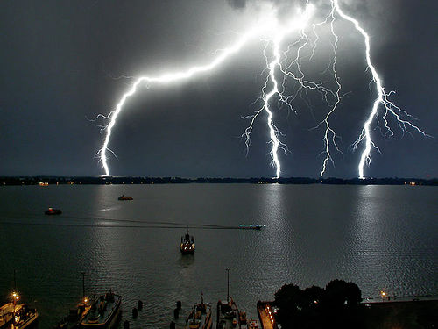
learning moments/ crossing conceptual thresholds
‘ ’

Slide 15
Learning moments where students indicate conceptual threshold crossing
In both the survey and interviews, postgraduate students have used a variety of metaphors to describe their learning journeys and experiences.
Learning leaps are often described metaphorically, in visual terms (‘a lightbulb moment’) or kinaesthetic terms (‘things clicked into place’)
as are moments where students feel they are stuck, e.g. ‘I hit a brick wall’.
The learning moments are more likely to occur when researchers :
Identify research questions;
In the literature review-Determine relationships between existing theories and their own work;
devise methodology and engage with methods;
Analyse and interpret data
See self as ‘researcher’, practitioner within field, e.g. sociologist
Become part of academic community
Contribute knowledge, engaging in debate
Take ownership of and responsibility for work
Reach conclusions - conceptual as well as factual.
Present to peers and others.
Notes:
Gradual, accumulative process,
And various learning moments occurring as move through difference phases of research
Postgraduate students are also developing a wide range of skills (research, technological, organisational, management, communication) some of which aid these learning leaps and or allow them to put what they are discovering and understanding into an accessible communicable form

Slide 16
Student responses: crossing a conceptual threshold....
In terms of learning moments I think you have those small or medium moments every now and again, don’t you, when you read and you are exposed to new ideas and you think ah now, I’ve got it and then actually a couple of weeks later you’re a bit further but then you have another one of those moments and so you kind of gradually I guess get closer and closer to the final thing, the final shape of your theories and ideas about it.
(2nd year Philosophy student)

Slide 17
A couple of weeks ago I found that things have stopped …mentally I found myself up against a brick wall… I just felt that I was kind of stuck and it wasn’t moving and it was all bitty, I’d done all these chunks of work but I couldn’t really see how they fitted together and yeah so I reached quite a crisis point. Especially when I got negative feedback I just felt quite down hearted about it and, but like I say I think having the supervision, talking it through, taking a step back from everything, taking it to bits and being questioned about everything and then having to simplify everything, in order to present. I mean over a couple of days - my supervision was one day and my presentation was the next day…
I came out of that whole process feeling that I could kind of see it, I could see that there was shape there… I can see shapes.
(1st year Gender Studies student)

Slide 18
What can you do to nudge your students to work at a
Conceptual critical creative level??
Eg overview, 3 min thesis, presentations (refining it right down to simplify and clarify)

Slide 19
Supervisor nudges
Supervision in a rescrch gro incorporating all levels - learn from each other,drive to succeed and improve
Encourage to read more, (and cleverly) analyse and extract rather than copy and paste
Ask people 2 things to delve into reading-evaluative comments alongside the comment from someone they’re reading
Use supportive evidence (not just copy from one)
Presentations 6 slides – helps focus down peers
Google wisely
Critique sup st, provoking to understand concepts and to develop the ‘I can’ mentality.And help shape project
Help develop foundation in writing skills first
Talk through the reading –help them find solutions
Regular deadlines and benchmarks
Force the research process eg journal club, involved at different parts of the organisation- arranging things themselves

Slide 20
Identifying conceptual threshold crossings
A stage/stages when students develop project ownership and researcher identity
New ideas- feeling the work becoming ‘clever’
Theoretical breakthrough-literature review
Fieldwork breakthrough
Breakthrough in accepting supervisors’ guidance
New perspectives and more complex understanding enabled by dialogue, casting new light
A gradual process
A single process
A series of learning leaps

Slide 21
The literature review
This is where
1) students start to work at a conceptual critical creative level (although initially it often looks like a hard slog and descriptive writing)
2) students star t engaging in a dialogue in the field and writing.

Slide 22
What are the characteristics of a good literature review/ theoretical perspectives chapter?

Slide 23
Literature review
Our work with supervisors to support the development of the literature review/theoretical perspectives chapter –identifies this as a crucial moment /moments for ‘learning leaps’ conceptual threshold crossing
Where students begin to see their own work in a dialogue with
Theorists
Others using similar/ same theories in critical practice
See how they contribute to the field

Slide 24
Developing critical thinking as part of dealing with the literature
Critical thinking is crucial in postgraduate research
much of this involves questioning and problematising accepted ideas and information
much of it involves engaging in a dialogue with others who have developed theories, carried out research
Creating a dialogue between theoretical perspectives and research activity

Slide 25
I ask
Have you identified the theorists?
The critical users of these theories in practice?
The main contribution you are making to this dialogue between these experts
A good literature review is characterised by
Engagement with theories and experts in critical dialogue to which your work contributes
Eg ‘Previous work by….. indicates…while the findings of ….seem to suggest that…..My work with ...argues that…and in so doing refutes….

Slide 26
Suggestions to students undertaking a literature review
Read widely (more than you need)for context & debates
Take careful notes & record sources
Summarise only in order to engage in critical debate- your arguments arise from, relate to, are underpinned by the experts-content & methods

Slide 27
Reading into the field is only one of the tasks
If you are unaware of debates in the field you might merely recreate them
You need to work out where your research engages with the debates and what it can add
Summary
Synthesis
Evaluation and reflection
Engagement in critique
Argument and dialogue with own work
Contribution to meaning –something new which is your own

Slide 28
You continue to draw on the literature throughout the dissertaion with threads running through -underpinning, feeding into conceptual findings
Keep reading- but know where to stop

Slide 29
(for students) Please Discuss-
Who are YOUR main theorists?
Who are you reading in relation to theory and to method?
What are the debates in these areas ?
And how does YOUR work engage in a dialogue with these debates?
Are you working at a critical level?
How does this show in your expression? Not merely descriptive???
Is it theorised or merely stated?
Are you working at a conceptual level showing the contribution to knowledge new ideas, new meaning, understanding of meaning
how is this indicated in the choice of words, shape, links, claims?

Slide 30
Activities to identify the characteristics of sound use of literature in writing
You can work from models of a key essay and ‘process it’ in terms of its
introduction of the issues and major developments in the field, in context
introduction and development of the major arguments , conflicts, trends and the work of (I)the major theorists (2) the major writers/researchers who put the theories into practice

Slide 31
Modelling an activity
Read examples of essays which use a wide variety of literature
How do they use the literature ?
Is it a dead list?, is it merely summarised?,
Is there any organisation into themes? Issues, or developments, or contradictions or arguments in the field?

Slide 32
Is it vague ? Too broad? Too narrow? Disorganised? Leading too widely?(remember boundaries!)
Do they summarise to add to debates ?
Do the texts read and written about here engage with the arguments developed by the author?
Is the discussion of the literature working at a summarising level or a conceptual level?
Is it properly referenced? And does it use quotation and extract appropriately?

Slide 33
Reading, arguing and writing in different ways for different purposes
reading on the topic- accumulating information, establishing the field-provides facts and basic underpinning ideas you use in your work and writing arguments
contrastive reading-identifying discussions debates disagreements different positions- helps you to critique and ask questions, then argue in a dialogue-between experts/others/your work

Slide 34
Analytical reading & writing-how does this work? What is it made of?What lies behind it? how does it fit in or not? Is it coherent? why does it matter? take it to pieces, find conflicts and arguments
How are YOUR reading, research &writing : informative, contrastive, analytical? If ONLY informative it won’t be at postgraduate level
where do you engage in dialogue? with what main theories and arguments? What are your points and arguments? How & where have you been analytical of theorists, research data, your own findings?

Slide 35
How can you work with and help other students who say the following ( and what are the problems here?)
There are no books in my area it is a completely new area and question
My theorists are diametrically opposed - help!
I know nothing about this topic/area-where can I start?
I just need to know who are the RIGHT theorists and critics to use –please tell me(so I don’t have to do all this reading)
It’s all been said before…what can I add?
I don’t want to read those writers because they might disagree with my argument
I’ve done the lit review- now I can leave it and do all the research
I’m going to do my lit review and work on my theorists after I’ve gathered my data

Slide 36
Using theorising to start research& writing
Visualise- use diagrams to identify contradictions
with colleagues-state research question
unpick ideas, concepts, problems, theories and contradictions
express visually as a diagram
start to build your arguments from the visualisation-explain to colleagues
identify research strategies to approach questions, complications, contradictions-plan research activities

Slide 37
Breaking blocks
Free writing-limited time, without stopping loosely round topic-frees up, then hone
‘Splurge’ writing about the topic, first thoughts, ungrammatical/punctuated/poor wording-developing ideas-return and shape
Start where you feel you have something to say- in the middle , in a section
annotate with scrawl-type up later &refine

Slide 38
Write with a partner/colleague/in a writing group- share, discuss,shape
Co referee then co edit each other’s work-ground rules, positive advice
Produce some staged work- annotated bibliography- explore key points of key texts indicating dialogue between them, and with own work

Slide 39
Read through and critically evaluate a key essay in the field for:
establishing research question/main points, argument, intellectual rigour, engagement in dialogue with the literature & theories/ theorists , themes, evidence to back up claims, both conceptual & factual conclusions
coherence, organisation, clear abstract, introduction sets context, ability to sequence &hierarchise ideas & arguments- links between paragraphs & sections, referencing

Slide 40
Levels of work
Descriptive
Summarise
Synthesise
Critique
Analyse
Conceptualise
Problematise
Evaluate
Contribute something new
You might start anywhere with this developmental process- probably you need to do all of it at different stages

Slide 41
Becoming a researcher-identity-developing a ‘voice’
‘As time goes on and you start to, you almost develop this skin that is academic and this persona within yourself and as you… get the feedback that comes back and you’re thinking about you’re doing this the right way and so you begin to start, it’s like watching a butterfly I suppose emerge from chrysalis pupa or pupa chrysalis and so on like that and so you begin to develop and I think as that goes on then you gain a certain amount of confidence.’

Slide 42
Becoming part of an
Academic Community
‘A big learning experience for me has been that doing a doctorate is not a search for the truth but is really just taking part in a conversation. This doesn’t stop me thinking that an 'expert' knows all of the answers and I suppose this is about confidence on my part… [But they don’t have my experience] So how can they know everything? and what I have to offer is just as important as theirs, and I suppose that is also a learning experience in that when I sit with the 'learned' in a conference I feel confident in challenging them as I now see myself as a peer.’

Slide 43
Integration
And then there are these wonderful moments where things just slot into place, but only after a long engagement and in depth knowledge …then suddenly all relates to each other, like my argument is revealing itself to me. Of course this isn’t the case… I can’t really explain what happens, but it does feel like the pieces of my puzzle physically move towards each other. (S10)

Slide 44
Nudges
Some of the visual prompts and metaphors I use to support students’ thinking then acting

Slide 45
Identifying a research question
Whole cake –whole field, all the questions you can ask in all the ways
boundaries
Your slice of the cake

Slide 46
A dissertation/thesis is a building
Research is a journey
It looks mapped but -risks, surprises,deviations
Ordered, coherent, organised, linked

Slide 47
(student) ‘A beautifully architected building is fairly misleading. It is the work, the result of being up here on the journey.’
‘No wonder it is so daunting for the rest of us to consider constructing such a building, because we are not actually anywhere near where we could build it. A mud hut is as much as I could hand in at the moment. ‘

Slide 48
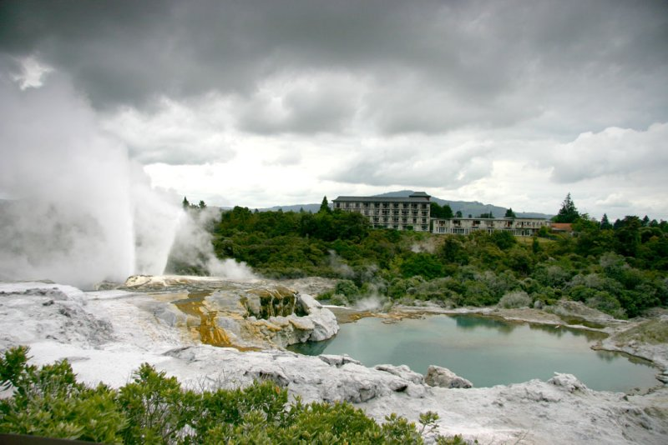

Slide 49
Supervisors
Supervisors’ comments (from parallel research) on recognising students’ work that evidences that they have:
  acquired and owned various threshold concepts, and
  crossed conceptual thresholds
  In the following discussions, posts and interviews, supervisors identify their recognition of threshold crossing, and their thoughts about what ‘nudges’ students across.
  How can they identify the crossing moments and the qualities?
  How can they nudge?
  what are YOUR views?

Slide 50
Support provided by supervisors and community
Confidence building
Suggestions on literature search
Encourage students to experiment
Students involvement with research community (seminars, conferences, and group study)

Slide 51
Supervisors:
Increased confidence
Well, they’ve got an extra dose of confidence. They’ve got an extra dose of clarity. They’re more confident, they’re clearer, and they’re probably very inspired to go and do something else quickly, to take advantage of those changes. I think that’s right. (S8)

Slide 52
Writing
In terms of the reports they can give to you, you can see they’ve become more sophisticated in their thought process, they’re more sophisticated in their analysis of what they’re looking at and as to how they’re thinking (S9)

Slide 53
Improved writing
Well, there are times when students start bringing you written work that begins to look like it could go in the final thesis, whereas initially it doesn’t. In that sense, you know, there’s a point at which the first time you say to a student, “Look you’ve written something here which I could see could go in the final thesis,” that for them is a very significant moment, I think. In that sense their whole thinking has moved forward between that and the last piece of written work (S7)

Slide 54
Conference presentation
They could be things that happen externally, they could be somebody does a conference presentation and they realise that their work is comparable with other people presenting (S6)

Slide 55
Confidence building through challenging
I think it’s very important that, you know, the supervisors are able to challenge what the student is writing down and actually saying about the literature. Sometimes students are a bit frightened about critically appraising other people’s work. it’s not until they get to the end of their PhD, when they’ve transferred, and you say right, now it’s time to go back and have a look at this chapter, see what you think about these people’s writing now, and it comes back and it’s quite different. So I think there is something in there about building confidence and I think you can do that, you can try to do it early on.(S7)

Slide 56
When they are writing that’s when I work really hard with the students. They send me each chapter sometimes several chapters. It’s me that goes through the threshold.

Slide 57
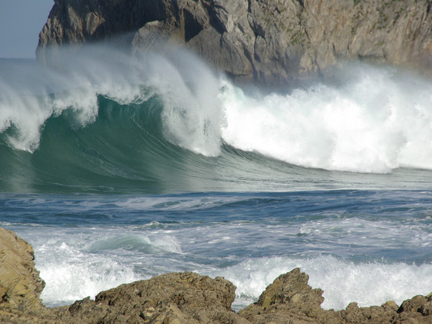

Slide 58
Overall what helps-…
Ensuring a boundaried (doable) and conceptual enough question
Early focus on conceptual framework, methodology and methods
Very close reading and focus on dialoguing with experts in the literature review/theoretical perspectives chapter
Oral prompting of conceptual, critical work individually in supervisions and in groups
Prompt feedback encouraging conceptual and critical work
Models, dialogues, pointing out contradictions and tensions and urging incorporation for critical conceptual engagement

Slide 59
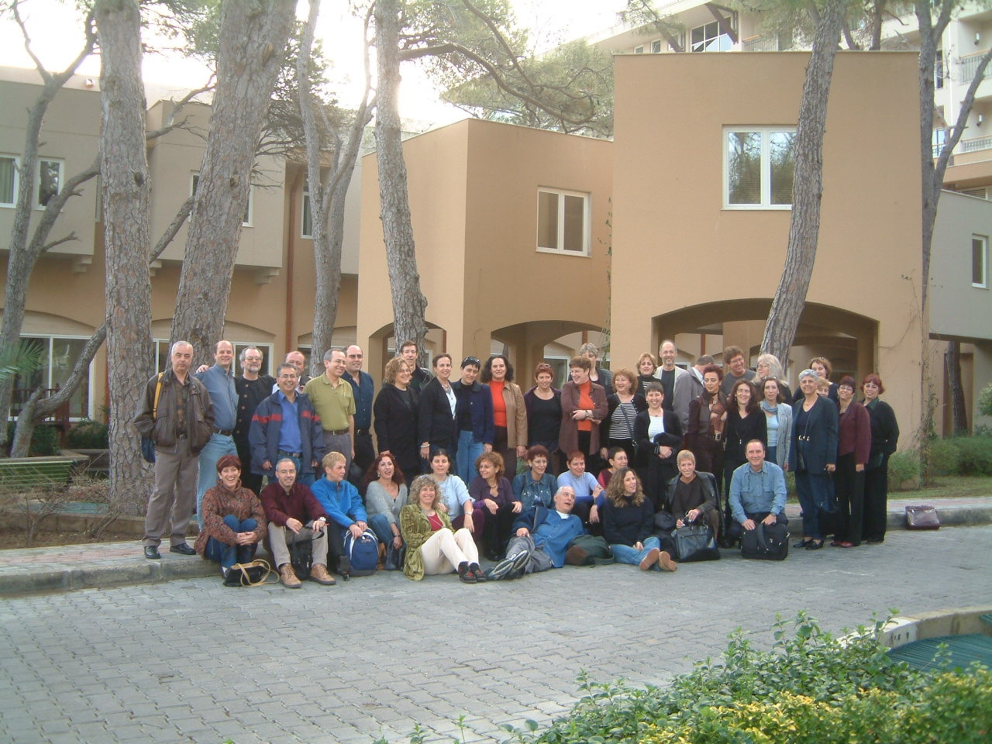
Notes:
What does conceptual threshold crossing at postgraduate level look like?
How is the conceptual level of work evidenced? What is the evidence of conceptual threshold crossing and the articulation and actioning of threshold concepts?
What do you do? What can we do? What can the institution do? To enable
conceptual
critical and
creative enough
Postgraduate research work and dissertation/thesis completion, and the development of competent, enlightened researchers?

Slide 60
Kiley, M., & Mullins, G. (2006). Opening the black box: How examiners assess your thesis. In C. Denholm & T. Evans (Eds.), Doctorates downunder: Keys to successful doctoral study in Australia and New Zealand (pp. 200-207). Melbourne: ACER.examiners approach the assessment of research theses. International Journal of
Kiley, M., & Wisker, G. (2008, June 2008). “Now you see it, now you don’t”: Identifying and supporting the achievement of doctoral work which embraces threshold concepts and crosses conceptual thresholds. Paper presented at the Threshold concepts: From theory to practice, Queen's University, Kingston Ontario Canada.
Kiley, M., & Wisker, G. (2010). Threshold concepts in research education and evidence of threshold crossing. Higher Education Research and Development.
Mullins, G., & Kiley, M. (2002). 'It's a PhD, not a Nobel Prize': How experienced examiners assess research theses. Studies in Higher Education, 27(4), 369-386
Wisker,G, Morris,C, Warnes, M, ,Lilly,J (2009 ) ‘Doctoral learning journeys’ in Assessment Learning and Teaching journal, Leeds Metropolitan university.
Wisker, G. (2005, 2012 ). The good supervisor: Supervising postgraduate and undergraduate research for doctoral theses and dissertations. Basingstoke: Palgrave Macmillan
Wisker, G., Robinson, G., & Kiley, M. (2008). Crossing liminal spaces: Encouraging postgraduate students to cross conceptual thresholds and achieve threshold concepts in their research. In M. Kiley & G. Mullins (Eds.), Quality in postgraduate research: Research education in the new global environment - Part 2: Conference Proceedings. Canberra: CEDAM, ANU.
Wisker, G., Robinson, G., Trafford, V., Lilly, J., & Warnes, M. (2004). Achieving a Doctorate: Meta-learning and Research Development Programmes Supporting Success for International Distance students. Paper presented at the Quality in Postgraduate Research: Re-imaging research education, Adelaide, Australia.

