Slide 1
What are examiners looking for? Supervisors and students learning from doctoral examining
Postgraduate supervision conference
Stellenbosch 2011
Gina Wisker
University of Brighton
Based on work with Margaret Kiley,
And Rachel Masika

Slide 2
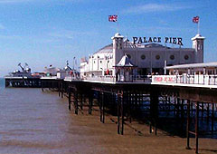
Brighton Palace Pier

Slide 3
How can supervisors advise students about what to expect in their doctoral examination and viva? What do examiners say they are looking for in successful PhD theses which make a contribution to knowledge? How do examiners go about their reading and examining a thesis? Do examiners cross conceptual thresholds when examining theses? Moments and stages where they recognise a thesis which evidences a sound contribution to knowledge, originality, coherence, and publishability?

Slide 4
Questions we addressed
How do examiners recognise and comment on doctoral level achievement?
How do they discuss theses considered marginal?
Characteristics of marginal theses
Characteristics of doctoral level achievement and conceptual threshold crossing

Slide 5
‘It’s not illuminating, I want to see lights come on in what the person is saying and what they’ve achieved, if it’s flat....... If it’s pedestrian and flat you know they can tick the boxes, they have done this, they have done this, and they have done that, then that’s the straightforward thesis work but something that’s moving on from that, the exception is where I see illuminated thinking coming through in the sections.’(Examiner interview)

Slide 6
Examiners of doctoral theses effectively have no formal training for this role, instead they learn by doing. It could be useful for new examiners to reflect on the learning gained from the role to feed not only into their supervisor practice but their activities as examiners.

Slide 7
This session builds on new research findings from the UK Higher education funded ‘doctoral learning journeys’ project and a parallel project (Wisker et al,2010; Wisker and Kiley 2010), both of which are informed by the work of Margaret Kiley and Gerry Mullins (2002) Vernon Trafford and Shosh Leshem (2008), on the PhD examining process.
It also builds on a paper delivered by Margaret Kiley and Gina Wisker at QPR 2010

Slide 8
Our new research explored whether it was possible to identify from thesis examiners comments how they recognised and commented on doctoral level achievement. We also sought to identify how the examiners discussed theses that were considered marginal.

Slide 9
Examiners report on examining processes and specific examples of stages in the thesis and viva when students are clearly evidencing work of doctoral quality, have ownership of their project, are articulate and confident about its achievements and discuss its workings and effectiveness in a collegial manner. Examiners talk about going through ‘conceptual thresholds’ (Kiley, Wisker 2009, 2010) in their recognition of the quality of the work.
From the analysis we argue that a marginal doctoral thesis will be characterised by 'patchy' work

Slide 10
That indicates that the researcher/ writer is still in a developmental process. In contrast, a candidate who presents work that is
  conceptually coherent and
  intellectually rigorous
indicates they have crossed various conceptual thresholds in their learning.
They show in their work, written and in the viva, that they have undergone an ontological shift that has changed them as a researcher, and an epistemological shift evident in the articulated quality of their work and their contribution to knowledge.

Slide 11
What the reports say (Mullins & Kiley, 2002)
A ‘good’ thesis has… Critical analysis & argument Confidence & a rigorous, self-critical approach A contribution to knowledge Originality, creativity & a degree of risk taking Comprehensiveness & scholarly approach Sound presentation & structure Sound methodology. | A ‘less than ideal’ thesis has… Too much detail with lack of analysis Lack of confidence, energy & engagement by the candidate Lack of argument and rigour Shoddy presentation (typos etc) Lack of critique of own analysis/ sweeping generalisations based on opinion rather than analysis Inadequate or poorly expressed methodology & scope.

Slide 12
A “good” thesis from the reports
Its strength lay in the depths to which the candidate was able to pursue numerous disciplinary insights and the capacity demonstrated to keep these various insights focussed on his complex topic. (Sci 12)
It shows an extensive knowledge of relevant literature, a comfort with conceptual development, an ease with qualitative research techniques, a talent for the analysis of data, and a facility for writing up results. (Soc Sci 55)

Slide 13
A ‘less than ideal’ thesis
What he provides instead is a comprehensive historical/political description of...It is certainly a well-written account but it is also quite superficial. (Soc Sci 71)
The thesis requires a critical analysis of the method chosen (Soc Sci 85)
It is clumsy and repetitious, and too much emphasis is given to trivial matters…and too little to the actual implications of the results (Sci 104)

Slide 14
What do interviewees say about a ‘good’ thesis
Sound design, methodology in action
Good qualities and cohesion throughout plus that extra ‘newness’ and ‘flourish’ which goes beyond the thesis
Engagement with the literature in dialogue
Real sense of mastery and adding something new
‘The magic ingredient’

Slide 15
I’m looking for somebody who really, really knows this subject so well that they’re able to step beyond the subject and go somewhere new with it. That for me is, it demonstrates their confidence, that they thoroughly comprehend where their subject is situated, that the theoretical underpinnings of it, but also the margins of the theory that they’re using, because then when they get to the margins of the theory and they’re challenging the theoretical underpinnings they’re then ready to move into a new realm and taking the methods of enquiry into that new realm to produce something, as an extension of the knowledge that they already had. (1)

Slide 16
A marginal thesis
Too complex without order or focus ‘too many beads’
Too mechanistic

Slide 17
Marginal
If they’ve really significantly missed something (1)
It’s not illuminating, I want to see lights come on in what the person is saying and what they’ve achieved, if it’s flat, I’m using expressive language here, sorry. If it’s pedestrian and flat you know they can tick the boxes, they have done this, they have done this, and they have done that, then that’s the straightforward thesis work but something that’s moving on from that, the exception is where I see illuminated thinking coming through in the sections.(2)

Slide 18
Workaday – OK?
The odd PhD programmes in some of our best universities where the sciences you know, you come along you knock on the door and somebody says well the team’s down there, this is the actual metaphor that was used when I was first told this story, there’s a gang of people down there in the quarry we’ll give you a bucket and a pick and you can get down there and when your bucket’s full we’ll pull you up. (2)

Slide 19
What do they say about poor theses?
The lack of cohesion of conceptual/critical level seems to be a result of poor supervision
The student has been drawn into a research group and just carried out the workaday work
It is competent enough but lacks the magic ingredient
The cohesion and spark only emerge during the viva (and so what happens in systems without one?)

Slide 20
Poor work and poorer supervision
To be brutally honest his internal supervisors were not that hot, in terms of their knowledge of the subject area, kind of dumped on... one way or another he got dumped on them, they got dumped on him,(5)

Slide 21
Too busy and unstructured
About four things wrong with it which are relevant to this discussion. One was that the hypotheses weren’t followed through, two was it wasn’t particularly up to date, with some quite old references, some key references and some key ideas hadn’t been explored, and the final thing, where you think at the end of the thing, things will come together into a nice coherent whole and in particular he was offering a model, which was a diagram, and the links between the components of what you call the model were lined in the diagram but were not explained, so it was a kind of conglomerate, (5)
Because he had about six hypotheses, some of which he dabbled with (5)

Slide 22
Role of the viva
To confirm the quality and enable a collegial dialogue
Explore the decisions made
Question certain errors and complexities Sometimes this enables students to make a more coherent form and argument – in person, in context – move through the conceptual threshold on the viva e.g.

Slide 23
R (7): In the viva we were able to ask questions in such a way that he indicated that he had made some of the connections and so we said okay.
INT: So the viva added a conceptual level to the paperwork?
R: Yes. And that’s how I see it, I know there’s a whole range of different approaches but I think the viva is so important in that to establish a relationship .. with the student or candidate however we refer to them and to ask the kind of questions no-one will ever ask them again, to you know honour their work and take it seriously and ask pressing questions.
Those where there’s a leaning forward and they’re enjoying the conversation because you’re taking it seriously, and they often think that you’re there to catch them out.
My own viva I learned something in the viva, I understood something from the question they asked me and I thought ‘Ah oh I see yes’.
INT: You went through a conceptual threshold in the viva.

Slide 24
Some examiners report that they transfer learning from the examination process to their own supervision practices (Wisker and Kiley, 2011)

Slide 25
As Halse and Malfroy (2010, p. 89) express it: ‘doctoral supervision is a specific, specialized type of professional work’. Their research discovered that supervisors have seen a distinct shift in the ways in which they now conceptualise and practise doctoral supervision. This shift is towards increased professionalisation, the distance of personal relationships, and intervention in students’ work to ensure quality. Supervisors are often isolated in their work,

Slide 26
We interviewed 7 very experienced examiners.
The simple thing you learn is the rules of the game—they help you to prepare [your own] students (Soc Sci Male A: Later study)

Slide 27
lessons learned and passed on
a clearer understanding of how a candidate can effectively ‘defend their thesis’ either in the text of the oral examination.
knowing their own stance and also being aware of different opinions, opinions that might be held by one or more examiner.
writing and the written text as a coherent document in argument and style as well being presented in a scholarly fashion.
‘rules’ around the doctorate, including format and approach.
an understanding of quality and standards, both in terms of Masters and PhD differences,
an appreciation of the significance of having up to date literature and analysis rather than description
how different examiners approach the assessment process.

Slide 28
Examining a doctoral thesis provides a valuable opportunity for professional learning for supervisors who learn firsthand of the examining processes and of the expected qualities of a thesis. Examiners in our study indicated how they took that learning directly back into their own supervisory practice. Demystifying the processes and practices of doctoral thesis examiners is a valuable outcome from research into the ways in which examiners approach, read and process doctoral theses, and the generic and discipline related quality indicators they seek in the passable thesis and the thesis of merit (Mullins and Kiley, 2002; Holbrook et al, )

Slide 29
How can we learn from this information about examiners’ processes and practices to inform our work as supervisors and students?

Slide 30
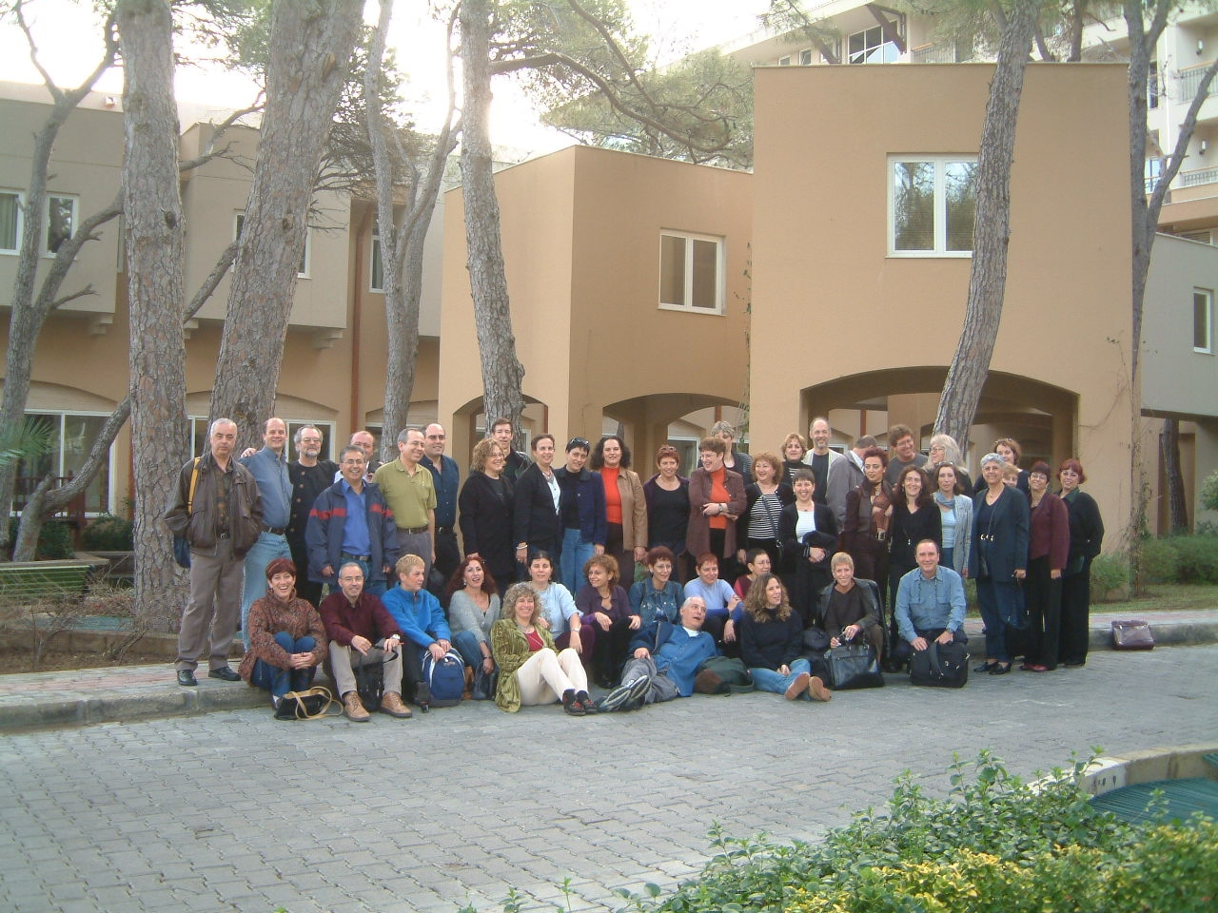

Slide 31
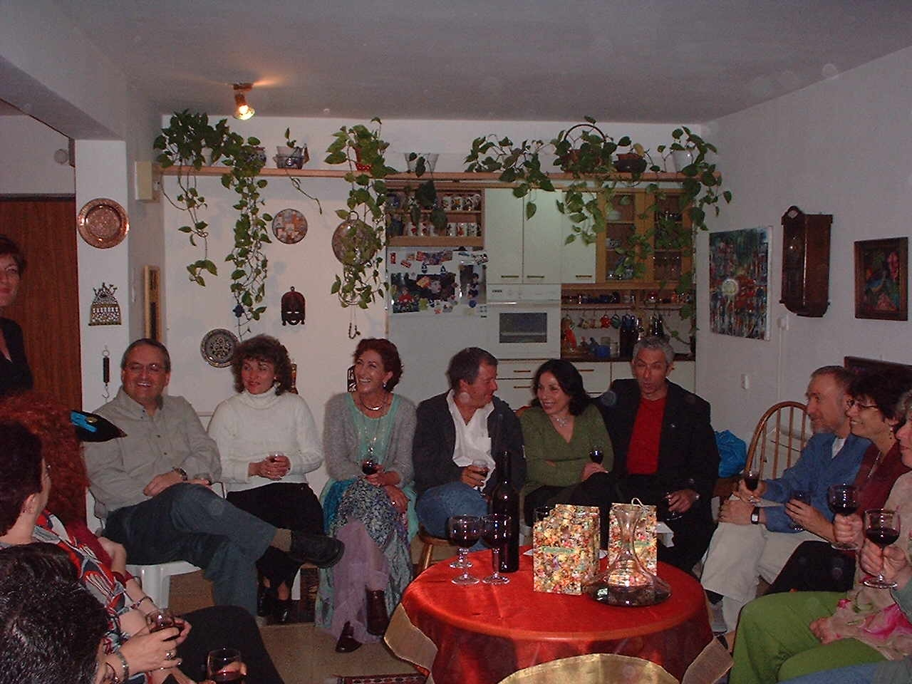

Slide 32
References
Kiley, M. & Mullins, G. P. & University of Canberra (2002) Quality in Postgraduate Research Conference, & The Centre for the Enhancement of Learning, Teaching and Scholarship. Quality in postgraduate research [electronic resource] : integrating perspectives / edited by Margaret Kiley and Gerry Mullins
Kiley, M. and Wisker, G. (2010), Learning To Be a Researcher: The Concepts and Crossings, in Threshold Concepts and Transformational Learning, Land, R., Meyer, J.H.F. and Baillie, C., (eds), Sense Publishers, Rotterdam, pp. 399−414
Trafford, V. & Leshem, S. (2008) Stepping Stones to Achieving your Doctorate: By focusing on your viva from the start, Open University Press: Maidenhead.
Wisker, G. & Kiley, M. (2009). 'Threshold Concepts in Research Education and Evidence of Threshold Crossing'. In Higher Education Research and Development.
Wisker.G (2005,2011 forthcoming) The Good Supervisor Palgrave Macmillan
Wisker, G., Kiley, M (2011 under consideration) Professional learning: lessons for supervision from doctoral examining. IJAD

Slide 33
Gina Wisker
G.Wisker@brighton.ac.uk

