Slide 1
Developing a writing career
Gina Wisker
University of Brighton UK
HELTASA conference 2015

Slide 3
Brighton Pier

Slide 4
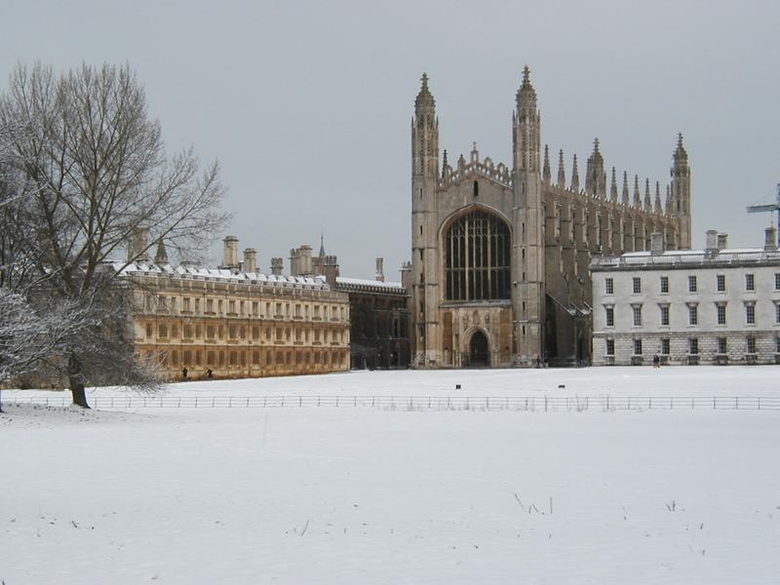
King's College Chapel
 | C

Slide 5
Burned book- Gillian Robinson

Slide 6
Why you want to write and publish
Importance of writing, publishing, freedom to speak, reading
Writing careers
Identity and writing
Time and other constraints
Joys
Forward planning

Slide 7
Why do you want to write? and publish? Please discuss
Part of your role?
Expectations?
A personal need?
Duty?

Slide 8
HELTASA colleagues said---
Travelling
Personal and professional development
Career scholarly promotion teaching to write
Job
Improve your own practice
Keeps you up to date latest as you read
Interaction and reflection
passion
Recognition
Supplementing income
Contributing your knowledge

Slide 9
Others said
Professional need to know about the info
Get your name out
Corporate marketing
Validation of research
Completion of the PhD
Want to and it is interesting
The academic discipline of pulling your work into an academic format
Process of review-
When doing a PhD it validates the work
Part of your role
Getting feedback
Influencing policy debates and society
Managing the academic voice
Strategically
Adding to specific debates
Valuing self and experience
Share my research
Inform policy
Pub at an academic level
Progress career and publish
Enjoy it - especially collaborative
Benefitting from editing- can I do it on my own?
Grappling with academic language

Slide 10
Some more responses strategic and positive-
Shifting kinds of writing to academic writing
Documenting innovative work properly
I want it to be interesting as a story – good enough to eat-
Now is the time to pounce build on confidence and voice I’ve developed
Academic writing style – getting to the point clearly-
Finding the right journal –niche – to take my work –
Doing some solo authored
The act of writing- discipline-grappling Learning from others
But not losing your voice

Slide 11
In academic terms/ in our roles as academics- teachers, researchers, facilitators of learning, managers etc etc writing is:
a method of communicating what you want to inform others about – knowledge, skills, values/attitudes/beliefs
It can accompany other forms of communication

Slide 12
Books (clips from film of ‘The Book Thief ‘ Marcus Zusak)

Slide 13
And reading- are empowering

Slide 14
‘I’ve done my 4 pieces for the REF so I don’t have to write any more.’(colleague)
‘Writing is like life, you could go under’ (Toni Morrison)

Slide 15
credentials
Publishing actually provides some! Here’s some of mine (what might these suggest regarding-decisions made, range, usefulness, formats)
Journal Innovations in Educational &Teaching International co edit
Spokes poetry etc e-magazine co edit
Dissections horror e-journal
Special editions of Femspec, Diagesis
On board of Femspec (US), Diagesis(UK), Educational Research journal
Review for Studies in Higher Education, HERD, Studies in Continuing Education,Compare, Femspec, Diagesis,Tulsa review,……Palgrave Macmillan books
Some books: The Postgraduate Research Handbook(2001, 2008),The Good Supervisor(2005, 2012 ),Postcolonial and African American Women’s Writing(2000),Horror Fiction (2005)Key Concepts in Postcolonial writing(2006)
Getting Published (2015),The Undergraduate research handbook (2009)

Slide 16
Planning the career
It might not seem like a career that is planned –
Qualifications
Presentations
Internal documents and lecture notes
Developing themes and concerns you are known for
Being a critical friend to others
Reviewing and refereeing
Editing
Journal articles
Chapters in edited collections
Editing a collection
Writing a monograph
Also – blogs, trade papers
Managing where it is published
seeking opportunities
Supporting and enabling others /so they support and enable you
not just writing anything
Developing your voice and varying it for the context and aim

Slide 17
What writing milestones have you had?
undergraduate and postgraduate courses
Internal papers
Internal publications
External publications
A series of publications
Supporting the writing of others- editing, peer reviewing, critical friend, mentoring

Slide 18
Statements about journeys and processes
I have always written – since I was 7
‘I write like a dream’
I find writing a struggle
I’m always wrestling with the words, and with the shape
I feel have something important to say
I feel I have something to say which might be of use to others
I love writing
I hate writing

Slide 19
Headmistress commended my story language (‘overturned’)
I got a letter published in a children’s magazine
I helped out with a journal and got an essay published about women’s writing
I got my PhD (6 ½ yrs)
I stopped hiding my creative writing and got some of it rejected and some of it published
I’ve paid for other younger scholars to get their work published
I edit and review and publish other people’s work
I ran creative writing courses/I run academic writing courses
I have had insulting reviews of book outlines, horribly critical responses to whole books or essays,
A writer friend called me a writer
I read some of my poems published in a magazine I admire
I published a book called ‘getting published’
I like supporting other people’s writing

Slide 20
Please discuss
How have you developed a writing identity and career so far?
What have been the stepping stones in your writing career?
What have the stages been ?
What have the highlights of your writing career been so far?
Tell your story

Slide 21
How will you continue to develop a writing career?
And a writing identity?
What do you really want out of your writing career for right now
For the future?

Slide 22
Writing and you – Tangled up: Mixing personal and professional identities in academic writing for publication

Slide 23
Question:
For you are there any relationships between personal and professional identity and experience in terms of writing for academic publication?
tensions,
mutual enrichments
challenges
balances

Slide 24
Some research into writing and academic identities- 2014-5

Slide 25
The focus on tensions and synergies between personal and professional academic identities in writing for academic publication emerged from re-scrutinising earlier work, then from recent research. All research reported here is based on qualitative data gathered during face to face and email interviews from the re-scrutinised projects and the new research.

Slide 26
One participant notes that publication can have positive spin-offs.
‘I have seen academic staff ‘grow’ as they proudly announce a first publication during a staff meeting. Often the first publication serves as a catalyst to further work – I know I can! Similarly with doctoral candidates ...Their identity shifts to one of ‘now I am a researcher’. There is no doubt in my mind that publication is central to being an academic.’(S)
Stories participants tell in the academic writing context can be understood using a lens informed by academic identities theories, since being in the world , personal and professional identities intersect in writing – a managed form of expression of the research and theory-based reflection on experience, on enquiry, topical, established and new contested issues, in the academic context.

Slide 27
Emerging themes
Importance of writing to academic identity
Tensions in relation to time and identity - writing role, research role, teaching role, management etc. role
Immense involvement of personal time in the writing identity process somewhat at odds with managerialist workload planning models
Lack of support for writing processes
Invisible nature of writing
Noticeable vs absent recognition for writing success
Kinds of writing relating to each other
Balancing of different writing practices and selves
Evidence and excitement in development resulting from articulacy in writing
The writing identity as crucial, intrinsically rewarding and affirmatory

Slide 28
Issues –from research and workshops
My previous work (2009, 2013) suggests challenges , richnesses, conflicts, tensions and balances in relation to the personal and professional in terms of writing for academic publication and academic identities.

Slide 29
Colleagues have noted -
university management expectations and pressures ,
lack of real time /under costing of time causing tensions- it takes a lot of personal time, this is unrecognised;
writing bound up with sense of self, creativity, self worth, personal history and life -so not so easy to offer it for scrutiny, public view, and evaluation in league tables etc. related to high impact journals and internal university ratings,
heightening self worth/undermining self worth in relation to publishing your writing
writing is your identity....

Slide 30
Time
Although academic writing and publication are now expected parts of our roles
There is often no time/ not enough time allotted (un-representative of the time needed)
There is little recognition of the ways in which our academic writing identity aligns with our overall sense of self-worth and identity in a way other roles do not

Slide 31
Exciting writing (what is that for you?)
There is a feeling of excitement if the writing’s good because, and I want it, people to read it, I think this will be something that people want to read so...and feeling particularly that you have been creative perhaps, so there is a difference between you know, if you have to write a formal report that is just a compliance with something, it might be OK but dull – (K)

Slide 32
development of a writer’s voice(s).
I’ve realised it’s about my voice and I know that sounds so, you know... of course it’s about my voice but I think I’ve relied more on having to speak through the literature and present my writing in a way that was academic enough and actually my most enjoyable time of writing is now just going with my thinking and my thoughts – (J)

Slide 33
Issues
Importance of recognising varying kinds of academic writing as engaging the personal and professional
Issues of time – academic writing is rarely offered enough time – time managers in institutions are often not writers, if it is your named role that can enable a sense of freedom to write and time to prioritise it, different stages in the academic professional journey enable that or not.
Recognition and reward rarely match the time and energy put in but sense of achievement, grappling with it and articulating ideas, arguments and work, lasting importance of getting into print (or online) compensates or is more important for some
Writing several different kinds of writing –professional academic, reflective , creative can help balance , release, support -of the writing and of identity
Importance of an intrinsic as well as extrinsic motivation
Development of an academic writerly identity in harmony with, different from, similar to, their other more private identities (whether this included writing or not)
Planning and managing a writing’career’

Slide 34
Create an identity and reputation
Speciality
Remember the writing you’ve been doing pull out the skills
Hone
And specialities what are your specialisms?
Community, sustainability, – readers other writers, supporters
Make your choices

Slide 35
What kind of themes and forms and outputs do you want to develop?
and be known for?

Slide 36
Planning
Milestones
Identifying that professional and researcher identity in advance and work to support it with appropriate publications

Slide 37
Pick the right things to write about
Don’t leave good conference work unpublished
Finish things off
Position where you send the range of your work
Develop a (shifting) masterplan internalise your sense of achievement
Gain/join/create a group who are interested in each others writing achievements

Slide 38
Market your work
Research gate
Academia
blogs
NRF/REF

Slide 39
Developing writing communities
Use existing support mechanisms and structures (centres, mentors)
Develop a (mutual) support team
Peer critical review and support
Identifying definitions of good writing and working towards them
Establishing consistent writing habits which work for you
Creating
Seizing
Sharing opportunities
Mentoring others
Peer reviewing and editing
leading

Slide 40
To do
Get strategic/selfish say no to tings which take you away from the important writing and focus on own writing
Get taken seriously and start writing and publishing
Find others with similar interests
Formalise and lead or start a writing community-shar work and act as critical friends
Ask people to suggest the best article they’ve ever read and see how it is constructed, written, argued
No ‘graveyard articles ‘- get them out but some stuff will just be seed corn for future work…
‘nothing you write is ever wasted…’ clive bloom editor/publisher
Bounce the work off supportive creative people

Slide 41
What are You going to do with your writing career NOW
How can you continue to write and develop specialisms
diversity
And how can you improve?
Will that mean more focused writing
Better writing
More specialised writing
better outlets
More?

Slide 43
Some websites and addresses
Oasis-for-learning.net
Doctoralwritingsig
The thesis whisperer
Patter pat thomson
G.wisker@brighton.ac.uk

Slide 44
Some pubs incl mine
Aitchison, C. (2009) ‘Writing Groups for Doctoral Education’, Studies in Higher Education, 34 (8), 905–16.
Murray, R. (2005) Writing for Academic Journals (Maidenhead: Open University Press), pp. 5, 31–2, 171.
Sword, Helen 2013 Stylish academic writingWisker,
Wisker, G (2015) Getting Published London: Palgrave Macmillan
Wisker G (2014) ‘Managing the writing energy ‘ doctoral writing blog http://doctoralwriting.wordpress.com/author/doc
Wisker, G (2014) ‘Voice, vision and articulation: conceptual threshold crossing in academic writing ‘ in ed Catherine o’Mahony, Avril Buchanan, Mary
o’Rourke, and Bettie Higgs Threshold concepts:from personal practice to communities of practice: proceedings of the national academy’s sixth biennial conference and the fourth threshold concepts conference NAIRTL epub ,
Wisker, G (2013) ,Articulate – writing, editing and publishing our work in learning, teaching and educational development ‘ in Innnovations in Education and Teaching International Vol 50: 4

