Slide 1
‘Why do undergraduates need to develop as researchers and co-constructors of knowledge?
And how do we enable them to do so?’
Gina Wisker
University of Brighton

Slide 2
‘Research and Writing Skills for Dissertations and Projects: An Introduction’
Some thoughts underpinning our programme

Slide 3
Developing students as researchers
‘Involving students in inquiry-in research-is a way of improving their learning, motivating them more.’(Brew, in Jenkins et al 2003)
Identifying ways in which we work with our students to create, help seize and support learning opportunities to develop a range of generic and subject specific research orientations and skills.
Developing and providing the activities, materials, resources underpinned by expectations, recognition and reward.

Slide 4
Linking research and teaching
Information transfer / teacher focused approach
Conceptual change / student focused approach
Prosser and Trigwell (1999)
Notes:
4

Slide 5
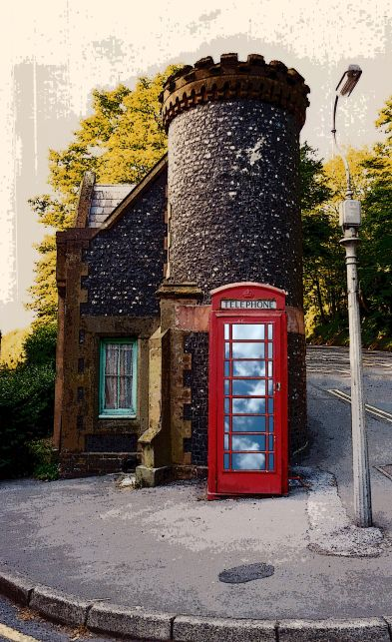

Slide 6
Ways of perceiving ‘reality’, identity and knowledge (ontology and epistemology)are challenged & changed (Barnett 2006)
Like the Tardis in Dr Who, engagement in research offers more than it seems to –it fundamentally questions established ways of perceiving reality, treatment of ‘knowledge’(seen as an ongoing construction to which students contribute).

Slide 7
STUDENTS ARE PARTICIPANTS
Research-tutored
Research-based
Engaging in research discussions
Undertaking research and inquiry
EMPHASIS ON RESEARCH PROCESSES AND PROBLEMS
EMPHASIS ON RESEARCH CONTENT
Learning about current research in the discipline
Developing research and inquiry skills and techniques
Research-led
Research-oriented
STUDENTS FREQUENTLY ARE AN AUDIENCE
Curriculum design and the research-teaching nexus
(based on Healey, 2005, 70)
Notes:
7

Slide 8
STUDENT-LED
Pursuing
(information-active)
Authoring
(discovery-active)
EXPLORING AND ACQUIRING EXISTING KNOWLEDGE
PARTICIPATING IN BUILDING KNOWLEDGE
Identifying
(information-responsive)
Producing
(discovery-responsive)
STAFF-LED
Inquiry-based learning: a conceptual framework
(Based on Levy, 2009)

Slide 9
Developing students’ research learning
A research active curriculum
Teaching learning and assessment which encourage research based practices, understandings and creations
Resources used interactively

Slide 10
A ‘research active curriculum’ (after Healey and Jenkins)
All undergraduate students in all higher education institutions should experience learning through, and about, research and inquiry.
Through a research-active curriculum. structured interventions at course team, departmental, institutional and national levels.
Embedding of research oriented learning and teaching activities, and assessments.
Through focused support – developmental opportunities, models and materials accessible to staff and to students when wanted and needed.

Slide 11
Research as learning-stages and elements
Problem identification
Autonomy and group work
Problem solving
Information identification
Information acquisition and management
Project design and management
Ideas—action—completer finisher skills
Writing and presenting
Sharing, and acting on the work.

Slide 12
Involves
Curriculum development to embed research/enquiry and critical thinking from the start- opportunities and support in teaching learning and assessment -
Thinking skills -creative problematising & problem solving, ideas generation,
Information identification, finding, gathering, processing, managing, using, making, sharing.

Slide 13
Reflective awareness of and building on generic and subject specific research skills
Developing communication in a variety of forms including presentations, essays, projects, dissertations,
Opportunities for evidencing growth, reflective learning, and independent learning, carrying students forward beyond degree study –employability, further study, life.

Slide 14
Time, space, constraints, values constructions of versions of knowledge the world and self all problematised
Skills and learning behaviour development lead to
  new firmly based confidence
  contributions to knowledge , ownership of that knowledge and the processes,
  communication of that knowledge and those processes

Slide 15
Why develop students as researchers? and co-researchers?
What are the skills and outcomes ?
What the benefits?
What is the transferability and sustainability
Of research and enquiry skills ?
Do you help develop your students as researchers?
and if so where? How?

Slide 16
Research learning -
Attitudes – Enquiring, creating , sharing.
Understandings- Critical thinking, problematising given arguments, interpretations.
Threshold concepts (Meyer Land Cousins 2003)- different disciplines see the world and construct knowledge differently-understanding and mobilising that understanding is a key to research learning.
Skills - focusing on issues and problems, questioning , knowing where to look, how to look, how to find, and what to do with what you find, selecting and focusing, theorising, conceptualising, interpreting, managing, seeing the patterns and themes, finding and making something new.
Communicating -being able to organise and communicate it to others.

Slide 17
Characteristics of critical thinking
Problem identification
Problem solving
Flexibility
Using research reading and evidence base to identify difficulties and address problems
Group working
Autonomy and independence
Sustainability of skills
Analysis
Reflection
Decision making
Deductive and inductive
Accepting others views/arguments
Knowledge creating
Accountability
Organisation
Selectivity of knowledge
creativity

Slide 18
Strategies for building the relationship between teaching and research
“Emphasize the construction of knowledge by students rather than the imparting of knowledge by instructors….
Ensure that students experience the process of artistic and scientific productivity.”
(Hattie and Marsh, 1996: 533).

Slide 19
Strategies for Linking Teaching and Research
Develop student understanding of the role of research in their discipline
Develop students’ abilities to carry out research in their discipline
Manage student experience of staff research. (Jenkins, 2001)

Slide 20
How do we encourage students to become researchers?
Research oriented activities early in studies-
  seeking information,
  asking questions,
  creating new knowledge,
  underpinning work with theories and reading
  building claims on evidence
Devising own questions &proposals
Annotated bibliographies
Critical evaluation of models of research eg in essays , reports

Slide 21
Active membership in a community of scholars
Encourage students to feel part of the wider community of scholars - and not passive recipients of ‘knowledge’.
Encourage and assist students to develop, present and publish their work.
Present the resulting papers to current and prospective students as evidence of the active contributions that can potentially be made to the field.

Slide 22
A synergistic system:
Students as active participants, not passive recipients
Inquiry, investigation, and discovery are the heart of the enterprise, whether in funded research projects or in undergraduate classrooms …
The teaching responsibility of the university is to make all its students participants in this shared mission. (Boyd Commission, 2000)

Slide 23
Learning and teaching practices to underpin students developing as researchers
Interactive lectures- short interactions – and tasks- handouts- break up the lecture
Online learning with variety of materials, interactions reflections resources
Group tasks and interactions in large and small groups- encourage discussion engagement critical thinking, debates – argument using evidence
Students as researcher assessment formats including projects and dissertations – encourage problem identification, shared practices, problem solving, finding out and making knowledge-in the real world context. Encourage management of enquiry, structure, data, argument, expression

