Slide 1
'Risk and Agency: Nurturing and valuing scholarship and research in learning, teaching and educational development .‘
Gina Wisker
University of Brighton
SEDA keynote
Cardiff 20 November 2015

Slide 2


Slide 3

Things aren’t what they seem to be

Slide 4
Way through
Context and research and scholarship in learning teaching and educational development practice
TEF
SoTL report – National project research based exec summary
Excellence locally –research based
Examples using our community to share good research and experience based practice (SEDA and HEDG on the TEF)
Examples in practice communities, prof practice courses etc

Slide 5

Threats ?

Slide 6
TEF
The TEF promises to put teaching excellence into a comparable place as research excellence- in the guise of enhancing teaching quality it substitutes flawed research methodology and methods results seen as measures and calculated as metrics decontextualised to differentiate between universities and to raise fees.

Slide 7
Help and insights from our community
Corony Edwards sums up the TEF aims, structure , future - the metrics (level 2 and above)
  Destination of Leavers from Higher Education Surveys (outcomes);
  Retention/continuation data from the UK Performance Indicators published by Higher Education Statistics Agency (HESA);
  National Student Survey teaching quality and learning environment questions.

Slide 8
Not to forget
Values (SEDA)
Structure –strategies, infrastructure
Culture –context ,interpreting differently
Agency- our own empowered roles and those of others (Margaret Archer’s framework)

Slide 9
Joanna Williams's article on TEF in THE: 'Unfortunately for the bureaucrats who drive so much of what happens in universities, learning is not a tangible commodity that can be weighed and measured. There is no way to determine in advance what students might gain from engaging with a topic; their academic ability, prior knowledge, interest and motivation cannot be regulated and quantified. How much students learn will be primarily as a result of their own efforts, and for this reason evaluating whether or not higher education represents “value for money” is a pretty meaningless task.'

Slide 10
Your thoughts on
What are we defining as teaching excellence ?
How do we identify excellence?(mechanisms eg teaching awards , SU awards, NTFS)
How do we encourage, empower, recognise and reward it? (Scholarship of teaching and learning, professional development suite of courses, opportunities etc, embedding in SDRs and promotions criteria?)
How do we engage with a more metrics oriented model for the TEF?
What challenges do we perceive in relation to measurement metrics, widening participation student engagement in learning, and
The rich variety of ways in which teaching and learning take place in the different disciplines?
TEF and REF balance? As HEIs how will we balance the expectations and cultures of teaching, research etc ?

Slide 11
A few questions for us
What issues and concerns, challenges and opportunities are uppermost for you in considering the TEF? And The Green paper’s/ Jo Johnson’s exploration of it ?
Your thoughts on - “teaching has been by far the weakest aspect of English higher education”. (David Willetts )

Slide 12
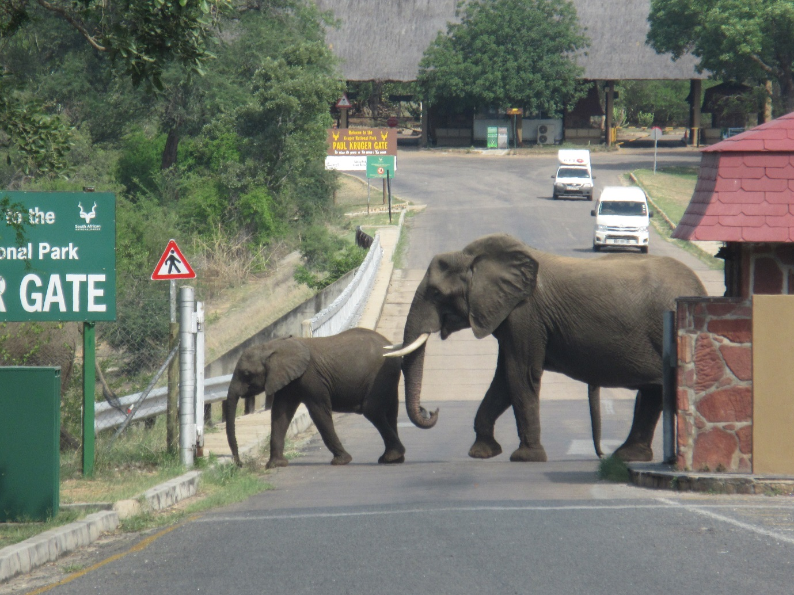
Values- Access, Development , Support

Slide 13

Being on the alert for opportunities

Slide 14

SOTL

Slide 15
SOTL report
From March to June 2015, a cross-university partnership conducted a qualitative study involving interviews with eight heads of academic development from universities from across the four nations: England, Wales, Scotland and Northern Ireland. The study formed part of the overall HEA funded Defining and Supporting the Scholarship of Teaching and Learning: A Sector-wide Study.
Interviews were analysed thematically. They were then drawn into case studies which form part of the findings in the exec report and sent to the HEA. We are not sure when the full report will be made available

Slide 16
Table 1: Characteristics of participants
Participant | Institution type and characteristics | Gender | Nation
Respondent 1 | Post 1992 university with approximately 21,000 students. Member of Million Plus mission group. | Female | England
Respondent 2 | Cathedral group university. Small in size institution with Catholic ethos. About half of its provision is teacher education and the other half is human sciences and liberal arts | Male | England
Respondent 3 | A pre 1992 university with approximately 30,000 students with overseas centres. Research-intensive Collegiate system. | Female | England
Respondent 4 | Million plus as well as a relatively small modern post 92 institution delivering a fairly focussed portfolio of vocational type education with a high number of our students as direct entrants from college, about 27 percent. | Male | Scotland
Respondent 5 | Post 92 and also university alliance so with approximately 27,000 students. Has a research and teaching remit, and is increasingly known for research. Has a long history of teaching excellence. | Female | England
Respondent 6 | Pre 1992 university with about 30,000 students | Male | Wales
Respondent 7 | Pre 92 university status 1960s, converted from technology college. Former member of the now-disbanded 1994 group of smaller research intensive universities. Approximately 16,000 students. | Male | England
Respondent 8 | A pre 1992 university with a student population of about 27,000 with a very high and widening access agenda but a strong culture and history of learning and teaching core to delivery. Our goals are shifting in line with many other universities across the UK, in line with us being even more student centred, engaging students as part of our process and also ensuring that staff have a clear focus on their professional practice and quality enhancement. | Female | Ireland

Slide 17
Interviews were transcribed and then analysed first inductively. This involved open coding in NVivo10 then axial coding in Word. The data was then categorised iteratively under key broad themes related to the questions which involved deductive analysis re-categorising subthemes within the key broad themes: definitional issues; positioning, institutionalisation and embedding; resources, advocacy and capacity building for supporting SoTL for professional development, recognition and reward; student engagement strategies and; evidence and impact. The broad themes provided a heuristic device for presenting the subthemes emerging from the data.

Slide 18
The main findings are:
Not all higher education providers (HEPs) have a clear shared understanding and meaning of the scholarship of learning and teaching (SoTL)
There is some agreement about the meanings and processes of SoTL amongst heads of education development
Institutional strategies, policies, processes and activities are important for enabling and embedding SoTL. Attention to the most appropriate institutional loci, processes and activities for the institutional context of the HEP is important for introducing and embedding SoTL as is creating different matrices of engagement
Staff engagement is still a challenge and it is important to involve a broad range of staff
Institutional cultural change and clear signposting of SoTL are needed
A transdisciplinary approach to SoTL has efficiency benefits but a discipline focus remains the preferred and most achievable route for embedding. SoTL buy-in tends to reflect individuals’ interests and discipline alignment

Slide 19
Professional development and recognition schemes and frameworks such as UKPSF aid SoTL reflection and provide a structure for embedding
Promotion criteria is key for the embedding of SoTL for professional development
There is increasing willingness to engage with SoTL activity but time constraints, dwindling financial resources and tensions between REF and SoTL research prominence are challenges
Student engagement in learning and teaching and SoTL is couched in terms of student partnership but more needs to be done
Co-curriculum development provides opportunities for student engagement in SoTL activity
A shift from a focus on outputs to SoTL impact is needed
There are challenges in ascertaining effectiveness and impact and evidencing improvements and change

Slide 20
Some quotations :
Perspectives on institutional definitions of SoTL
‘…we have a very specific definition of that…we define that as scholarly activity that ensures that teaching is of the highest quality based on current good practice, reflects sound knowledge and evidenced that in some external way…’ (Respondent 6)
Head of ed dev definitions
‘I think that is about seeing learning and teaching in higher education particularly as being evidence led and evidence based, being research led and research based. Its moving learning and teaching away from top tip and a view that its merely a series of techniques, so that its seeing learning and teaching as more than competencies in a b-tech model, and much more about thinking and reflecting on the ways in which students learn and we facilitate their leaning through an evidence base’. (Respondent 7)
‘

Slide 21
I think SoTL for me is linking of research and teaching it is a scholarly practice it is about evidence informed innovation and enhancement in one’s practice…SoTL is a spectrum so there’s everything from your reflective practice and taking more scholarly approach to your teaching straight through to, I’m applying for grants I wasn’t to have PhD students I want to have REFable publications’ (Respondent 4).
‘Applying a theoretical understanding to practice on two levels, that’s both in terms of researching our practice to understand it better and also thereby to improve our own practice by thinking about that scholarship, that’s probably what it means to me in my context here’. (Respondent 1)

Slide 22
The key recommendations are:
Develop clear definitions and descriptions of SoTL that can be integrated into policy and institutional strategies
Support the dissemination of SoTL research
Engender communities of practice and supportive networks
Resource SoTL practice to demonstrate its value and counter the need to generate income
Incentivise and encourage HEPs to allow more time for CPD in workload models
Support the development of tools and models to demonstrate impact.

Slide 23
‘…you do sit and listen at various away days and bits and piece of colleagues actively briefing each other not to get involved in the learning and teaching because ultimately they’re not going to have time to deliver their research outputs that are requested of them, that’s anecdotal. I am surprised to hear it raised so vocally in the culture…that’s the cultural whisperings’ (Respondent 1)
A lack of clear-signposting of the value of SoTL is implied:
‘I think that’s one of the difficulties, staff don’t often have clear signposting as to what is valued and what’s not…heads of school and deans would not necessarily see sotl as a priority if its not income generating or its not directly part of the core business’ (Respondent 8)

Slide 24
‘we have more people wanting to come on our course, I think the growth, the change in our culture people really want to come on it…The uptake of the programmes the development and support for the development of the programmes so for example…I think that is a measure of the change in the culture’ (Respondent 3)
In relation to the tensions between research and teaching a challenge identified by interviewees is that staff do not always have clear signposting of what is valued and should be prioritised. Nevertheless, overall SoTL is generally seen in a positive light helping drive quality and enhancements. .

Slide 25
Professional development and recognition schemes aid reflection on SoTL
For some HEPs, the professional development and recognition scheme has provided a very strong basis for reflecting on SoTL across their institutions, identifying good practice and exploring processes that need to be embedded to develop to levels where the quality of the evidence begins to make an impact across the sector. As one interviewee reported:
‘…I think the professional development and recognition scheme has been a very strong basis for us reflecting on our SoTL across the university, and identifying the good practice that’s there and processes that need to be embedded to really develop that to a level where the quality of the evidence begins to make an impact across the sector. The kind of activities and professional development and recognition scheme also working with our in house journal with colleagues there to begin to see where practice enhancements have informed the kind of critical reflection that allows a wider dialogue around the methods that are used to evaluate learning and practice I think that’s been very helpful and we need to develop that further to look at various, just to enhance pedagogic outputs across the institution.’ (Respondent 8)

Slide 26
Evidencing impact is also mentioned by another head of academic development:
So for us to evidence our processes I think is very important, increasingly we are benchmarking our processes not just in terms of the metrics but in terms of the quality enhancements and the impact’ (Respondent 8).

Slide 27
Internal research :
Developing the Teaching Excellence Framework
University of Brighton

Slide 28
Definitions and Conceptions of teaching excellence
No commonly agreed definition
Examples of definitions and conceptions distinguish between teaching excellence, the excellent teacher and excellent learning – in reality all part of teaching excellence

Slide 29
Definitions from literature
Table 1: Definitions and conceptions of teaching excellence have included:
Emerging from their literature review Gunn and Fisk (2013) provisionally define teaching excellence as overall, system-wide conceptions of excellence (with the systems relating to sector, institutions and disciplines. And that it is important to distinguish this from teacher excellence (conceptions of excellence related to individual philosophies and practices rewarded and recognised) and from excellent learning (levels of understanding and meaning-making from abstract, contextual and situational forms of knowledge).
Teaching excellence may be perceived as a balance in statements around teaching excellence between: content and process which foster maturity in disciplinary ways of thinking and doing; teaching process which foster maturity in disciplinary ways of thinking and doing as well developing attributes for future use; developing professional; providing and environment of ways of being, doing and acting linked to wider career opportunities and economic, financial, socio-cultural and ethical attitudes (Gunn and Fisk, 2013).

Slide 30
In an effort to make teaching excellence explicit and to subject it to public scrutiny, Skelton recently outlined four ‘ideal type’ understandings, calling these: traditional; performative; psychologized and critical (see Skelton, 2005: 21–37 cited by Skelton, 2007).
At Penn State, teaching excellence is viewed at: an academic process by which students are motivated to learn in ways that make a sustained, substantial, and positive influence on how they think, act, and feel; a process that elevates students to a level where they learn deeply and remarkably because of teacher attributes – subject matter and pedagogical expert, excellent communicator, student centred mentor, and systematic and continual assessor (Penn State, nd).

Slide 31
Response from internal research 2011 2015
‘Very inspiring, enthusiastic and extremely current in her subject area, and always responsive to students requests for support with their study. Her knowledge and facilitation skills have made a huge impact...’ (EFEL, 2011)
‘Always inspirational multi-media presentations, His inaugural lecture was fantastic and he is always involved in L&T conference with new ideas. Pushing forward pedagogic research and xxx research in tandem’ (EFEL, 2011)

Slide 32
‘imparts a thorough understanding of his modules and their significance in the bigger picture of xxx...his passion and enthusiasm are infectious; his subject knowledge both detailed and broad. On top of this he sparks original thinking, takes any contribution you make in class seriously and considers where your idea may have come from.’ (STEA, 2011)

Slide 33
‘The general teaching of my course in both my subject areas has been fantastic. The assignments have been challenging but very engaging and enjoyable and have related very well to the topic as a whole. Support has been there when needed with prompt responses to queries via email or arranging of tutorials.’ (NSS, 2015)
Two comments on same lecturer. ‘The lecturer is like a friend to all the students and at the same time provides us with an experiential learning, which is the most effective especially in Travel and tourism course. The lecturer is inspiring, motivating and definitely made the course interesting to study and gave an ability to continue the project after graduating uni’ and ‘Rarely have I ever had a lecturer who has as much passion about a topic in which they teach. I think that Dr xxx's module is one that has made the most impression on me in all my years at this university. I thank her and all the lectures that were involved in a special module’. (EFEL, 2015)
‘xxx has played a key role in my academic experience at university. He has helped me immensely with not only content related issues I have had regarding pieces of work, but also in structure and style of my written work. He always makes time for debate and discussion, and has raised my confidence in my work hugely. Lastly he is committed to reviewing and improving the modules that he has taught us. He is always interested on our thoughts and opinions of lecture we have had and module we have taken. It is of great encouragement and support to know that a busy lecturer still makes time to personally find out the feedback of students and I have seen first hand the changes he has made after hearing our feedback. He is a fantastic asset to school of sport and service management and not recognise his excellence would be an oversight’. (EFEL, 2015)

Slide 34
Teaching Excellence at the University of Brighton- some thoughts for consideration
An analysis of UOB student comments in 2011 suggested that teaching excellence was perceived as inspiring, accessible, imaginative and responsive. Students’ comments on an excellent teacher (CLT, 2012) reflected multiple attributes and behaviours
Excellent teachers combined different, multiple pedagogical roles and attributes to enable learning as appropriate for their respective course and field as well as proactivity in terms of ‘going the extra mile’.
Teaching excellence at the University of Brighton was(2011) and is (2015) depicted by students responding to the NSS and nominating excellent teachers (SU awards, Excellence in Facilitating and empowering Learning awards admin by CLT) as encompassing values, behaviours, reflective practice and continued professional development.
The literature discussing teaching excellence , and our students’ responses indicate that there is value in having flexible definitions and perceptions of teaching excellence and
in taking note of other evidence that provides a much richer and more exhaustive characterization of the impact teachers have on their students.

Slide 35
‘There has not been a single lecture or seminar of xxx's that has made me wish I'd stayed in bed; which says a lot coming from a first year student. No matter how heavy the night before I always drag myself to xxx to hear xxx as I know everything he says is worth listening to. xxx has inspired me to look into so many sides of xxx that I had not even considered before. The sheer amount of knowledge that seems to just evaporate from him has encouraged me to work so much harder and it is xxx's own enthusiasm and passion for the subject that has really inspired me to delve deep into the world of xxx. xxx is also very caring about his students (despite asking me my name every week!) and regularly asks us if we found the lecture okay and easy enough to follow when we go into complex matters. (STEA, 2011)

Slide 36
Some essential thoughts and conversations
What is the relationship between the TEF (teaching excellence framework), and teaching excellence?
definitions of teaching excellence-
excellence, in relation to competence
Identification of the values at the heart of excellent teaching underpinning excellent learning:
empowering, enabling, reward and recognition system;
based on? causality between qualifications and quality; based on student valuation and survey responses ; based on matrices of value for money throughput,employability,surveys…

Slide 37
Teaching Excellence at the University of Brighton
An analysis of UOB student comments in 2011 suggested that teaching excellence was perceived as inspiring, accessible, imaginative and responsive. Students’ comments on an excellent teacher (CLT, 2012) reflected multiple attributes and behaviours
Excellent teachers combined different, multiple pedagogical roles and attributes to enable learning as appropriate for their respective course and field as well as proactivity in terms of ‘going the extra mile’.

Slide 38
Teaching excellence at the University of Brighton was(2011) and is (2015) depicted by students responding to the NSS and nominating excellent teachers (SU awards, Excellence in Facilitating and empowering Learning awards admin by CLT) as encompassing values, behaviours, reflective practice and continued professional development.
The literature discussing teaching excellence , and our students’ responses indicate that there is
(i) value in having flexible definitions and perceptions of teaching excellence and
(ii) in taking note of other evidence that provides a much richer and more exhaustive characterization of the impact teachers have on their students

Slide 39
Communities : Building and nurturing scholarship and research across the academic role

Slide 40
Route through
Why research into teaching/using research to explore and enhance teaching ?
History –Boyer, Healey, and current context, SOTL project, your context
Research and teaching links and tensions
Threshold concepts as a way in
Strategies and internal support and facilitation modes
Exploring the challenges , successes and nurturing of professional developments – fellowships, projects communities of practice, UKPSF
Effecting enhancement and sustainable, positive change. Ways forward?

Slide 41

Preconceptions?

Slide 42

An uphill task?(but essential and rewarding )

Slide 43
The research and teaching nexus
Ernest Boyer (1990)Scholarship Reconsidered: “the most important obligation now confronting the nation’s colleges and universities is to break out of the tired old teaching versus research debate and define in more creative ways, what it means to be a scholar”

Slide 44

Why research ?
Research is the fundamental human learning activity -involving enquiry, problem solving, diversity, flexibility and decision making.
Lifelong learning, learning organisations
Research led teaching/learning facilitation - far superior to training - encourages, enables & empowers learning involving enquiry, problem solving, diversity, flexibility & decision making.
’Graduateness’ and employability skills are developed by encouraging enquiry and research in our students .

Slide 45

Context changes:
Research
A strong research base is vital for our future in a global knowledge economy .... strong in both fundamental, curiosity-driven research and research applied to the challenges facing businesses and public services. (UUK conference David Willets 2010)

Slide 46

Some thoughts about the links between research and teaching
Research in our discipline and interdisciplinary areas is informing and underpinning our teaching
  our own
  others’ (usually referred to as scholarship)
Research into learning and teaching
  our own
  others’(usually referred to as scholarship)
Encouraging and enabling students as researchers – the skills, and the discipline specific work creating knowledge

Slide 47
We are all researchers now . Teaching and research are becoming ever more intimately related . In a knowledge society all students certainly all graduates have to be researchers. Not only are they engaged in the production of knowledge; they must also be educated to cope with the risks and uncertainties generated by the advance of science.(Scott 2002, 13)

Slide 48
Crucial in universities for energy, motivation, creativity,
linking theory & practice for colleagues & students,
establishing informed habit & skills for continuing to ask questions, seek information & answers, in context, throughout life
Research capacity building to inform society

Slide 49
The nature of scholarly work
Angela Brew
Scholarship as a quality
Scholarship as an activity
Preparation
Creating new knowledge
Integrating & disseminating
Notes:
What is noticeable about these views of scholarship is that they all focus on scholarship as an activity or activities of some kind. However, there was another view of scholarship expressed and that is the idea of scholarship not as an activity, but rather as a quality of the way academic work is done. In the research there were two elements to this: one referred to the qualities of meticulousness and rigour associated with academic reporting. For example, making sure footnotes are accurate and that all statements can be substantiated.

Slide 50

  “It’s really the difference between amateurism and professionalism. That’s the only way I can describe it. Being scholarly is being professional. It’s treating your work professionally. Thinking about it as something that needs to be done well, that needs to stand up to the scrutiny of other scholars.”
  From Angela Brew’s research
Notes:
And another said:
I want to suggest that it is this quality of academic professionalism that is key to moving beyond the divide to redefine the nature of academic practice. Let me explain.
Questions about the role of research and scholarship in relation to teaching are related to questions about the kinds of education appropriate for our students, and these in turn are bound up in questions of how we are to live in a society that is uncontrollable and unpredictable.

Slide 51

Some of what we do as educational developers is submerged…not obvious

Slide 52

Our scholarship based learning and teaching research
helps inquire about student learning,
identify and deal with problems,
advance innovation,
and evaluate.
It feeds into curriculum and practice change,
developing colleagues and with them students as inquiring learners/researchers/co–constructors of knowledge , and
into continuous improvement based on theorising, reflection, planning, and an evidence base.

Slide 53
Question : Please think and discuss
What have you done
Or what could you do
By way of research into your own students’ learning and your own teaching
or your own practice of educational development?
What is appropriate for you and your community of practice? Your discipline area?

Slide 54

seeing the wood for the trees, a route through – (Troodos Cyprus)

Slide 55
Threshold concepts as a way in to engaging colleague wit research in their disciplines in relation to teaching
Threshold concepts, theories and practice enable this –
In understanding how your discipline constructs knowledge in the world, sees the world, you are already splicing between research pedagogy and your discipline –threshold concepts

Slide 56
Threshold concepts:
A theory and practice based approach many have found useful
Identifies essential concepts-ideas, ways of seeing the world and constructing knowledge – in different disciplines
Highlights problems in learning behaviours and approaches –and is a foundation for positive developments-
Has led to many teachers exploring ways of ensuring students understand the concepts, in practice
Researching ways to enable this, and to show how effective it is

Slide 57
I ask….
What threshold concepts are there in your discipline? Ie what have students got to understand about how the discipline sees the world? How knowledge is constructed ? Eg representation, interpretation
How might knowing this – and finding out about how it can be learned and used in practice – feed into your own pedagogical research with students?

Slide 58

learning moments
‘ ’

Slide 59

Critical professionalism- communities

Slide 60

Or lone bulls

Slide 61
Communities and professional development which support our research
More than ever a need for the professional development of learning communities which nurture, recognise, reward and embed the successes of academics as professionals
CPD
Fellowships/scholarships/projects
Teaching excellence
A range of institutionally supported opportunities to make informed change
Recognition and ‘reward’ processes

Slide 62

Ways through
membership of an academic community of practice, giving greater cohesive voice and power, and creating a vital professional network:
  “The creation of a sense of community and a willingness to examine values openly are not, by this reckoning, some kind of optional extra. They are the necessary conditions for constructing a context within which questions relating to ‘quality’ can be taken seriously.”
  (Nixon, 1996)
It is also proposed that the integration of teaching and research, again helps to reaffirm the identity of academic as both teacher and researcher (Nixon, 1996).

Slide 63


Slide 64
Communities of practice
‘A theory of learning that starts with the assumption that engagement in social practice is the fundamental principle by which we learn and so become who we are’ (Lave, 1998).
Over time, this collective learning results in practices that reflect both the pursuit of our enterprises and the attendant social relations. These practices are thus the property of a kind of community created over time (Wenger, 1998).

Slide 65
Communities and practices which nurture research and research/ teaching links
using various modes of engagement and projects at central national or university local levels
Scholarships/Fellowships/projects
Teaching excellence awards
Interest groups
PGCert Masters EdD PhD with elements focusing on researching our practice
Professional Standards Framework based PRD
Writing groups and programmes
Workshops on grant funding, bid writing, project management, conference presentations, publications

Slide 66
Developing good practice - building a people culture: fellowships as learning conversations in communities of practice
Working with/through the enthusiasm of those facilitating learning - encouraging the work of others
Development & support for/of those facilitating learning across the university and partnerships
Encouraging, supporting, sharing & embedding successful learning & teaching practices
  traditional & innovative,
  student-centred, flexible,
  learning outcome & process related
  research informed

Slide 67

Specific activities at UofB
Funded learning and teaching ‘scholarship’ projects and unfunded projects which incorporate subject and area specialists as well as Learning and Teaching colleagues based around developments in the disciplines and focus on learning teaching assessment student engagement etc
Bringing groups together to share current thinking and research e.g. Supervisor forums, teaching excellence winners forum
Professional standards framework based PRD scheme encouraging reflection, and reflective evidence based theorised submissions- for recognition.
Developing reward and promotion systems.

Slide 68

Internal research communities support at U of B
Fellowships / now scholarships have been a way of involving and supporting the energies and innovations of colleagues at U of B since 2006, building on a history of varied other involvements
£20,000 a year, funding several projects for one or more colleagues across the university and its partner institutions, bid for (with support) twice yearly
Meetings termly for new fellows, all fellows, established fellows - development activities e.g. project planning, ethics, conference presentations
Topics include – ethical tourism; student learning quiz; transitions;
Research developed to explore the experience and quality enhancement of the fellowship programme in practice

Slide 69
Research projects with internal or external funding- a selection
HEA funded SOTL project
‘What works’ HEA retention and success
PGCertHE and the workgroup
UBIC international students and transitions
Postgraduate student learning
Doctoral supervision
Social justice practices transfer
Ed Development units and student interns/involvement
Higher education e-learning survey
HE scholarship of teaching and learning support reward and recognition

Slide 70
Comments from the research into the fellows
“This project has given me professional confidence, for although it’s not much money, it’s enough for my school to release some time for me to work on this project. Presenting the paper at a renowned international conference and receiving positive feedback from the audience was also great.” (Interview 3)
“As a result of presenting the outcomes of the fellowship project at the Learning and Teaching Conference, we were able to network with someone and do a project with them. It’s a good idea for fellows to feed back...increasing possibilities for networking and cross-fertilisation.” (Interview 5)
“It’s early to say what impact this fellowship will have on colleagues’ professional development, but once we have disseminated it through the official staff development process, it might be a catalyst for change.” (Interview 5)

Slide 71
Determination to disseminate fellowship findings through articles and journal publications
“I’m now writing a journal article based on the conference articles that I have written. That’s the next step, and I’m hoping my publications will grow as I do more research in this area.”
(Interview 4)

Slide 72
Some dissemination activities at Brighton
Writing for Academic publication module (and workshops)
Internal opportunities to publish
  Post conference publication
  Website –
  blogs
Books and journal articles

Slide 73
Challenges?
Its doing the teaching and also adding pedagogical research onto it
But it enthuses motivates and offers insights and also could improve your work and that of the students
We are entering a research and discipline world which has its own language – the discourse and the theories are impenetrable, how can we see the world this way? and enable others to enter and feel articulate and confident in it?

Slide 74
How to splice the discipline research and practical in with the pedagogical work? Two discourses and two ways of seeing the world at least
Linking research into your teaching and your own discipline issues and practices – what are the steps? And what the benefits? What is already in place? What could be developed?

Slide 75

International research links last 3 yrs

Slide 76
Dissemination-conferences

Slide 77


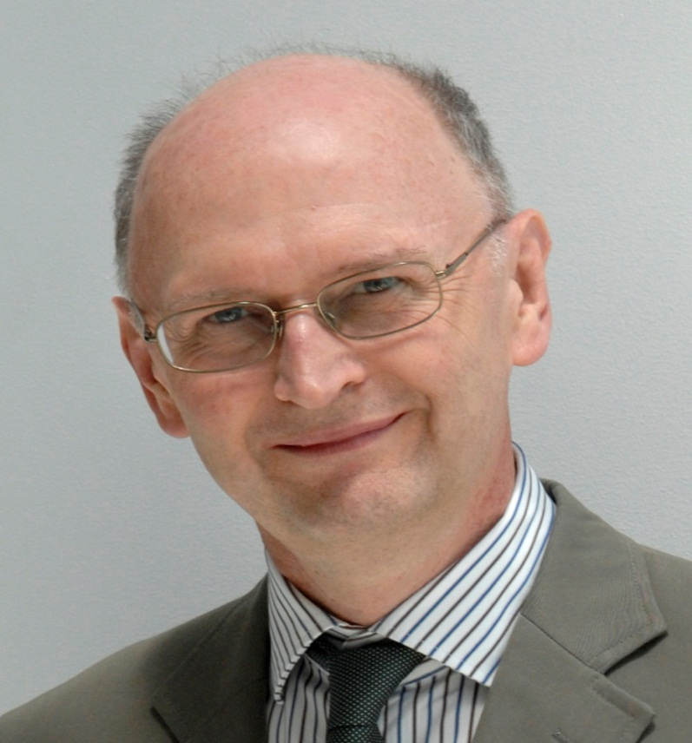

some of our keynotes
Ron Barnett
Liz Beaty
Mick Healey
Sue Clegg

Slide 78
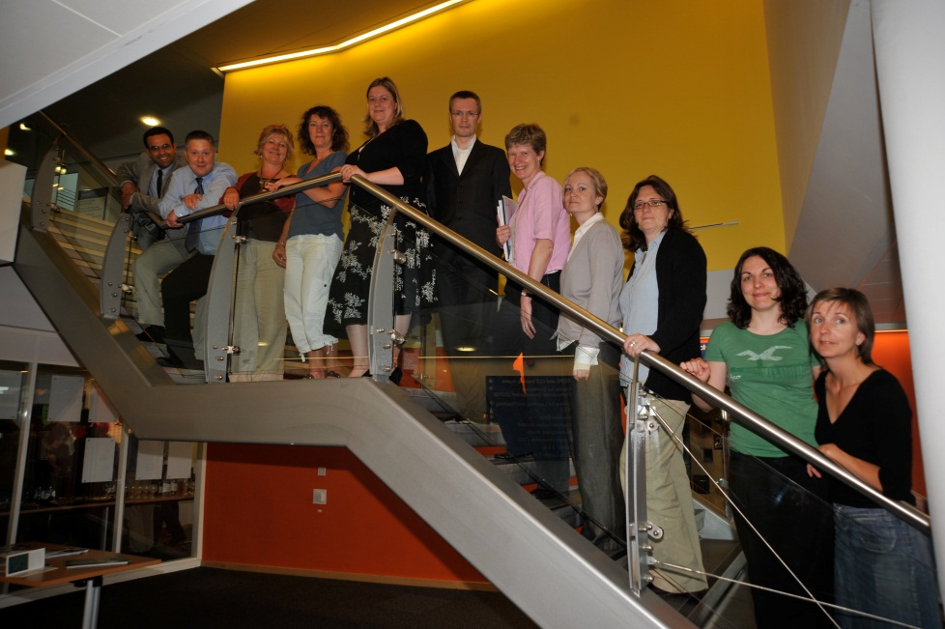
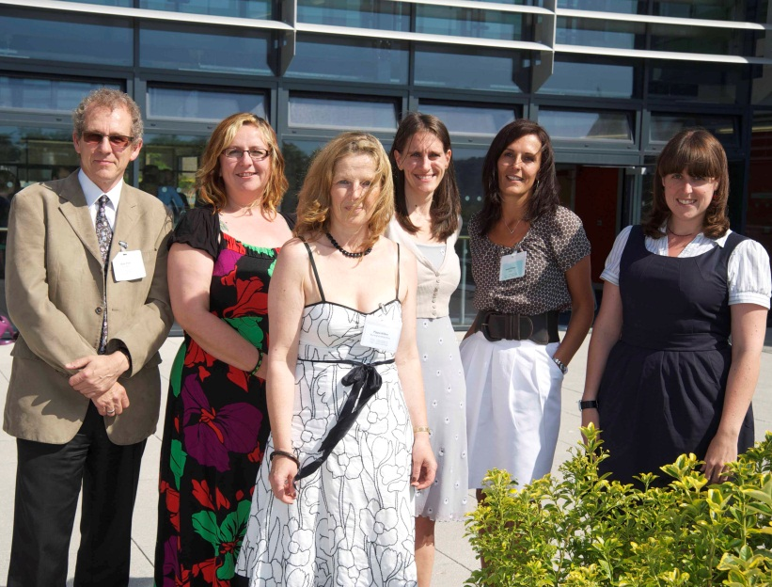
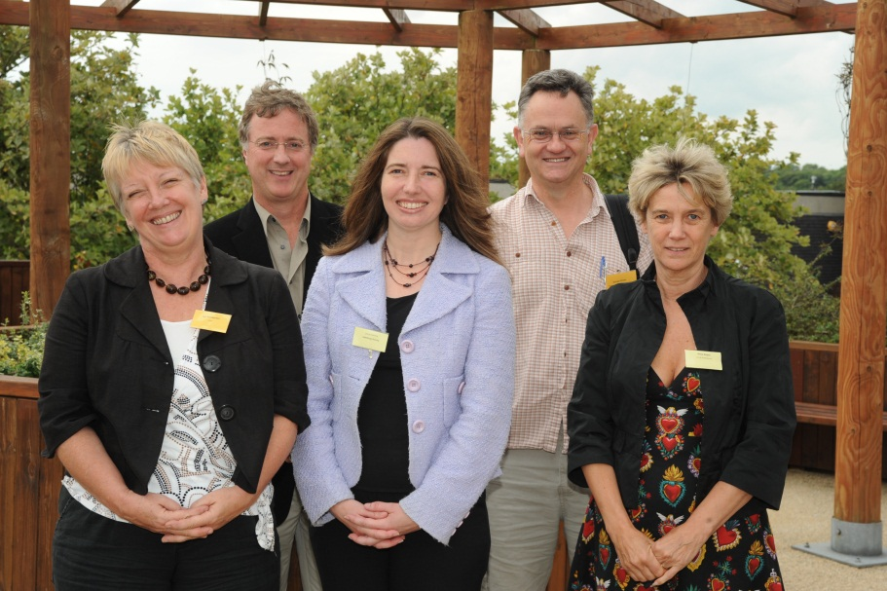
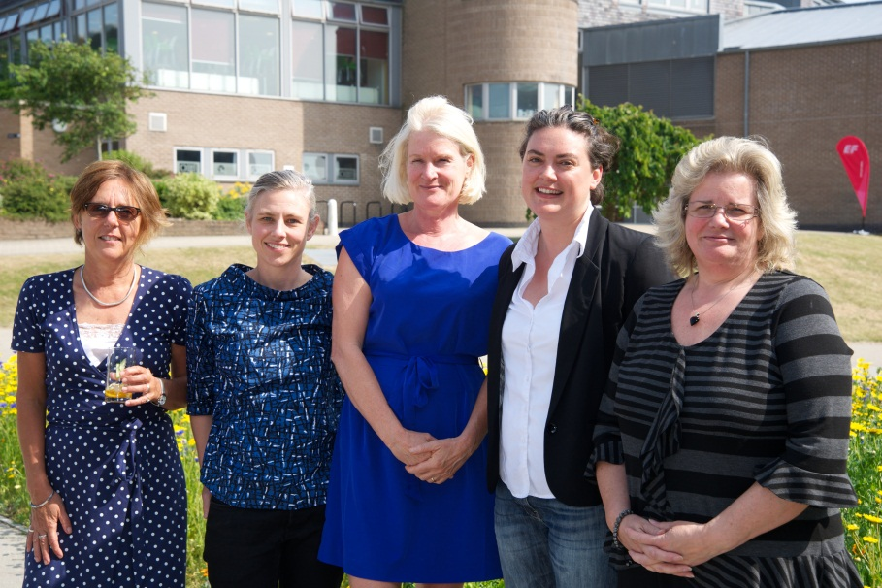
Some of our Excellence in Facilitating and Empowering Learning award winners taken at the Learning and Teaching Conferences

Slide 79
‘I will be eternally grateful to those unknown reviewers who gave me a chance early in my publishing career by offering so much constructive feedback and guidance.’ ( H)

Slide 80
Reviewing as learning about writing and publication
‘As an educational developer, academic publishing is key for me in terms of credibility. I peer review because I consider it part of the academic role and essential to ensure continuation of publishing activity. I also like to keep up to date by reading new papers. However, there are few intrinsic benefits, so to some extent it is an altruistic role.’ ( A)

Slide 81


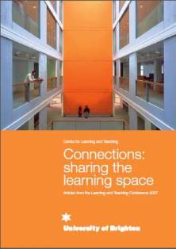

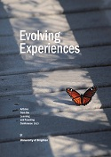
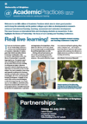
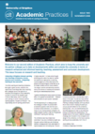

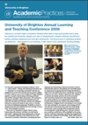

Some research and practice publication outputs

Slide 82

Some more

Slide 83


Slide 84
Questions
What do you do or could you do to further develop
yourselves as researchers?
and researchers into learning and teaching?
and nurture the community of researchers with other academic colleagues ?

Slide 85

Curricula need to become a series of open-ended spaces rather than a series of permissions to proceed that focus on compliance and rule-based models.
Such open-ended curricula will be provisional, unstable and uncertain, and will reflect the translocational state of the university of the future.

