Slide 1
Managing your supervisor
Professor Gina Wisker
University of Brighton

Slide 2
A PhD is about asking questions and addressing them

Slide 3
How can we ‘manage ‘our supervisors?
Dimensions
What are your expectations of supervision?
Are they realistic/unrealistic?
Good supervision
Working together
Ground rules and stages
Gurr’s supervisory model
Anne Lee’s framework
From the journey to the building
Roles

Slide 4
Dimensions in which supervision operates
Personal
Institutional
learning

Slide 5
Rite of passage
Licence to teach
Grow a colleague

Slide 6
Good supervision
supports, enables, challenges, encourages and empowers research students to produce good research
which is rigorous, ethical, well written and makes a significant, contribution to knowledge
Helps develop the next generation of researchers
Empowers research and outcomes that can make a positive contribution to the public good

Slide 7
Some thoughts from others:
Enthusiastic about the research
Guide rather than lead
Well organised –keeps meeting deadlines
Accessible
Treats supervisory role as a priority role
Ability to access resources needed by the student
Knowledge of the field
Approachable
Enables student to be part of the academic/scientific community
Remain a colleague and adapt as student changes /develops
Secure & unthreatened as student develops

Slide 8
Essentials in the process of research and production of a thesis
Development of research skills, strategies, processes behaviours mindsets –
Problematising and asking questions,
Project design and planning,
Carrying it out, analysing data and producing interpretations and findings
Writing /writing it up with an argument and theorising running throughout, using the evidence /data imaginatively and critically, conceptually underpinned
Coherent whole-
Reflection
Knowing what has been achieved, why it matters

Slide 9
stages
Setting up and maintaining good workable ground rules- scaffolding and structuring the supervision, and the research
Supporting and enabling the construction of a doable piece of research-
Identifying the field, the gap, the question, the reasons for doing the work and intended outcomes
Supporting and enabling the research journey and the production of a well expressed, well constructed argument, story, and thesis

Slide 10
Working together
How do you work together to establish ‘ground rules’? Think about:
First meetings
Regularity of meetings
Agenda setting
Note keeping
Rules of communication
Milestones eg research proposal approval;confirmation of candidature/transitioning/;yearly meetings;examination and viva
Working with supervisory teams
What can go wrong and what can you do about it?

Slide 11
Dealing with difference
Supervisors and Candidates present differences in terms of :
Learning styles and behaviours
Gender, culture, age,.......
Reasons for undertaking the PhD , intended outcomes
Levels of motivation with the work
‘take ‘ on the discipline/inter-discipline

Slide 12
Range of strategies , variations in role and dialogues based on
Appreciation of diversity
Mutual respect
Not trying to grow a clone
Constantly learning
Caring about the person, the project, process and achievement of outcomes

Slide 13
(student) ‘A beautifully architected building is fairly misleading. It is the work, the result of being up here on the journey.’
‘No wonder it is so daunting for the rest of us to consider constructing such a building, because we are not actually anywhere near where we could build it. A mud hut is as much as I could hand in at the moment. ‘

Slide 14
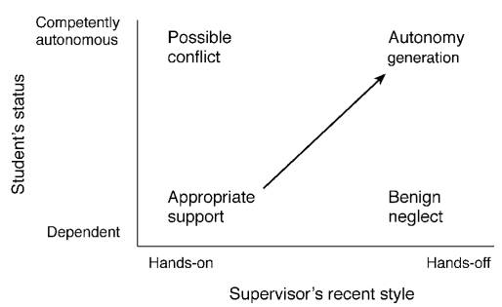
GURR’S SUPERVISORY ALIGNMENT MODEL
Notes:
Utilitarian and functional – can be used to adaptively adjust the level of help (of whatever sort is required) the supervisor provides to the student based on student needs…
Could use as first stage. Other models provide more detail…

Slide 15
Wellbeing issues -
Supervisors also consider
Stress and time management
Referrals
Different learning trajectories
Community building

Slide 16
Overall what helps-…
Ensuring a boundaried (doable) and conceptual enough question
Early focus on conceptual framework, methodology & methods
Very close reading and focus on dialoguing with experts in the literature review/theoretical perspectives chapter
Oral prompting and challenging of conceptual, critical work individually in supervisions and in groups
Prompt feedback encouraging conceptual and critical work
Models, dialogues, pointing out contradictions and tensions and urging incorporation for critical conceptual engagement
Establishing and supporting a peer community

Slide 17
Becoming a researcher-identity-developing a ‘voice’
‘As time goes on and you start to, you almost develop this skin that is academic and this persona within yourself and as you… get the feedback that comes back and you’re thinking about you’re doing this the right way and so you begin to start, it’s like watching a butterfly I suppose emerge from chrysalis pupa or pupa chrysalis and so on like that and so you begin to develop and I think as that goes on then you gain a certain amount of confidence.’

Slide 18
Becoming part of an
Academic Community
‘A big learning experience for me has been that doing a doctorate is not a search for the truth but is really just taking part in a conversation. This doesn’t stop me thinking that an 'expert' knows all of the answers and I suppose this is about confidence on my part… [But they don’t have my experience] So how can they know everything? and what I have to offer is just as important as theirs, and I suppose that is also a learning experience in that when I sit with the 'learned' in a conference I feel confident in challenging them as I now see myself as a peer.’

Slide 19
Levels of work
Descriptive
Summarise
Synthesise
Critique
Analyse
Conceptualise
Problematise
Evaluate
Contribute something new
You might start anywhere with this developmental process- probably you need to do all of it at different stages

Slide 20
Supervisors:
Increased confidence
Well, they’ve got an extra dose of confidence. They’ve got an extra dose of clarity. They’re more confident, they’re clearer, and they’re probably very inspired to go and do something else quickly, to take advantage of those changes. I think that’s right. (S8)

Slide 21
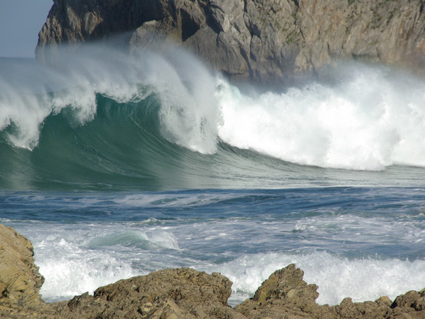

Slide 22
Roles
How do you define your supervisor’ s role ?
When and why does it differ?
Please consider the range of roles
how far do they fit what you experience?
What would be helpful, supportive and challenging?

Slide 23
Manager
God
Mum/Dad
facilitator
counsellor
friend
doctor
advocate
mentor
?? What else ? Why and when?

Slide 24
And the excellent supervisor –
Does all of this and -

Slide 25
A few examples of university criteria for supervisor excellence

Slide 26
In an early project at the ANU, Cullen et al. (1994) used the language of ‘good’ and ‘successful’ to Identify ‘a model of the supervisory process which is common to all disciplines’. The key elements in this model are:
‘negotiating/guiding the move from dependence to independence’
‘varying the supervisory approach to suit the individual student’s needs and personality, disciplinary differences and so on’
‘recognising that a key to the process is the formulation of the problem/topic/question because it is that which ensures focus and engagement’ (pp. 74-75)
They conclude that ‘(s)upervision should be seen as the total oversight by the institution of a student’s progress and broad academic development

Slide 27
Imperial College London University
Creating a stimulating environment for research
Encouraging students to innovate and push boundaries
Being available, approachable and supportive
Offering high quality advice and guidance
Giving students the confidence to present their work at conferences and other events
http://www3.imperial.ac.uk/registry/abouttheregistry/awardsforexcellence

Slide 28
University of Bath
Also.....
encouraging their students to disseminate their work, maximise its impact and exploit its results wherever appropriate
a concern to support the personal, professional, and career development of doctoral students
an ability to evaluate critically their practice as supervisors and, where appropriate, disseminate it, acting as a role model for students and colleagues.

Slide 29
Characteristics of ‘excellence’ beyond ‘good’ ?
Willing to do the extra
Not a superwoman or superman (not a good role model!)
Enacts and believes in all the positive characteristics of supervision
Then sensitive, challenging criticality which stretches students thinking and practice
Extends the dialogue and conversation in the discipline and enables the student to do so through support challenge opportunities
Grows a colleague (even if their future work is outside the academy)

Slide 30
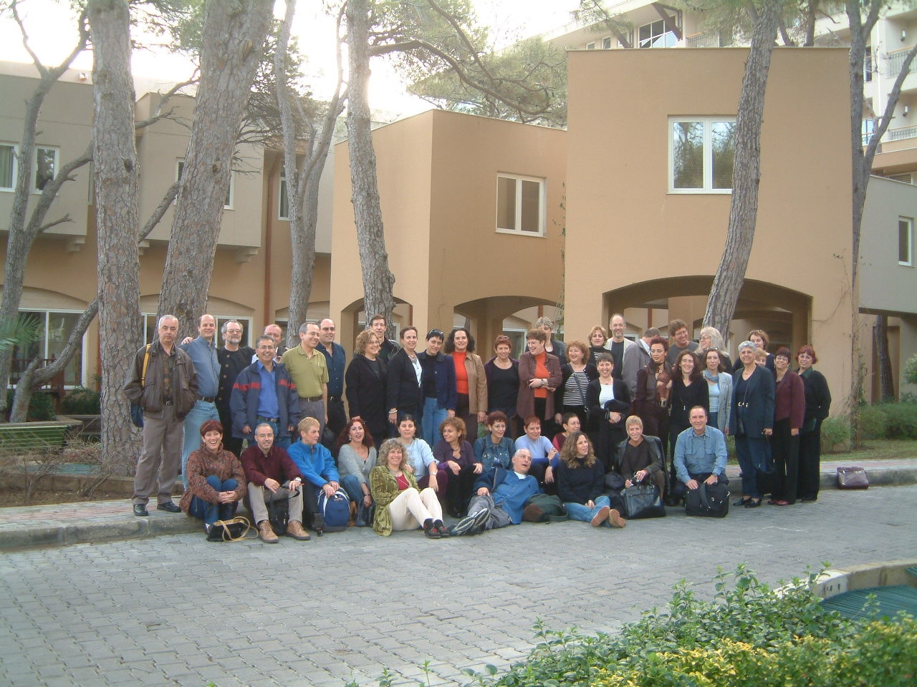
Notes:
What does conceptual threshold crossing at postgraduate level look like?
How is the conceptual level of work evidenced? What is the evidence of conceptual threshold crossing and the articulation and actioning of threshold concepts?
What do you do? What can we do? What can the institution do? To enable
conceptual
critical and
creative enough
Postgraduate research work and dissertation/thesis completion, and the development of competent, enlightened researchers?

Slide 31
Gina’s useful books and contact
G.wisker@brighton.ac.uk
The Good Supervisor – (Palgrave macmillan 2012)
The Postgraduate Research Handbook (2nd edn Palgrave macmillan 2008)
(Look on palgrave website, some tips on www.palgrave.studyguides.com)
Oasis-for-learning.net
Materials on postgraduate research, supervision, writing.

Slide 32
Kiley, M., & Mullins, G. (2006). Opening the black box: How examiners assess your thesis. In C. Denholm & T. Evans (Eds.), Doctorates downunder: Keys to successful doctoral study in Australia and New Zealand (pp. 200-207). Melbourne: ACER.examiners approach the assessment of research theses. International Journal of
Kiley, M., & Wisker, G. (2008, June 2008). “Now you see it, now you don’t”: Identifying and supporting the achievement of doctoral work which embraces threshold concepts and crosses conceptual thresholds. Paper presented at the Threshold concepts: From theory to practice, Queen's University, Kingston Ontario Canada.
Kiley, M., & Wisker, G. (2010). Threshold concepts in research education and evidence of threshold crossing. Higher Education Research and Development.
Mullins, G., & Kiley, M. (2002). 'It's a PhD, not a Nobel Prize': How experienced examiners assess research theses. Studies in Higher Education, 27(4), 369-386
Wisker,G, Morris,C, Warnes, M, ,Lilly,J (2009 ) ‘Doctoral learning journeys’ in Assessment Learning and Teaching journal, Leeds Metropolitan university.
Wisker, G. (2005, 2012 ). The good supervisor: Supervising postgraduate and undergraduate research for doctoral theses and dissertations. Basingstoke: Palgrave Macmillan
Wisker, G., Robinson, G., & Kiley, M. (2008). Crossing liminal spaces: Encouraging postgraduate students to cross conceptual thresholds and achieve threshold concepts in their research. In M. Kiley & G. Mullins (Eds.), Quality in postgraduate research: Research education in the new global environment - Part 2: Conference Proceedings. Canberra: CEDAM, ANU.
Wisker, G., Robinson, G., Trafford, V., Lilly, J., & Warnes, M. (2004). Achieving a Doctorate: Meta-learning and Research Development Programmes Supporting Success for International Distance students. Paper presented at the Quality in Postgraduate Research: Re-imaging research education, Adelaide, Australia.

