Slide 1
Refining your research proposal planning and actioning it
Prof Gina Wisker
University of Brighton UK
University of Johannesburg
Emerging researchers/supervisor workshop series 2016

Slide 2
Auditing and refreshing your research work
Introductions
Outcomes
Today we are looking at
Your research journey so far
Your research question
Your research proposal – tacking stock and moving on

Slide 3
Brighton Palace Pier

Slide 4
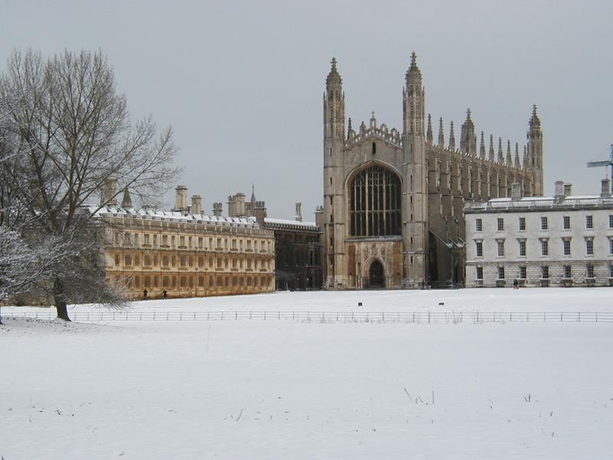
King's College Chapel
 | C

Slide 5
also: Getting Published: Academic publishing success 2015 ppt etc materials freely downloadable at oasis-for-learning.net

Slide 6
What has been your research journey so far ?
Delights
Challenges
Intentions now

Slide 7
GURR’S SUPERVISORY ALIGNMENT MODEL
Notes:
Utilitarian and functional – can be used to adaptively adjust the level of help (of whatever sort is required) the supervisor provides to the student based on student needs…
Could use as first stage. Other models provide more detail…

Slide 8
Research journeys

Slide 9
Research questions
What is your research question?
Can you ask it address it even answer it within your research project?
How will doing this research contribute to knowledge
Why does this research matter?

Slide 10
Identifying a research question
Whole cake –whole field, all the questions you can ask in all the ways
boundaries
Their slice of the cake

Slide 11
1 What is the problem issue and question
In the field?
2 Why are you going about it the way you are (and how?)
3 What is it contributing to knowledge
And meaning (ie factually and conceptually)

Slide 12
Help me with these students - How should they go about their research?
‘I want to look at airline terrorism’
I’m interested in literary vampires’
I want to look at how first world countries help third world countries
I’m looking at the relationship between fruit flies and alzheimers

Slide 13
Research proposal
what does a research proposal aim to do ?
What does it look like?
Consideration of the research proposal information and examples

Slide 14
What is yours like ?
What are its strengths and weakness?
Is it fit for purpose?

Slide 15
What have you done so far to action it?
Any issues?
What do you need to do next?

Slide 16
Work on your own and with others to
Consider and discuss questions to
prompt thought and clear expression
Find, share discuss process useful models to feed into your own development ,
helping, enable and empower yourself and others to:
• Problematise – question and unpick what is given or taken for granted as ‘natural’.
• Conceptualise – move beyond the descriptive to identifying concepts or ideas that underlie the representation of experience.
Action- Make it doable –get on with putting the proposal into action
Troubleshoot problems - and keep going

Slide 17
Putting research proposals into action-the research
• Plan – organise ways of asking research questions or testing hypotheses that are realistic, achievable, timed.
• Action – translate a plan into a series of actions, processes and linked activities.
• Manage – pull together data, activities, and ideas.

Slide 18
• Analyse – ask questions of data, theories and theorists, drawing them together into categories and themes that emerge or have been identified, helping the student to make sense of and sum up the meaning and contribution of what they have found.
• Reflect and evaluate – What happened? What was found? What does this mean? Does this make any significant contribution, challenges, change?
• Make it all coherent – find the right format, language, shape, expression, connections between arguments, sense of the impact, and meaning of it all – so it is coherent:
1 at the level of argument;
2 at the level of expression and presentation;
3 conceptually – the piece of research finally expands and clarifies ideas or concepts because the questions were asked using those concepts, theories and methods and were analysed and reflected on.

Slide 19
A dissertation/thesis is a building
Research is a journey
How do you help your student get from the research journey to the thesis building?
It looks mapped but -risks, surprises,deviations
Ordered, coherent, organised, linked

Slide 20
How do you get from the research journey to the thesis building?

