Slide 1
Senior academics professional development programme
April 2016
Professor Gina Wisker
University of Brighton UK

Slide 2


Slide 3
Senior academics professional development programme April 2016
AIM OF THE COURSE
This 3-day programme is designed for mid-career to senior academics in higher education institutions who often have to perform an increasing number of key roles and functions as they progress on the career ladder.
Many of these roles come in addition to the core functions of teaching and research.
There is often an assumption that lecturers can perform such roles naturally. However, there is little professional training available to support lecturers in developing the skills required to perform the different facets of their roles effectively. Much of the practices used by individual lecturers evolve from one’s own experience, informal knowledge, or trial-and-error methods.
The aim of this programme is to provide an opportunity for lecturers to be equipped with professional training and skills that will strengthen their technical and strategic capabilities to perform their professional roles with greater confidence, and also an opportunity to reflect upon their current practices in a manner which is informed by relevant theory and international best practice.

Slide 4
PROGRAMME
DAY 1 Achieving excellence in different facets of the senior academic’s role
am
Welcome and introductions.
Outcomes of the course – including outcomes you seek, challenges and issues you bring
Achieving excellence in different facets of the senior academic’s role- What does this mean to you?
Research informed thoughts on context, challenges, choices, reflection.
Leadership and management
Balancing and planning
Ideas from developments based on the UK Professional Standards Framework as a way of identifying skills, knowledge, values in action in context.
pm Programme/curriculum development approaches
Curriculum planning – Biggs and Tang, constructive alignment
Staying topical, changes in the discipline, market forces, student engagement, learning teaching and assessment processes.
Sound documentation and processes
The cycle of planning, monitoring, change, validation, accreditation.

Slide 5
DAY 2 Developing teaching, research and scholarship
Am
Developing teaching practice at personal and departmental levels
Some C21st teaching expectations and challenges
Departmental and college/university wide development programmes- the UK professional standards framework as a guide
What do we mean by teaching excellence? Characteristics, schemes to support enable and recognise teaching excellence
Pm
Planning and developing your research and scholarship
What is the scholarship of teaching and learning? linking research and teaching –practices, processes , support, development , reward.
Developing a research and writing career
Developing grant proposals and strategies for raising funds to support academic programmes and activities. Bidding for funding for research and development activities

Slide 6
DAY 3 Supervision, Leadership , career planning
Am
Supervising students' research work / project work - Honours, Masters, PhD
Research informed insights into successful supervision
Approaches and insights for guiding and supervising research students successfully-managing expectations, planning, building and maintaining good working relationships
What is a good supervisor? personal learning and institutional dimensions of the role
Supervising the project –questions, conceptual frameworks, and working at a conceptual level
Students’ engagement in a ‘dialogue’ with the field, making a contribution to knowledge
pm
Leadership and management of academic programmes, departments and institutions –styles, challenges , choices in context
Strategies for academic workload management
Managing colleagues, time and work.
Planning and strategizing your career (from day 1) -milestones
Working with and developing your own examples of leadership and management of teaching and learning and people.-Models
Topical issues and tensions
Reflection
Your choices and planning

Slide 7
Welcome and introductions.
Outcomes of the course
What outcomes do you seek from this three day programme?
What challenges and issues do you bring?

Slide 8
Outcomes and challenges
Plan for focusing more on research
How to secure funding for research
Strategy to get pub in top journals
New approaches to managing in academia- and supervision
Ideas for leading in academic environment
Strategies to build strong and formidable research consulting
Get best practices in research and effective teaching
Best ways to supervise students-and build cordial relationship
Networking with colleagues
Getting mentorship in research – particularly new faculty
Good research output
Managing academic challenges
Putting out worthwhile research work

Slide 9
challenges
Collaboration-busy
Student numbers and effective interactive teaching(oxford centre for staff and learning development materials )
Getting space resources and informed colleagues to do research
Combining teaching advising and managing a faculty
Not wanting to let any of these go
Institutional perspective

Slide 10
Having the right mentoring in place
Using established staff to mentor newer formally
Pressure to publish for the sake of it
Getting right supervision feedback-vijay kumar
Student lecturer relationship –time – supporting weaker students
Find a new goal
Management of priorities and financing from the learning spaces to the domestic responsibilities
Time management – extra work

Slide 11
Issues from groups

Slide 12
Achieving excellence in different facets of the senior academic’s role- What does this mean to you?
Research informed thoughts on context, challenges, choices, reflection.

Slide 13
Balancing and planning
In academic work there is a high correlation between career and life satisfaction. The university, more than other places of employment, is highly influenced by life outside of work .In addition, universities are training grounds for future leaders and need to offer an effective model on how to balance family and career.(Hensel, 1991)

Slide 14

We probably juggle and spin more than our predecessors did as academics, teachers, researchers, administrators/
managers, members of families and of the community
Being careful not to drop any of the balls
What are the implications of balancing for you?

Slide 15
Domestic and other responsibilities/delights
work
Social

Slide 16
Work life balance
What is your work life balance like?
Where are the overlaps? conflicts? contradictory demands?
What is overwhelming ?
What left out?
Has this changed as your job has changed ?
Has anything else changed?
Is it as you would like it or would you like it to change?
While this might not be an issue for you (balancing ), you might like to consider it when working with colleagues whom you lead or manage.

Slide 17
teaching
Administration
or management or
leadership
Research

Slide 18
Balance in role
Research (Shirley Alexander, Stress in academic life) suggests stress is caused when the balance is
Unexpected ,
changes suddenly in an undesired way,
not as chosen or hoped for,
No balance at all

Slide 19
What are your work balances of research/ teaching/ management/leadership like?
Have the proportions of your time , focus, effort changed over time?
How would you like it to change?

Slide 20
Meetings not fixed so you cant plan
Finer outputs take longer
Making responsible statements about responsible processes-from your role(notyou) with colleagues and advocates make it clear what is in it for them –
New uni? Old uni? Partner?
Delegation is a mark of trust and your sense of security in yr role
Leaders respect good minds- sharing power- and information- ‘making them look good ‘’helping them do their job’is the flipside of a leader who recognises that there are good ideas from staff
Identifying your weakness and build on them to improve
Create your own protected time to get research etc done
Find synergies using your work to engage with your research and teaching eg pub on pedagogy
Give the problem to the students to help solve /use/ a fashion design case, a book

Slide 21
A few thoughts
Make deliberate changes
Build on and use unexpected demands and opportunities they wont come round again
Let some things go as their time is up
Hang on to others theyre part of your identity and development
Decide What
  to stop for while-
  to prioritise,
  to develop
  To do just for a while and build on
Manage your time to suit you and demands – even if it sounds odd to others
Research on women leaders- stepping up, taking on a project, solving a problem (provided you build on these)

Slide 22
Leadership and management

Slide 23
What are the differences?
What are the characteristics of effective
Leaders
Managers

Slide 24
Business models and sustainability
Skills grad attributes and discipline skills and knowledge
Money and vision and people
Vision through to curriculum and fees – where are you placed ?

Slide 25
Leaders and managers in academic contexts
Robin Middlehurst suggested in the early 1990s that in university contexts the roles are blurred- I see them as more of a continuum depending on your role, and interpretation of it , and circumstances .
Vice chancellors lead
Deans, heads, directors are more likely to both lead and manage

Slide 26

Managing
Communicating with and managing people
HR issues, hiring, promotions , performance management
Mentoring, training
Workload management , time and task management
Everyday activities , production of agreed work .implementation
Managing projects –money, budgets , time , people, outputs, responsibilities
Partnerships internal and external
Typically team , task and role oriented, -whole university links
Learning from and with others

Slide 27
When is planning and monitoring micro managing?
Transactional analysis
Parent Parent
Adult adult
Child child

Slide 28

Leading
Strategic decision making
Inititiating strategic alliances
Vision and mission
Commitment /value driven eg integrity,social justice
Lead by positive example
Enabling achievement through recognising constraints in context
Consulting with others over decisions
Plan, negotiate, motivate and direct the team

Slide 29
See
http://www.lfhe.ac.uk/ leadership foundation

Slide 30
Leading and managing
Leaders are policy makers - managers are policy implementers- ‘in higher education the new cadre of manager-academics ‘(Deem 2010) has shifted this divide.
Together they lead and manage the complex institutions

Slide 31
Leaders- vision, values, overall responsibility more strategic
Managers – more operational , manage people, tasks, time resources
In HE we need to do both
Other research looks at dimensions which apply variously to both . A study at the University of Michigan identified these two behaviours as (Katz, Maccoby, Morse, 1950; Northouse, 2007):
Employee Orientation - approaching employees with a strong human relations orientation (concern for people)
Production Orientation - stressing the technical and production aspect of the job (concern for tasks)

Slide 32
Leaders and managers
Leaders
Managers
Mission, vision
Values
Strategic
Motivation
Outside university links and insights
Creativity
Change
Organisation/organisations
Operational
Time
Space
People relationships
Task
Resources

Slide 33
‘The relationship between leadership and management, Is a recurring theme in the leadership literature (Bennis, 1990; Kotter, 1990; Zaleznik, 1977). In higher education, as elsewhere, Kotter’s (1990) argument that most organizations are over-managed and under-led (particularly in times of change and uncertainty) would resonate with some. Others would agree with Mintzberg’s (1973) view that leadership is a key managerial role and that an over-emphasis on leadership at the expense of management is potentially dangerous (Gosling &Mintzberg, 2003).’(Middlehurst et al 2009 Why Research Leadership in Higher Education? Exploring Contributions from the UK's Leadership Foundation for Higher Education
ARTICLE in LEADERSHIP · JULY 2009)

Slide 34
universities
‘Universities are complex institutions ‘Structural complexity is associated with combining a wide range of functions (finance and student administration, bio-medical research and the teaching of performing arts) and the delivery of different services to different markets, at home and, in many cases, overseas (national and international student recruitment, fundamental and applied research and the delivery of trans-national education, on-campus teaching and distance learning). Different constitutions, funding sources and regulatory regimes are a further source of complexity. In some parts of their activities, universities operate within the public sector by virtue of receiving public funds; they are also educational charities. In other parts of their operations, they are firmly in the private sector. UK universities are classified by UNESCO-UIS/OECD/EUROSTAT (2005) as private organizations in receipt of public funds; they are also treated as private institutions when operating overseas in the delivery of trans-national education.

Slide 35
Universities are also often large employers, employing staff from a wide range of occupational categories under
different contractual arrangements (in the UK and overseas, within partnerships and dual contracts) and with different trades union representation.
Internal systems and support services have to respond to this complexity. Social and cultural complexity is a further dimension of universities. Moreover, the university community typically contains a range of ‘academic tribes and territories’(Becher, 1990, Becher & Trowler, 2001), with an increasing number of inter -national staff (Universities UK, 2007) and a wide range of professional staff, some of whom carry ‘hybrid’ roles (Whitchurch, 2008). Complexity also emanates fromthe management, directly or in partnership, of cultural and social resources including libraries, theatres, teaching hospitals, museums, art galleries and publishers.’Leadership Foundation –( Middlehurst et al 2013)

Slide 36
As a leader you push against the ways in which difference leads to hierarchy
Tribes, religion ethnicity gender discipline distance disability access and different staffing groups and lecturers and students

Slide 37
Context matters
The structural and cultural dimensions of organizational
functioning – as well as the environmental aspects of context – are as
integral to the practice of leader ship as are leaders and/or followers. This comment
resonates with the Situation-Behavior-Impact model of leader ship promulgated bythe Centre for Creative Leader ship which involves a relationship between leaders, followers and ‘situation’ (Centre for Creative Leader ship, 2008).
Yet context is often down-played in leader ship research designs or ignored in comparative analyses. It does not always feature, either, in approaches to leader ship development. This is despite Burgoyne’s contention, repeated recently in LFHE-funded research, that
‘what works in terms of leadership development is highly context specific [and this]is one of the few generalisations that can be justified in the area of management and
leader ship development’ (Burgoyne et al., 2009: 20; see also Burgoyne et al., 2004).
Those who practice leader ship in higher education are aware of the importance of context, and are frequently dismissive of generalized solutions to specific problems.(Middlehurst et al 2013)

Slide 38
Day 1 pm
Programme/curriculum development approaches

Slide 39
Curriculum planning – Biggs and Tang, constructive alignment
Considering
Staying topical, changes in the discipline, market forces, student engagement, learning teaching and assessment processes.
Addn LOs ppt

Slide 40
Curriculum change
To take in account HR hours
apathy
Curriculum –

Slide 41
Sound documentation and processes
The cycle of planning, monitoring, change, validation, accreditation.
Addn material

Slide 42
DAY 2 Developing teaching, research and scholarship

Slide 43
What was useful from yesterday?
Any issues thoughts and questions?

Slide 44
Developing teaching practice at personal and departmental levels
Some C21st teaching expectations and challenges

Slide 45
Key Issues in University Learning and Teaching

Slide 46
Some issues
Student diversity
Flexibility
Teaching and learning
Research and
Scholarship
Research in learning and teaching terms
Economic and social engagement
Income generation
Identity of the college or university with wide range of student needs and abilities
Student engagement
Quality of the student experience overall is paramount
Excellence in learning and teaching
Competition
Funding

Slide 47
Some issues and some developments
The notion of student engagement which means students taking responsibility for their learning, and being involved as much as possible. Student engagement in the learning ,curriculum development, quality, feedback
Themes
  Employability
  Developing students as enquiring learners/researchers
  Internationalisation
  social justice
  equality and diversity
  Sustainablity -----
  Modes, forms ….
E and blended learning
Flipped classrooms
Learning communities
field work and field trips, years abroad, placements (all based on immersion in the real )
PLEASE ADD what are the issues nd developments for you in your university/college?

Slide 48
You also said
Learning and teaching
Plagiarism/poor academic behaviour
Learning capacity and learning gain
Maintaining concentration and activity in intensive teaching periods
The richness of diversity of learners esp international in a classroom- difference in perspectives
Conceptual and cognitive issues and developments
Employability
Entrepreneurship
Interns
Placements
Visiting lecturers
Real world relationships with the uni
Simulations

Slide 49
Oasis-for-learning.net
G.wisker@brighton.ac.uk

Slide 50



ppt etc materials freely downloadable oasis-for-learning.net

Slide 51

Some more

Slide 52
Please discuss
How do any of these relate to or influence your own teaching learning, curriculum development, feedback and management or leadership of courses?

Slide 53
Strategies and roles
Strategies and dedicated roles enable learning and teaching to be given a higher profile
Most universities and colleges have a mission statement or strategic plan.
Many have a learning and teaching strategy
As well as a research strategy

Slide 54
University strategies and learning and teaching strategies
Do you have a mission statement? Corporate plan? Strategy
a learning and teaching strategy? and if so how does the learning and teaching strategy relate to the overall strategy ?

Slide 55
L and T strategies
How are they developed?
By a small team
An individual
Through university wide consultation?
What works? why?
Aims, topics, practical implementation, targets, achievable targets, responsibilities and accountabilities, measures of achievement. Key performance indicators
How do you/would you plan?
What should be in it?
How are they used?
How can the strategy be put into action?
How would you monitor it ?
Targets, action points, responsibility, deliverables/outcomes/outputs
Achievements, reporting structures and committees.
Are they monitored and measured and evaluated and updated?
Reports, annual monitoring,

Slide 56
Grows from the mission/corporate/strategic plan the unique selling point(USP) and identity of the university/college
With a focused eye on the national and international developments in L and T strategies (to differentiate, to be similar)
Led by a pvc/head of CLT
With a team
And involves full consultation with heads/deans, and discipline leads and students employers alumni etc etc

Slide 57
Through – development team meetings, awaydays, focus groups, consultations in meetings in the departments etc,learning and teaching committee consultations, SU etc ie involving all the stakeholders
Must have
An accessible quickly found and owned format
A reporting committee, strategic focus, overall themes, broken down into implementation elements, responsibilities, accountability, targets and measureable outcomes KPIs
Updates on achievements
5 yrly refreshment/re write

Slide 58
LEARNING AND TEACHING STRATEGY topics example ( these are nuanced by the institution, though surprisingly often have the same core values and aims…)
Quality of Learning and Teaching
E-and blended learning
Scholarship of Learning and Teaching
Professionalisation
Achieve effective L and T through improved assessment practice
Quality of the student experience
Student engagement
Widening participation
Learning Environment
Innovation and flexibility
Employability
Regional/national
Internationalism
Recognising and Rewarding excellent teachers

Slide 59
Twenty first century students
Student experience and engagement are uppermost
  How does this drive decision making about curriculum, learning spaces?
Market forces, competition, advertising, fees
Does this lead to the best learning environment and engagement?
Internet savvy, want their degrees to lead to employment, want value for money, want to study in spaces and places with quality connections and facilities, are likely to be working alongside study

Slide 60
What are your students like???
What are their demands and expectations and can we meet or manage them?

Slide 61
E and blended learning

Slide 62
How are we using e and blended learning?
Argument- today’s students are v internet and e learning aware and skilled
It makes sense to use the E and blended learning opportunities available
E and blended learning – reach more students, esp those at a distance, part time , reach learners differently, offer opportunities to revisit learning,
But recent research suggests we need to revisit the benefits of communities learning together, real time human interaction involving dialogue and building learning.

Slide 63
What have you done with /what might you do with
Learning management systems- VLEs to locate course information- including materials, timetables , links
Real e learning on courses- synchronous and asynchronous learning- chatrooms, embedding interaction eg comment on each others work, building a wiki together( a bit like a joint piece of knowledge like a tree) through a group -into courses –
E assessment –(i)uploading assessments, (ii) marking online and (iii)giving feedback and (iv)grades in one space
LSHTM example

Slide 64
How might you use these and what might the development needs be?

Slide 65
Developing teaching
You as a teacher
Departmental and college/university wide development programmes- the UK professional standards framework as a guide

Slide 66
s
Learning and teaching philosophies and experiences
Sharing-please discuss-You as a teacher
Your teaching histories – where have you taught? What other kinds of work have you been involved in?
What is your philosophy as a teacher?
What are your values and commitments?
What versions of you role are you aware of?
and does this role differ from any other for you?

Slide 67
Good and bad learning and teaching
Please explore, and discuss good and bad experiences of being taught and of learning
What were the characteristics of a good experience?
What makes a good learning experience?
What would you define as a good teacher / lecturer / facilitator of learning?
What do we mean by good practice?
Please draw up 6 characteristics of good practice/a good teacher.

Slide 68
Teaching excellence
What do we mean by teaching excellence?
How might it be evidenced?
and encouraged?
Surveys? Internal research? Prizes? Student feedback? Awards and Fellowships based on reflection, evidence references?
National teaching fellowships
National student satisfaction survey
Internal student led or other excellence awards….

Slide 69
Te aching for critical thinking
Enhance students output
Aligned Los and objectives
Providing significant learning experiences for all students
Incorporating tasks and activities to achieve learning goals
Teaching academic language in an easy understandable way
Developing a framework for linking research outputs into t and l
Imparting academic knowledge for transformation
Meeting the LOS and objectives at the preset quality standard
Intellectual socialisation
Passion for course material delivery
The lighting of a fire
Developing competences through active reflection
‘going the extra mile’
Categories- transformational learning for the student
Whats in the teaching and learning-knowledge competences research etc
HOW eag active reflection imparting etc
Coherent consistent systems and planning

Slide 70
An institution wide example of Scholarship of Teaching and Learning in practice - Internal research :
Developing the Teaching Excellence Framework
University of Brighton

Slide 71
Project undertaken to investigate and discover how one university recognises and rewards teaching excellence
Clarification- theories, literature and current practice informing the term ‘teaching excellence’
Student and awards focus –what do students think teaching excellence is in practice? How do we recognise ‘it’ in awards
Evidence gathered from free text NSS and two internal teaching excellence awards

Slide 72
Definitions and Conceptions of teaching excellence
No commonly agreed definition
Examples of definitions and conceptions distinguish between teaching excellence, the excellent teacher and excellent learning – in reality all part of teaching excellence

Slide 73
Definitions from literature
Definitions and conceptions of teaching excellence have included:
Emerging from their literature review Gunn and Fisk (2013) provisionally define teaching excellence as overall, system-wide conceptions of excellence (with the systems relating to sector, institutions and disciplines. And that it is important to distinguish this from teacher excellence (conceptions of excellence related to individual philosophies and practices rewarded and recognised) and from excellent learning (levels of understanding and meaning-making from abstract, contextual and situational forms of knowledge).
Teaching excellence may be perceived as a balance in statements around teaching excellence between: content and process which foster maturity in disciplinary ways of thinking and doing; teaching process which foster maturity in disciplinary ways of thinking and doing as well developing attributes for future use; developing professional; providing and environment of ways of being, doing and acting linked to wider career opportunities and economic, financial, socio-cultural and ethical attitudes (Gunn and Fisk, 2013).

Slide 74
‘In an effort to make teaching excellence explicit and to subject it to public scrutiny, Skelton recently outlined four ‘ideal type’ understandings, calling these: traditional; performative; psychologized and critical (see Skelton, 2005: 21–37 cited by Skelton, 2007). ‘
‘At Penn State, teaching excellence is viewed as: an academic process by which students are motivated to learn in ways that make a sustained, substantial, and positive influence on how they think, act, and feel; a process that elevates students to a level where they learn deeply and remarkably because of teacher attributes – subject matter and pedagogical expert, excellent communicator, student centred mentor, and systematic and continual assessor (Penn State, nd).’(example)
(either or both of these might inform ways you structure and categorise your questions, and thematically analyse your data…)(or not)

Slide 75
Response from internal research 2011- 2015 (data)
‘Very inspiring, enthusiastic and extremely current in her subject area, and always responsive to students requests for support with their study. Her knowledge and facilitation skills have made a huge impact...’ (EFEL, 2011)
‘Always inspirational multi-media presentations, His inaugural lecture was fantastic and he is always involved in L&T conference with new ideas. Pushing forward pedagogic research and xxx research in tandem’ (EFEL, 2011)

Slide 76
‘imparts a thorough understanding of his modules and their significance in the bigger picture of xxx...his passion and enthusiasm are infectious; his subject knowledge both detailed and broad. On top of this he sparks original thinking, takes any contribution you make in class seriously and considers where your idea may have come from.’ (STEA, 2011)

Slide 77
‘The general teaching of my course in both my subject areas has been fantastic. The assignments have been challenging but very engaging and enjoyable and have related very well to the topic as a whole. Support has been there when needed with prompt responses to queries via email or arranging of tutorials.’ (NSS, 2015)

Slide 78
Two comments on same lecturer. ‘The lecturer is like a friend to all the students and at the same time provides us with an experiential learning, which is the most effective especially in xx course. The lecturer is inspiring, motivating and definitely made the course interesting to study and gave an ability to continue the project after graduating uni’
and ‘Rarely have I ever had a lecturer who has as much passion about a topic in which they teach. I think that Dr xxx's module is one that has made the most impression on me in all my years at this university. I thank her and all the lectures that were involved in a special module’. (EFEL, 2015)

Slide 79
‘xxx has played a key role in my academic experience at university. He has helped me immensely with not only content related issues I have had regarding pieces of work, but also in structure and style of my written work. He always makes time for debate and discussion, and has raised my confidence in my work hugely. Lastly he is committed to reviewing and improving the modules that he has taught us. He is always interested on our thoughts and opinions of lecture we have had and module we have taken. It is of great encouragement and support to know that a busy lecturer still makes time to personally find out the feedback of students and I have seen first hand the changes he has made after hearing our feedback. ’. (EFEL, 2015)

Slide 80
Finally…..
‘There has not been a single lecture or seminar of xxx's that has made me wish I'd stayed in bed; which says a lot coming from a first year student. No matter how heavy the night before I always drag myself to xxx to hear xxx as I know everything he says is worth listening to. xxx has inspired me to look into so many sides of xxx that I had not even considered before. The sheer amount of knowledge that seems to just evaporate from him has encouraged me to work so much harder and it is xxx's own enthusiasm and passion for the subject that has really inspired me to delve deep into the world of xxx. xxx is also very caring about his students (despite asking me my name every week!) and regularly asks us if we found the lecture okay and easy enough to follow when we go into complex matters. (STEA, 2011)

Slide 81
question
What do you think are the characterisics of excellent teaching – considering
Your experience
Any literature
The findings from the UofB reports?

Slide 82
Teaching excellence at the University of Brighton was(2011) and is (2015) depicted by students responding to the NSS and nominating excellent teachers (SU awards, Excellence in Facilitating and empowering Learning awards admin by CLT) as encompassing
values, behaviours, reflective practice and continued professional development.
The literature discussing teaching excellence , and our students’ responses indicate that there is:
  (i) value in having flexible definitions and perceptions of teaching excellence and
  (ii) in taking note of other evidence that provides a much richer and more exhaustive characterization of the impact teachers have on their students

Slide 83
Teaching Excellence at the University of Brighton (findings from data)
An analysis of UOB student comments in 2011 suggested that teaching excellence was perceived as having the following characteristics
inspiring,
knowledgeable and scholarly
accessible,
imaginative and
responsive.
Students’ comments on an excellent teacher (CLT, 2012) reflected multiple attributes and behaviours
Excellent teachers combined different, multiple pedagogical roles and attributes to enable learning as appropriate for their respective course and field as well as proactivity in terms of ‘going the extra mile’.

Slide 84
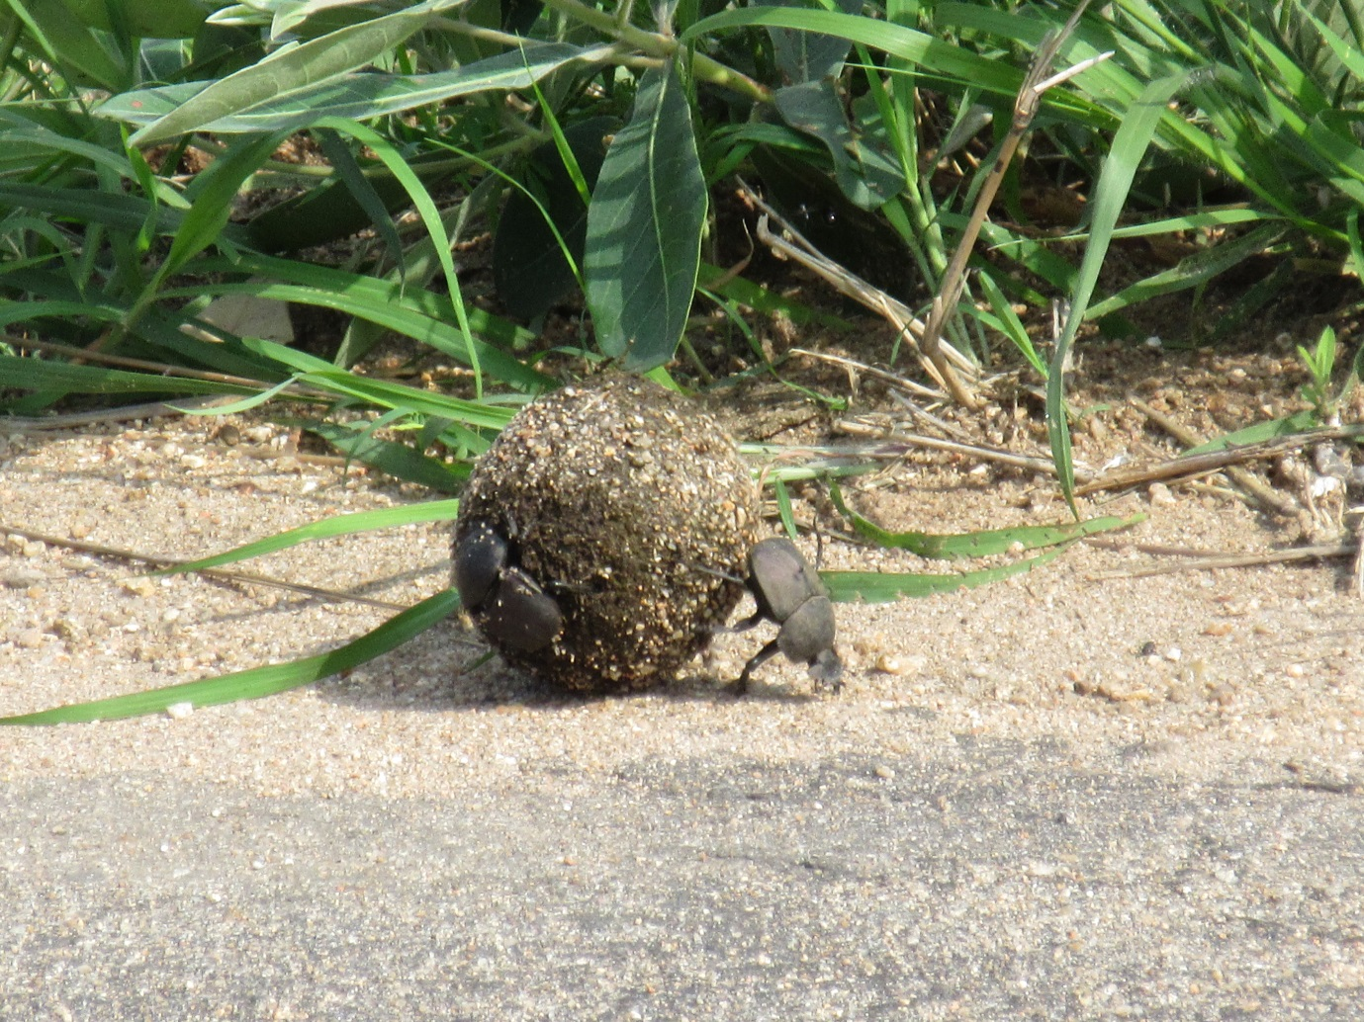
An uphill task?(but essential and rewarding )

Slide 85
DAY 3
Am
UKPSF-developing teaching, developing your teaching leadership
SoTL scholarship of teaching and learning
Writing funding bids
Pm Supervision,
Developing your writing and research career
Leadership career planning

Slide 86
What was useful from yesterday?
Any issues thoughts and questions?

Slide 87
UKPSF-developing teaching, developing your teaching leadership

Slide 88
Developments of teaching to enable learning
Look at the details of the UKPSF
What development programmes would work in your context?
Postgrad certificates, masters, EdD, Prof Doc
Recognition schemes
Continuing professional development in the shape of workshops- compulsory or voluntary?
Mapped into staff development review/appraisal?
Rewarded and recognised in promotion schemes?

Slide 89
UK professional standards framework
Ideas from developments based on the UK Professional Standards Framework as a way of identifying skills, knowledge, values in action in context.
A scheme that helps build recognise and share leadership and management beliefs and practices

Slide 90
Outline and aims
Running the scheme(you might want to run one or something similar)
Uof B handbook and examples(this is how we do it, how people interpret it –you might want to do something similar)
Case study examples
Writing your own milestones

Slide 91
UKPSF
The UK Professional Standards Framework was launched 2011-12 after a pilot with several universities including Exeter, and consultation and advice from the Heads of Educational Development (HEDG) and the Staff and Educational Development Association (SEDA).
It aims to provide a supportive developmental scheme to enable colleagues to gain recognition for their development and achievement- at four levels related to job roles in learning, teaching and its management and leadership.
It operates under the governance of the Higher Education Academy (HEA) who accredit the schemes. Universities have developed their own schemes, which doffer. These are quality assured by external examiners and internal processes. The HEA also run the scheme internationally in partnership with universities abroad , or international colleagues in partner institutions can take their UK university’s scheme.

Slide 92
Achievement of D1 (associate fellowship) and D2 (fellowships) are considered teaching in HE qualifications (for HESA)
D2 is for middle managers with leaderships ad ,management responsibilities in teaching and learning ,course, curriculum etc, D4 is for senior managers with such leadership at institutional , national, even international levels .
Increasingly for promotions and new jobs achievement at various levels is expected.

Slide 93
Outcomes –change
One of the powerful aspects of this scheme is that at D3 senior fellow colleagues are supported to reflect on and identify their leadership and management values, core knowledge and activities in relation to learning and teaching in the HE context.

Slide 94
This builds a reflective community at the heart of the institution- Uni Nottingham has built the Senior and principal fellows into group leading HE learning and teaching.

Slide 95
University of Brighton scheme
Descriptor 3 Senior Fellow of the
Uof B and HEA

Slide 96
Why undertake this now?
Some responses
Personal development
Professional development and recognition
Been a teacher for x years and a leader of learning and teaching elements – and would like to reflect on and evidence this
For promotion
To then turn round and support others at
D 1,2,3

Slide 97
D3 Senior fellow of the Uof B scheme and HEA
Core knowledge
Professional values
Areas of Activity

Slide 98
‘Demonstrate a thorough understanding of effective approaches to teaching and learning support as a key contribution to high quality student learning’
This is evidenced in the written or oral assessment form-
Across all 5 areas of activity
All aspects of core knowledge
Commitment to professional values

Slide 99
It is shown through theorised discussion, reflection and evidence of
Successful engagement in appropriate teaching practices -related to areas of activity
Successful incorporation of subject and pedagogic research and or scholarship ...as part of an integrated approach to academic practice
Successful engagement in CPD in relation to teaching, learning assessment scholarship and as appropriate related academic or professional practices
Successful coordination, support, supervision, management and or mentoring of others (individual /teams) In relation to teaching and learning

Slide 100
How? This is what our colleagues write or collect in a portfolio and defend in a conversation
The application is centred around CPD(continuing professional development)
D3 incorporates D2
1 Account of Professional Practice
Reasons for choices of activities
6000 words-
Reflective commentary on your education roles and experience-this is about development as well as achievement
2 Evidence against the criteria structured in two case studies which outline contributions you have made to learning and teaching in HE
2 referees
Institutional approval

Slide 101
How does Uof B scheme differ?
Uses same criteria and shape etc as HEA
Should be in electronic format- from word document to e portfolio online- (but whatever form it must address the core knowledge, values, areas of activity and fit the HEA scheme)
We provide supportive developmental activities – you might identify further development needs during this process to achieve – we can suggest ways of fulfilling these
Critical friends
Online space to exchange developing work and thoughts
discipline input
Uof B provides the assessment board

Slide 102
Assessment for Uof B scheme
Internal assessor team made up of Dvc, CLT, subject colleagues with LT responsibility and external

Slide 103
Session 1 of the PSF CPD course
How do you interpret the core knowledge
Values
Areas of activity?

Slide 104
Please look at the Account of Professional Practice principles APP p1,2,
They inform your RAP p 3-
Reflection on Academic Practice Look at the aspects for inclusion on page 3 preparing your RAP. It would be useful to have a recent cv to hand to cross refer.
Jot down what formal and informal learning and practice relates to each of the subheadings in the RAP thinking as you begin to do this
What have you done?
When and where?
How do you know it was successful? (evidence)

Slide 105
Case Studies
Please start to think about what you could include as case studies to go along with your RAP and consider the aspects for inclusion the case studies are contributions or roles which :
Have had a significant impact upon the coordination, support, supervision, management and /or mentoring of others (individuals /teams) in relation to teaching and learning
Demonstrate your sustained effectiveness in relation to teaching and learning and that you meet the criteria for Senior Fellowship.

Slide 106
More examples of core knowledge – both disciplinary (not information -but how the discipline constructs knowledge and how that relates to teaching )and the next step is about lading others to learn from and use this –
So some of the core knowledge at this level is about the leadership of developments and teaching influencing others as well as in addition to your understanding how it happens in your discipline
It could emerge in examples of course development or your effective presentation when leading a keynote, a consultancy , a development session- a leader in the field of this thinking

Slide 107
We can look at examples of the
Language
The reflection theorising and evidencing
The specialist areas that go in case studies – as examples of developments of leadership and management in learning and teaching areas-
Addn- D3 scheme ppts

Slide 108
I have worked as an academic in H.E. for 32 years. I started as a lecturer immediately following a PhD. I felt I had good knowledge of the core subject material and an understanding of some of the values of H.E. but my understanding of learning and teaching was limited to personal reflection. Fortunately, my first job involved working with excellent colleagues and they provided excellent support. This seven year ‘apprenticeship’ led me into my second job wherein I progressively developed a more co-ordinating and managerial role. My career path took me further in this direction, accumulating experience, to my current role as Head of a School of xx students and xx academic staff. Throughout, I have developed my understanding of how people learn, applied this to my own teaching and, in turn, to the organisational and staffing matters that help the whole- School learning environment .

Slide 109
Involvement in teaching and learning initiatives;
Example
I design, develop, deliver and manage xxxx modules across our range of work-based provision for over 300 part-time, ‘mature’ students, taking the lead on the xxxxxx modules (V1, V2, V4.) My management responsibilities and duties in relation to these courses have included managing the team of 5 tutors in module delivery and assessment practices. These courses are University led and delivered in Falmer and Hastings, and form a significant part of the School’s portfolio of programmes (A1, A2.)
My ethos and values for teaching and leadership are based on those I developed as a youth worker, and encompass equality of opportunity and striving to meet individual needs. The reflective practice teaching I am involved in utilises Kolb’s reflective learning cycle (Kolb, 1984) and Maslow’s Hierachy of Needs (Maslow, 1954.) My teaching style is facilitative rather than authoritative, as referred to in Heron’s 6-catergory intervention analysis (Heron, 1975.) This ensures that students receive ongoing formative feedback, and our reflective practice modules encourage peer and self-assessment (A3.)

Slide 110
I have been part of the management team for xxxxxx course since 2006, initially as deputy course leader and currently as programme leader (K6), (V2). This is the University of Brighton’s largest programme with about 900 students across all years. This further illustrates, collaboration with others, involvement in teaching and learning initiatives and well as leadership, management and organisational roles.

Slide 111
For the past 5 years xxxxxxx suite of courses modular structure resulted in xxxxxx sharing 4 of the 6 level 4 modules; 4 of the 6 level 5 modules and 2 of the core modules at level 6, however all but 2 of the 50 options at level 6 are available to all students. xxxxxxxxxxxat level 4 and 5 the same 2 core modules and options at level 6 (A1, A4). This structure meant that completely separate analysis of issues and concerns was not appropriate, therefore when it came to the last periodic review 2011/12 the outcome was a new xxxxxxxxx programme .
The new xxxxx degree structure was introduced in Sept 2012 to improve our offer and competitiveness, however importantly aiming to support retention and progression rates from level 4 to 5; all first year xxxxx students follow the same 6 core module with 2 modules that integrate learning from the other four and the opportunity to specialise from level 5 for the first time (K2, K4, K6)
There was a marked improvement in first time pass rates on the first year (17% to 11.5%), in

Slide 112
What have you led and managed in teaching and learning etc modules programmes changes staff development that could be a case study?
How is it research informed
What did you do
How do you know its effective?

Slide 113
question
Would a development and recognition scheme which supports shares and recognises and rewards
Teachers at all levels
Middle and senior managers with teaching and learning responsibilities
Be useful in your context?
In some form?
If so how could you develop and support it?

Slide 114
Planning and developing your research and scholarship

Slide 115
What is the scholarship of teaching and learning? linking research and teaching –practices, processes , support, development , reward.

Slide 116
SoTL in practice is a scholarship and research based interest in and approach to learning, teaching, assessment …
In universities it ranges between
  supporting encouraging enabling research into learning and teaching etc,
  courses , qualifications which are built on research based professionalisation of practice,
  recognition and reward for teaching and learning and its scholarship through promotions etc

Slide 117
We will discuss some of the key issues and tensions such as:
Why get involved in the scholarship of learning and teaching?
What are the tensions and challenges? the excitements and benefits?
How can SoTL can be a generator of valuable evidence relevant to a research-intensive university without expecting colleagues to become educational researchers?
How can we link research and teaching to inform and enhance student learning?
How do universities support, embed, recognise and reward SoTL?

Slide 118
University dimensions which enable and use SoTL
  Attitudes (valuing teaching and learning knowing it can be enhanced from a research informed base)
  Practices and activities (support, development, translation between discipline research approaches, funded projects, courses, communities )
  Strategies (embedding SoTL in the infrastructure and identity of the university- recognition, rewards , promotional routes, leadership)

Slide 119
We are all researchers now
Teaching and research are becoming ever more intimately related. In a knowledge society all students certainly all graduates have to be researchers. Not only are they engaged in the production of knowledge; they must also be educated to cope with the risks and uncertainties generated by the advance of science (Scott 2002, 13).
See Mick Healey –developing students as researchers-research/teaching links

Slide 120


Context changes:
Research
A strong research base is vital for our future in a global knowledge economy .... strong in both fundamental, curiosity-driven research and research applied to the challenges facing businesses and public services. (UUK conference David Willets 2010)

Slide 121
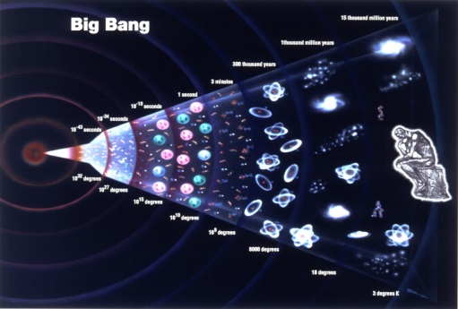
Some thoughts about the links between research and teaching
Research in our discipline and interdisciplinary areas is informing and underpinning our teaching
  our own
  others’ (usually referred to as scholarship)
Research into learning and teaching
  our own
  others’(usually referred to as scholarship)
Encouraging and enabling students as researchers – the skills, and the discipline specific work creating knowledge

Slide 122
Examples - Ghana
Sts as researchers-in economics- write twds confs challenge paper acceptance a norm embed as assessment eg uni conf
Students Writing articles =internal publications online –
All professions require research based decisions and pitches
Students eveloping app lets to create animation to present a concept- deduce from your obsevatio- waorking with the way their subject cinstructs knowledge objects
Encourage and support students to develop research topics
Methodology and valid evidence –
Asashse-surveys re learning gain (US influenced ) re a problem in sotl lack of trust in the rigour and reliabilty

Slide 123

(1) Report on SOTL
Defining and Supporting the Scholarship of Teaching and Learning: A Sector-wide Study. (2016 Fanghanel, Potter, Pritchard, Wisker

Slide 124
SoTL reports
From March to June 2015, a cross-university partnership conducted a qualitative study involving interviews with eight heads of academic development from universities from across the four nations: England, Wales, Scotland and Northern Ireland. The study formed part of the overall HEA funded Defining and Supporting the Scholarship of Teaching and Learning: A Sector-wide Study. (2016 Fanghanel, Potter, Pritchard, Wisker)
Interviews were analysed thematically. They were then drawn into case studies which form part of the findings in the exec report and sent to the HEA.

Slide 125
The main findings are:
Not all higher education providers (HEPs) have a clear shared understanding and meaning of the scholarship of learning and teaching (SoTL)
There is some agreement about the meanings and processes of SoTL amongst heads of education development
Institutional strategies, policies, processes and activities are important for enabling and embedding SoTL.
Staff engagement
Institutional cultural change and clear signposting of SoTL are needed
A transdisciplinary approach to SoTL -efficiency benefits but a discipline focus preferred and most achievable route for embedding.
SoTL buy-in tends to reflect individuals’ interests and discipline alignment.

Slide 126
Professional development and recognition schemes and frameworks such as UKPSF aid SoTL reflection and provide a structure for embedding
Promotion criteria is key for the embedding of SoTL for professional development
There is increasing willingness to engage with SoTL activity
However time constraints, dwindling financial resources and tensions between REF and SoTL research prominence are challenges
Student engagement in learning and teaching and SoTL couched in terms of student partnership =more needs to be done
Co-curriculum development provides opportunities for student engagement in SoTL activity
shift from a focus on outputs to SoTL effectiveness and impact needed

Slide 127
Some quotations :
Perspectives on institutional definitions of SoTL
‘…we have a very specific definition of that…we define that as scholarly activity that ensures that teaching is of the highest quality based on current good practice, reflects sound knowledge and evidenced that in some external way…’ (Respondent 6)
Head of Education Development definitions
‘I think that is about seeing learning and teaching in higher education particularly as being evidence led and evidence based, being research led and research based. Its moving learning and teaching away from top tip and a view that its merely a series of techniques, so that its seeing learning and teaching as more than competencies in a b-tech model, and much more about thinking and reflecting on the ways in which students learn and we facilitate their learning through an evidence base’. (Respondent 7)
‘

Slide 128
‘I think SoTL for me is linking of research and teaching it is a scholarly practice it is about evidence informed innovation and enhancement in one’s practice…SoTL is a spectrum so there’s everything from your reflective practice and taking more scholarly approach to your teaching straight through to, I’m applying for grants I wasn’t to have PhD students I want to have REFable publications’ (Respondent 4).
‘Applying a theoretical understanding to practice on two levels, that’s both in terms of researching our practice to understand it better and also thereby to improve our own practice by thinking about that scholarship, that’s probably what it means to me in my context here’. (Respondent 1)

Slide 129
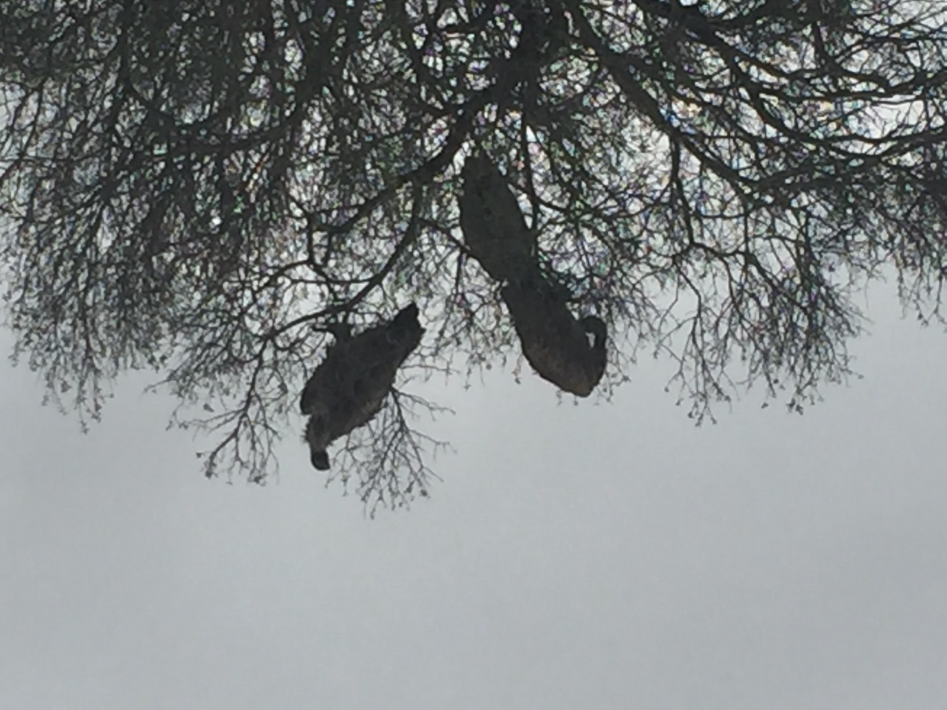
Threats ?

Slide 130
Problems with scholarship of teaching and learning in universities
‘…you do sit and listen at various away days and bits and piece of colleagues actively briefing each other not to get involved in the learning and teaching because ultimately they’re not going to have time to deliver their research outputs that are requested of them, that’s anecdotal. I am surprised to hear it raised so vocally in the culture…that’s the cultural whisperings’ (Respondent 1)
A lack of clear-signposting of the value of SoTL is implied:
‘I think that’s one of the difficulties, staff don’t often have clear signposting as to what is valued and what’s not…heads of school and deans would not necessarily see SoTL as a priority if its not income generating or its not directly part of the core business’ (Respondent 8)

Slide 131

Or being on the alert for opportunities

Slide 132
Positives
‘we have more people wanting to come on our course, I think the growth, the change in our culture people really want to come on it…The uptake of the programmes the development and support for the development of the programmes so for example…I think that is a measure of the change in the culture’ (Respondent 3)
‘In relation to the tensions between research and teaching - overall SoTL is generally seen in a positive light helping drive quality and enhancements. ‘

Slide 133
Professional development and recognition schemes aid reflection on SoTL
For some HEPs, the professional development and recognition scheme has provided a very strong basis for reflecting on SoTL across their institutions, identifying good practice and exploring processes that need to be embedded to develop to levels where the quality of the evidence begins to make an impact across the sector. As one interviewee reported:
  ‘…I think the professional development and recognition scheme has been a very strong basis for us reflecting on our SoTL across the university, and identifying the good practice that’s there and processes that need to be embedded to really develop that to a level where the quality of the evidence begins to make an impact across the sector. The kind of activities and professional development and recognition scheme also working with our in house journal with colleagues there to begin to see where practice enhancements have informed the kind of critical reflection that allows a wider dialogue around the methods that are used to evaluate learning and practice I think that’s been very helpful … to enhance pedagogic outputs across the institution.’ (Respondent 8)

Slide 134
The key recommendations are:
Develop clear definitions and descriptions of SoTL that can be integrated into policy and institutional strategies
Support the dissemination of SoTL research
Engender communities of practice and supportive networks
Resource SoTL practice to demonstrate its value and counter the need to generate income
Encourage HEPs to allow more time for CPD in workload models
Support the development of tools and models to demonstrate impact.

Slide 135
(2) Second report looking at research teaching links- SoTL
Fung, D., and Gordon, C. (2016)Rewarding Educators and Education Leaders in Research-Intensive Universities.

Slide 136
Context for Russell group
‘In fact we have become victims of our own success at research because what has received far less attention – although is equally important to us – is the outstanding education we give our students. (Russell Group statement 2014 , report p15)
‘our universities are committed to providing an outstanding student experience where teaching is enhanced by world class research and facilities. (Russell Group 2015b)

Slide 137
Locke and Bennion, 2010), this work has identified the complexity and fragmentation of academic roles in relation of both teaching and research activities; and pointed to the way those two functions have been almost completely separated in terms of the way they are funded, assessed, rewarded and managed (Locke, 2012), with evidence that research has a much higher status than teaching, especially in the reputation of institutions and the career success of academics.

Slide 138
‘this project is an opportunity to continue to develop the sector’s understanding of the Scholarship of Teaching and Learning (SoTL) as a vehicle for linking teaching and research, and as an effective tool to support teaching and career development.’ (p.4 literature review)

Slide 139
‘research-intensives have very promising opportunities to move forward into the new era by explicitly recreating and re-stating
(i) distinctive models of academic education leadership, which speaks to a clearer definition of ‘teaching excellence’, and
(ii) distinctive models of research-based education, which maximise research education synergies for both staff and students.

Slide 140
We argue that both possibilities have the potential to create the cultural changes needed for education to have ‘parity of esteem’ with research and to send very strong signals, in the era of the new Teaching Excellence Framework, about the particular contributions made by research intensives to student education.’p4

Slide 141
Recommendations
Senior management teams in research intensive institutions
(i) develop a credible and persuasive narrative regarding the importance of education to the institutional mission, in the context of competing drivers for change,
(ii) ensure that this narrative is reiterated consistently to internal and external audiences and
(iii) use the narrative explicitly to inform and shape changes to rewards and recognition processes. (p6)

Slide 142
Recommendations- Support , CPD , dissemination

Slide 143
‘We recommend that research-intensive universities
engage, develop, empower and reward heads of departments (or equivalent) to take a lead in developing research-education synergies in ways which are meaningful and effective either disciplinary contexts’ (2016, p52).

Slide 144
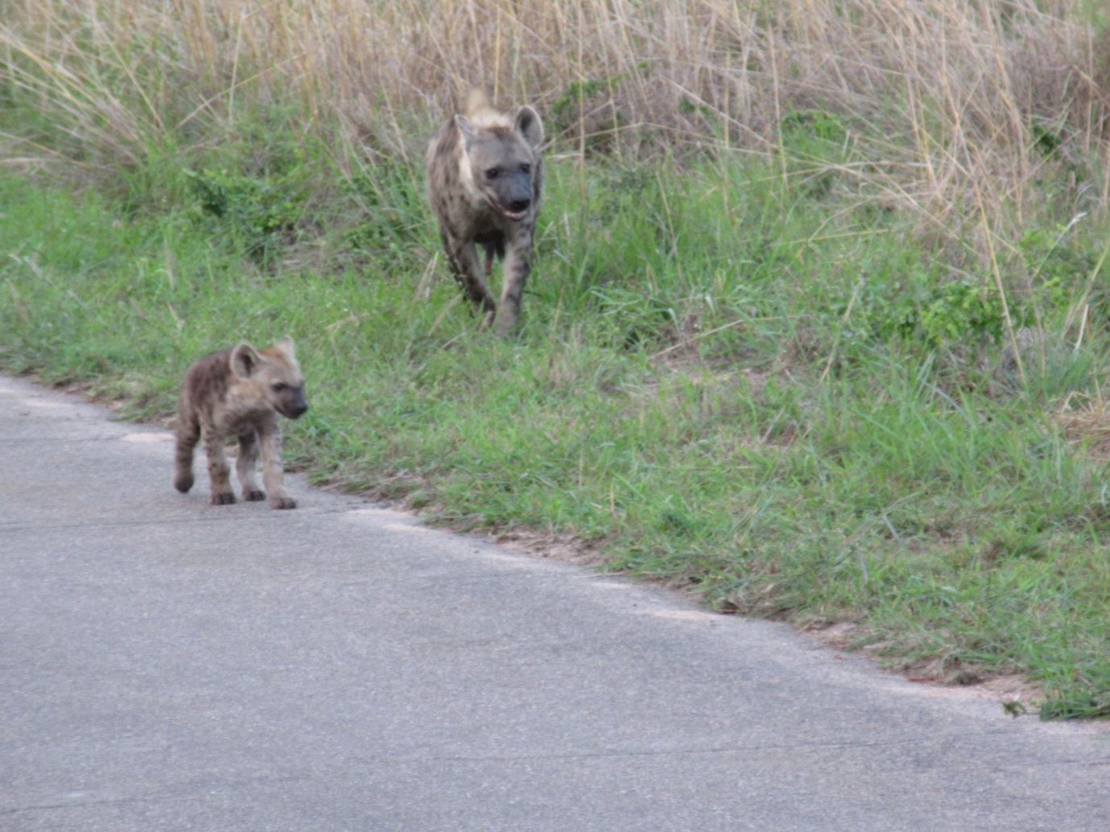
Preconceptions?

Slide 145
The axis- rather than a problem
Teaching and research have been seen at odds (time, focus, status, different skill sets?)
Boyer, followed by Healey and Jenkins etc. instead argue that learning , teaching and research are linked-
- Part of this involves us using research practices and processes to understand and enhance learning and teaching, assessment , student experience etc. practices
- Part of it is about changing curricula and practice to encourage and empower students to use enquiry/research approaches, perspectives, practices to con construct (and do , own-develop) knowledge (skills , values-in practice ) (much of that involves turning from predominantly using didactic informative teaching)

Slide 146
Ernest Boyer (1990) Scholarship Reconsidered: “the most important obligation now confronting the nation’s colleges and universities is to break out of the tired old teaching versus research debate and define in more creative ways, what it means to be a scholar”

Slide 147
Why might research and teaching be in tension?
How does research benefit teaching?
Links theory & practice for colleagues & students;
Establishes informed habit & skills for continuing to ask questions, seek information & answers, in context and throughout life;
Research builds knowledge to inform society

Slide 148
Links between research and teaching
Research in our discipline and interdisciplinary areas is informing and underpinning our teaching
  our own
  others’ (usually referred to as scholarship)
Research into learning and teaching
  our own
  others’(usually referred to as scholarship)
Encouraging and enabling students as researchers – the skills, and the discipline specific work creating knowledge

Slide 149
Context revisited- a reminder
Teaching excellence framework(TEF) forthcoming White paper
However if we teach or enable/support learning we have always been looking at how we can:
Solve problems and issues in our teaching/student learning/assessment/retention etc.
Innovate
Encourage students to do the learning (active learning, co construction of knowledge)

Slide 150
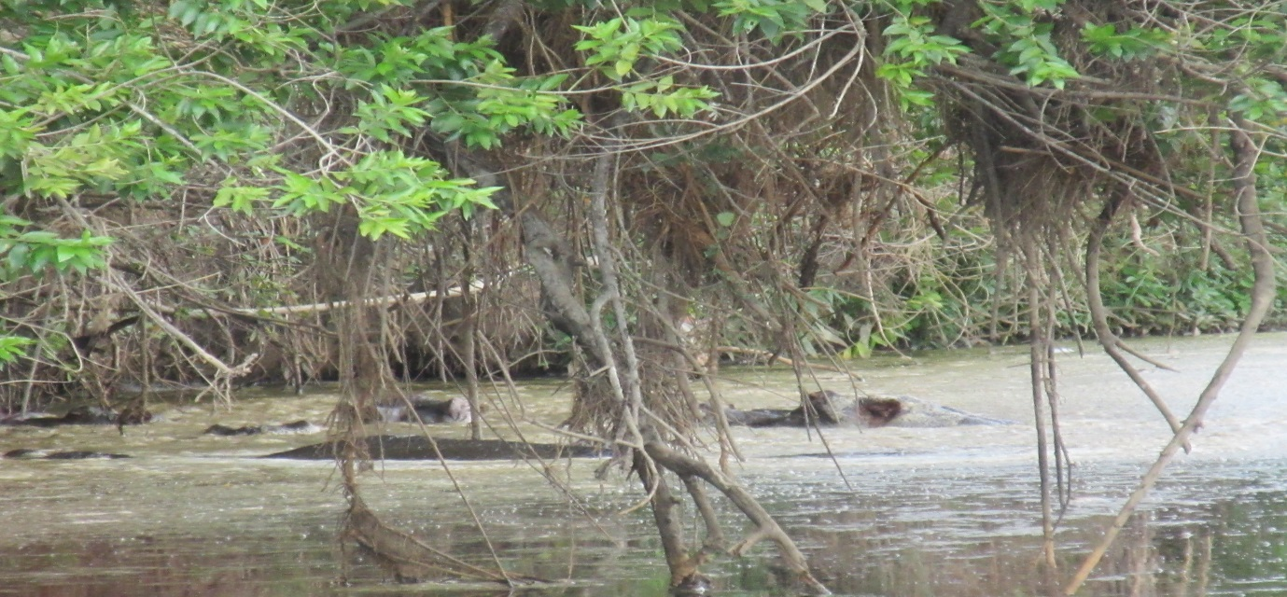
Some of what we do is submerged…not obvious

Slide 151
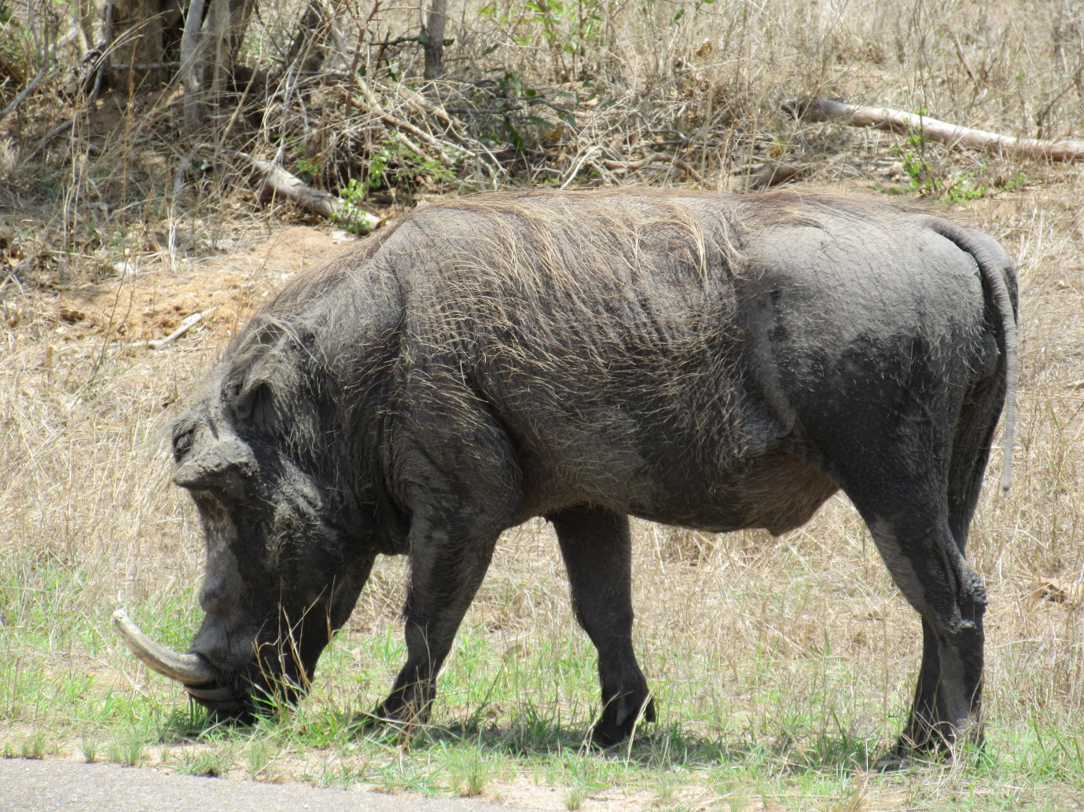
Things aren’t what they seem to be- research into teaching and learning clarifies

Slide 152
Research informs our teaching
We carry out research projects into our teaching , learning etc and issues and practices concerned more broadly with learning and teaching etc
Fascination with teaching, learning etc and a desire to solve problems, innovate, building from a research base
Not everyone finds transitioning into learning and teaching research/SoTL research, straightforward- methodology and methods (usually social science) literature (not in your discipline) language of argument (not discipline) confidence in this research, and in writing about it (publications politics, a new ‘country’)

Slide 153
Questions: Researching our teaching and student learning
· What kind of questions and issues do we explore and how?
· What theories and methods do we use from our disciplines and from HE?
· How do we know if an innovation or a problem solution is successful?

Slide 154
Finding a question, addressing an issue
Why is retention poor on my course?
How can I introduce group work and group assessment effectively into my module?
How can I introduce e and blended learning and e assessment effectively into my module?
What can we do to enhance motivation?

Slide 155
Steps
Students seem to love the international fieldwork-why? What are they getting from it? Is this related to the learning outcomes?
Who has written on this? What have they found and how does it relate to my interest?
What theories are there about formal and informal learning or learning in an unfamiliar context, effects of international experience, learning in a practical real world context, and about motivation ad learning approaches that might provide insights?

Slide 156
How might I go about finding out answers to my questions ?
What will do with this understanding and knowledge?
-to enhance the programme- to make benefits explicit to and prepare students for the programme, to find out further about its impact
To disseminate what I have found so others can benefit ?

Slide 157
Question: Your questions and issues?
What might you want to find out?
how can you go about it? Methodology and methods-
Problems? Challenges?

Slide 158
Methodology and methods
Quantitative (e.g. survey) and qualitative (e.g. interviews, focus groups) are common
but so are
Observation, action research…

Slide 159
Methodology and methods
E.g. appreciative Inquiry – exploring fellowships in 2 coutries
Qualitative research was conducted (2008-2010). The investigation involved in depth-interviews with:
9 Learning and Teaching Fellows at the Post-92 UK university
17 Fellows at the research intensive South African (SA) university
‘Appreciative Inquiry techniques were adopted during interviews, since the research aimed to discover ways in which the Fellowship award and the Fellows’ associated membership of a COP enhanced learning and teaching. The researchers focused primarily on the beneficial aspects of participants’ experiences during interviews. However, the researchers also ensured that participants’ negative responses and opinions were not stifled by positive questioning techniques.
In Appreciative Inquiry, Donovan et al’ (2007) and Bushe (2007) suggest that all participants’ responses, positive and negative, can help contribute towards organisational development, by informing strategies for good practice. The conceptual framework for this research incorporates themes from previous research literature, and the Anglia Ruskin study findings (Constable and Wisker, 2005). However, the data collection and analysis were also open-ended, and open to new themes that emerged throughout the course of the research. In data analysis, cross-sectional content methods were applied across all interviews. NVivo and Atlas software were used as data management tools.’

Slide 160
Findings
Usually expressed following thematic analysis of the data produced from the methods- so themes from a survey, or from a focus group (don’t leave the data to speak for itself!)
Can combine e.g. survey themes and the interview themes- to talk about themes from the two or three methods pulled together.
There is a massive data analysis industry …

Slide 161
What do we mean by teaching excellence? Characteristics, schemes to support enable and recognise teaching excellence

Slide 162

Our scholarship based learning and teaching research
helps inquire about student learning,
identify and deal with problems,
advance innovation,
and evaluate.
It feeds into curriculum and practice change,
developing colleagues and with them students as inquiring learners/researchers/co–constructors of knowledge , and
into continuous improvement based on theorising, reflection, planning, and an evidence base.

Slide 163
Question : Please think and discuss
What have you done
Or what could you do
By way of research into your own students’ learning and your own teaching
What is appropriate for you and your community of practice? Your discipline area?

Slide 164
Route through
Threshold concepts as a way in (disciplinary oriented )
Strategies and internal support and facilitation modes
Exploring the challenges , successes and nurturing of professional developments – fellowships, projects communities of practice, UKPSF
Effecting enhancement and sustainable, positive change. Ways forward?

Slide 165
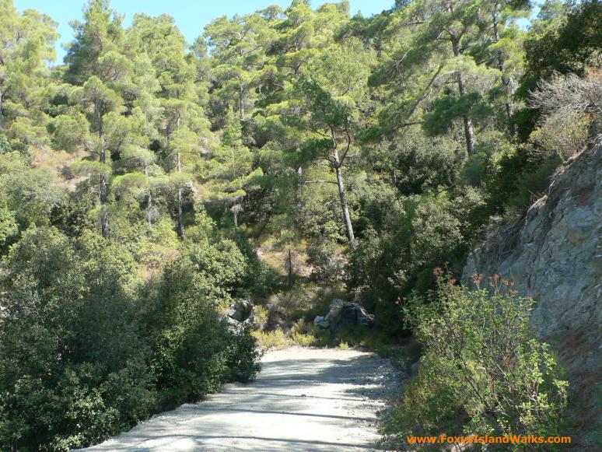
seeing the wood for the trees, a route through – (Troodos Cyprus)

Slide 166
Threshold concepts as a way in to engaging colleagues wit research in their disciplines in relation to teaching
Threshold concepts, theories and practice enable this –
In understanding how your discipline constructs knowledge in the world, sees the world, you are already splicing between research pedagogy and your discipline –threshold concepts
Mick Flanagan’s website ***

Slide 167
Threshold concepts:
A theory and practice based approach many have found useful
Identifies essential concepts-ideas, ways of seeing the world and constructing knowledge – in different disciplines
Highlights problems in learning behaviours and approaches –and is a foundation for positive developments-
Has led to many teachers exploring ways of ensuring students understand the concepts, in practice
Researching ways to enable this, and to show how effective it is

Slide 168

Threshold concept
The absolutely essential concepts for understanding how knowledge is constructed and the world is seen in a discipline
‘Akin to a portal, opening up a new and previously inaccessible way of thinking about something. It represents a transformed way of understanding, or interpreting, or viewing something without which the learner cannot progress….’ (Meyer & Land, 2003)

Slide 169
Threshold concepts
Threshold concept
Transformative
Irreversible
Integrative
Troublesome Knowledge
Ontological- changes the way you see yourself in the world
Epistemological- changes way you perceive knowledge and its construction
Notes:
Threshold concepts
Distinct from core concepts –more than a building block, leads to a qualitatively different view of the subject matter
Likely to be
Troublesome-Difficult because they shake established beliefs
Transformative-once understood likely to lead to perceived shift in perception on subject –can shift identity and personal subjectivity--- parallels with Mezirow’s (1978) work on perspective transformation
Integrative –exposes the previously hidden interrelatedness of something
Probably irreversible

Slide 170
I ask….
What threshold concepts are there in your discipline? i.e. what have students got to understand about how the discipline sees the world? How knowledge is constructed? e.g. representation, interpretation
How might knowing this – and finding out about how it can be learned and used in practice – feed into your own pedagogical research with students?

Slide 171

learning moments
‘ ’

Slide 172
Communities and professional development which support our research
More than ever a need for the professional development of learning communities which nurture, recognise, reward and embed the successes of academics as professionals
CPD
Fellowships/scholarships/projects
Teaching excellence
A range of institutionally supported opportunities to make informed change
Recognition and ‘reward’ processes

Slide 173
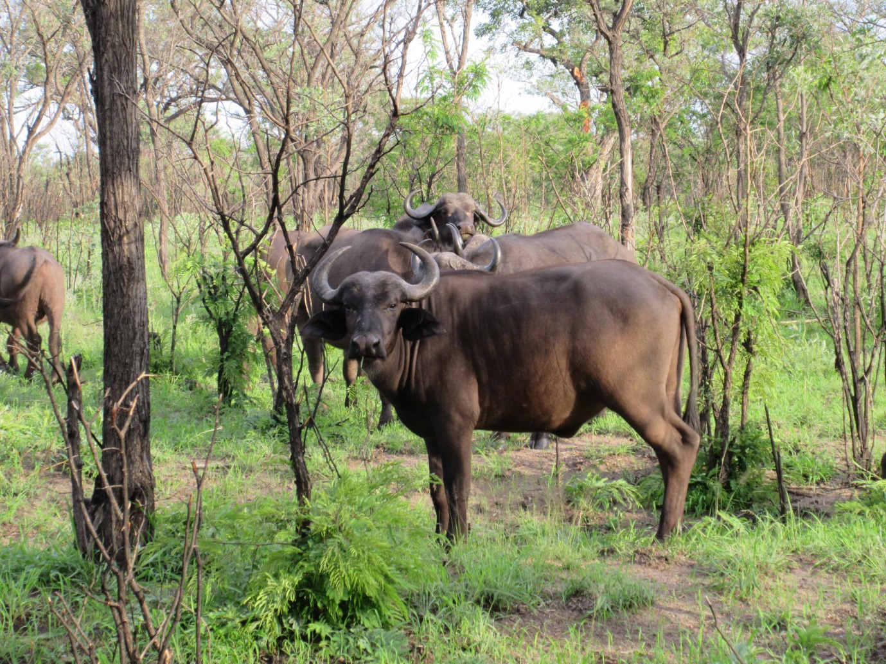
Critical professionalism- communities

Slide 174
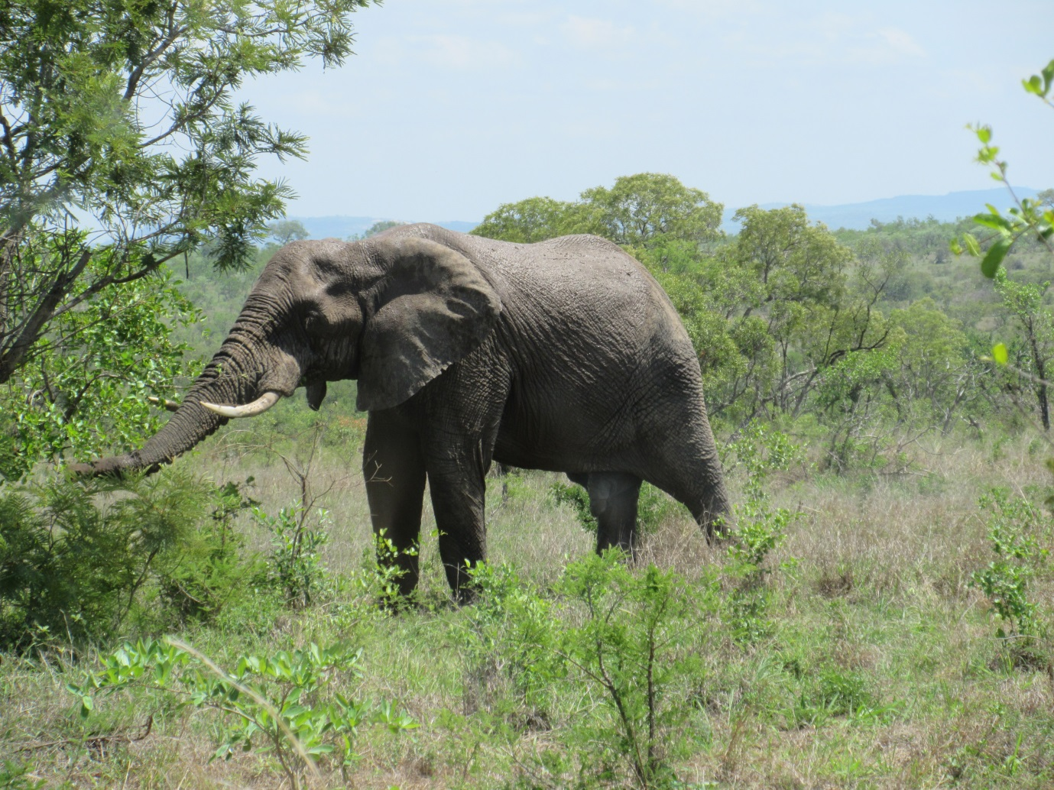
Or lone bulls

Slide 175

Ways through
membership of an academic community of practice, giving greater cohesive voice and power, and creating a vital professional network:
  “The creation of a sense of community and a willingness to examine values openly are not, by this reckoning, some kind of optional extra. They are the necessary conditions for constructing a context within which questions relating to ‘quality’ can be taken seriously.”
  (Nixon, 1996)
It is also proposed that the integration of teaching and research, again helps to reaffirm the identity of academic as both teacher and researcher (Nixon, 1996).

Slide 176
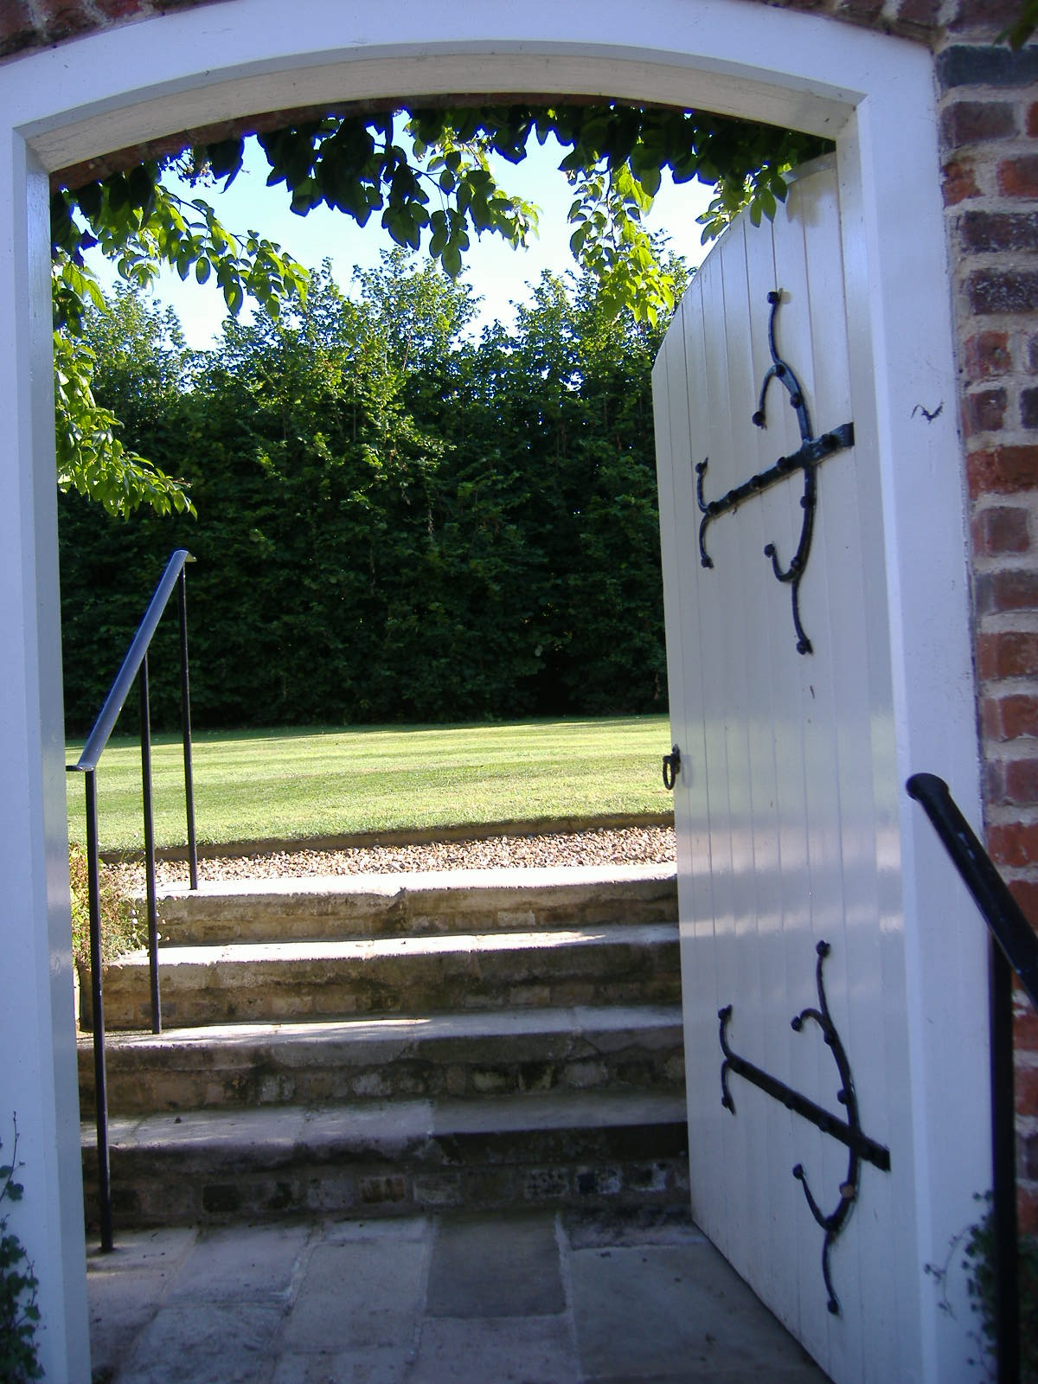

Slide 177
Communities of practice
‘A theory of learning that starts with the assumption that engagement in social practice is the fundamental principle by which we learn and so become who we are’ (Lave, 1998).
Over time, this collective learning results in practices that reflect both the pursuit of our enterprises and the attendant social relations. These practices are thus the property of a kind of community created over time (Wenger, 1998).

Slide 178
Communities and practices which nurture research and research/ teaching links
using various modes of engagement and projects at central national or university local levels
Scholarships/Fellowships/projects
Teaching excellence awards
Interest groups
PGCert Masters EdD PhD with elements focusing on researching our practice
Professional Standards Framework based PRD
Writing groups and programmes
Workshops on grant funding, bid writing, project management, conference presentations, publications

Slide 179
Developing good practice - building a people culture: fellowships as learning conversations in communities of practice
Working with/through the enthusiasm of those facilitating learning - encouraging the work of others
Development & support for/of those facilitating learning across the university and partnerships
Encouraging, supporting, sharing & embedding successful learning & teaching practices
  traditional & innovative,
  student-centred, flexible,
  learning outcome & process related
  research informed

Slide 180

Internal research communities support at the University of Brighton:
Fellowships / now scholarships have been a way of involving and supporting the energies and innovations of colleagues at U of B since 2006, building on a history of varied other involvements
£20,000 a year, funding several projects for one or more colleagues across the university and its partner institutions, bid for (with support) twice yearly
Meetings termly for new fellows, all fellows, established fellows - development activities e.g. project planning, ethics, conference presentations
Topics include – ethical tourism; student learning quiz; transitions;
Research developed to explore the experience and quality enhancement of the fellowship programme in practice

Slide 181
Communities help
‘Previous work at Anglia Ruskin University found that the success of research underpinned learning and teaching fellowship projects related to fellows’ membership of COPs, and in particular, to their attendance at regular fellowship meetings that provided opportunities for:
peer support
reciprocal enthusiasm
constructive criticism
self-reflection
professional development
enhanced professional knowledge/ expertise
networking ‘
(Constable and Wisker, 2005)

Slide 182

Specific activities at Brighton
Funded learning and teaching ‘scholarship’ projects and unfunded projects which incorporate subject and area specialists as well as Learning and Teaching colleagues based around developments in the disciplines and focus on learning teaching assessment student engagement etc
Bringing groups together to share current thinking and research e.g. Supervisor forums, teaching excellence winners forum
Professional standards framework based PRD scheme encouraging reflection, and reflective evidence based theorised submissions- for recognition.
Developing reward and promotion systems.

Slide 183
Schemes and communities can support this development
‘University teaching fellowships underpinned by pedagogic research can help to encourage and sustain teaching excellence, especially when they operate in collaborative community contexts where practice is shared’ (Jones, 2010).

Slide 184
‘This article compares the findings of research, which explores the experiences of teaching Fellowship holders at one Post-92 UK University and at one research intensive South African University. Despite the difference in university type and international location, the evidence indicates that fellowships operating in communities of practice produce sustainable beneficial influences on enhancing teaching and learning in both institutions. This suggests that such benefits can be replicated in different types of university across the international HE sector.’ International teaching excellence: Comparing learning and Teaching Fellowships within Communities of Practice in a UK and a South African university
Jones, J., Wisker, G. and E. Bitzer (IETI, 2013)

Slide 185
Comments from the research into the fellows
“This project has given me professional confidence, for although it’s not much money, it’s enough for my school to release some time for me to work on this project. Presenting the paper at a renowned international conference and receiving positive feedback from the audience was also great.” (Interview 3)
“As a result of presenting the outcomes of the fellowship project at the Learning and Teaching Conference, we were able to network with someone and do a project with them. It’s a good idea for fellows to feed back...increasing possibilities for networking and cross-fertilisation.” (Interview 5)
“It’s early to say what impact this fellowship will have on colleagues’ professional development, but once we have disseminated it through the official staff development process, it might be a catalyst for change.” (Interview 5)

Slide 186
Determination to disseminate fellowship findings through articles and journal publications
“I’m now writing a journal article based on the conference articles that I have written. That’s the next step, and I’m hoping my publications will grow as I do more research in this area.”
(Interview 4)

Slide 187
Some embedded practices
Developmental groups in a wide range of universities eg Higher education pedagogies and policy group (Brighton)
Courses PGCertHE compulsory and engaging colleagues with reading the research to inform teaching, and undertaking research projects –for assessments. Masters, EdDs
UK Professional standards framework based recognition route courses expect theory and (some)research informed basis to reflective discussions of professional practice and own developments in practice – at all 4 levels –encourages a dialogue and develops and rewards this approach
Funded and unfunded projects

Slide 188
Research projects with internal or external funding- a selection
HEA funded SOTL project
‘What works’ HEA retention and success
PGCertHE and the workgroup
UBIC international students and transitions
Postgraduate student learning
Doctoral supervision
Social justice practices transfer
Ed Development units and student interns/involvement
Higher education e-learning survey
HE scholarship of teaching and learning support reward and recognition

Slide 189
Some dissemination activities at Brighton
Writing for Academic publication module (and workshops)
Internal opportunities to publish
  Post conference publication
  Website –
  blogs
Books and journal articles

Slide 190
Challenges?
Its doing the teaching and also adding pedagogical research onto it
But it enthuses motivates and offers insights and also could improve your work and that of the students
We are entering a research and discipline world which has its own language – the discourse and the theories are impenetrable, how can we see the world this way? and enable others to enter and feel articulate and confident in it?

Slide 191
How to splice the discipline research and practical in with the pedagogical work? Two discourses and two ways of seeing the world at least
Linking research into your teaching and your own discipline issues and practices – what are the steps? And what the benefits? What is already in place? What could be developed?

Slide 192

International research links last 3 yrs

Slide 193
Dissemination-conferences

Slide 194

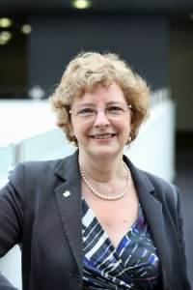
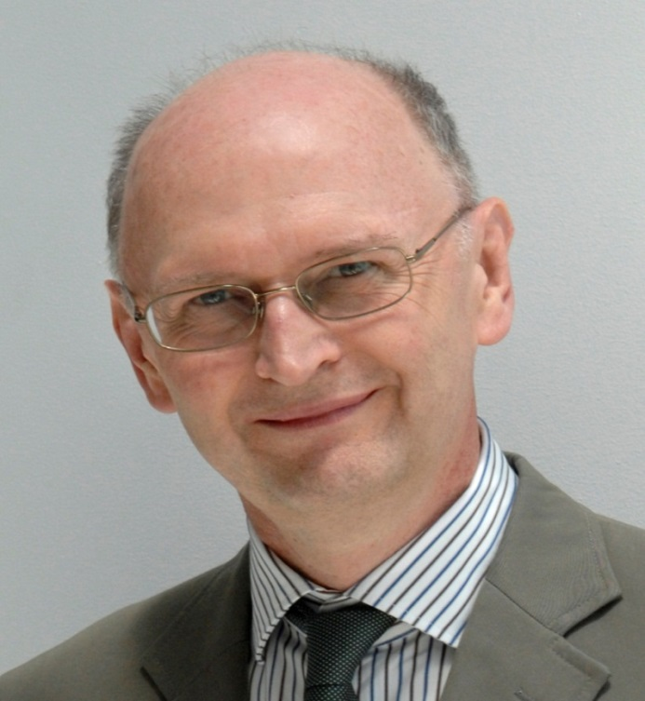

some of our keynotes
Ron Barnett
Liz Beaty
Mick Healey
Sue Clegg

Slide 195
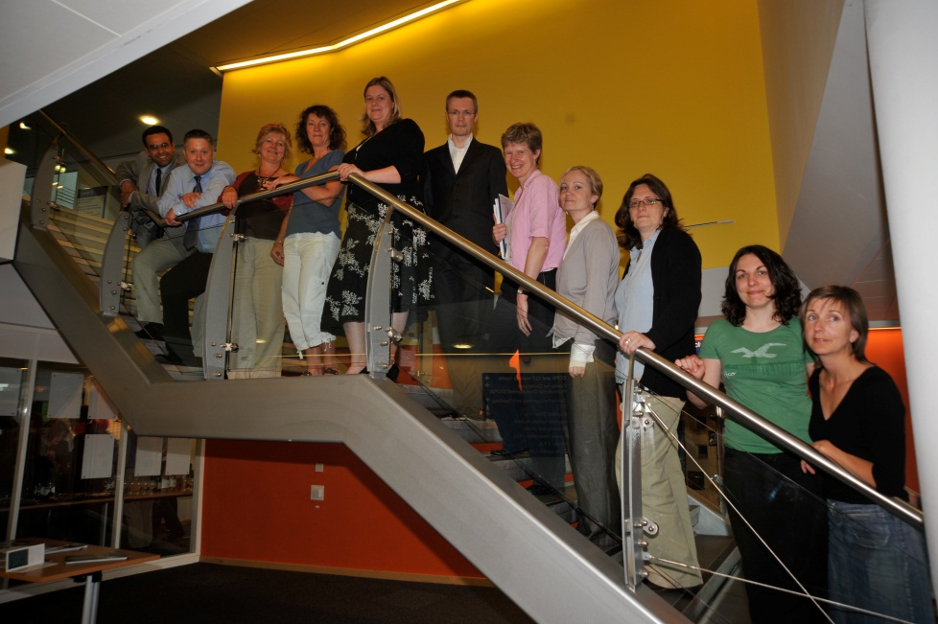
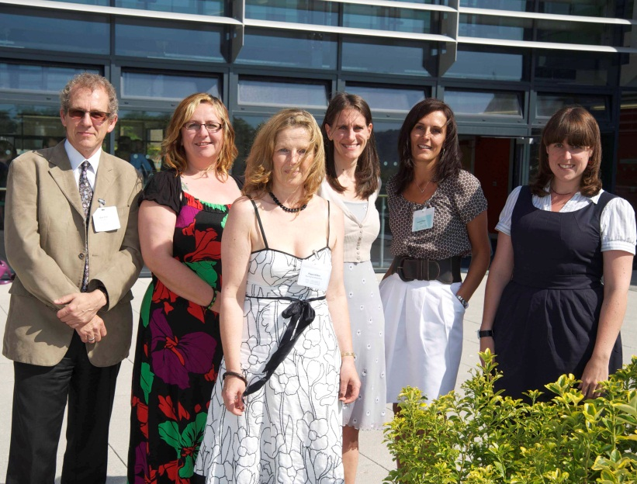
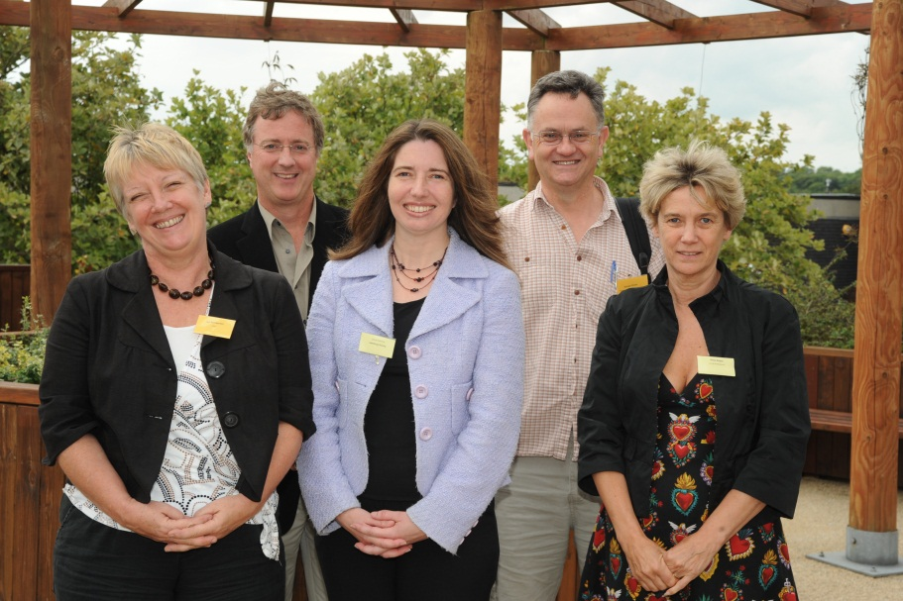
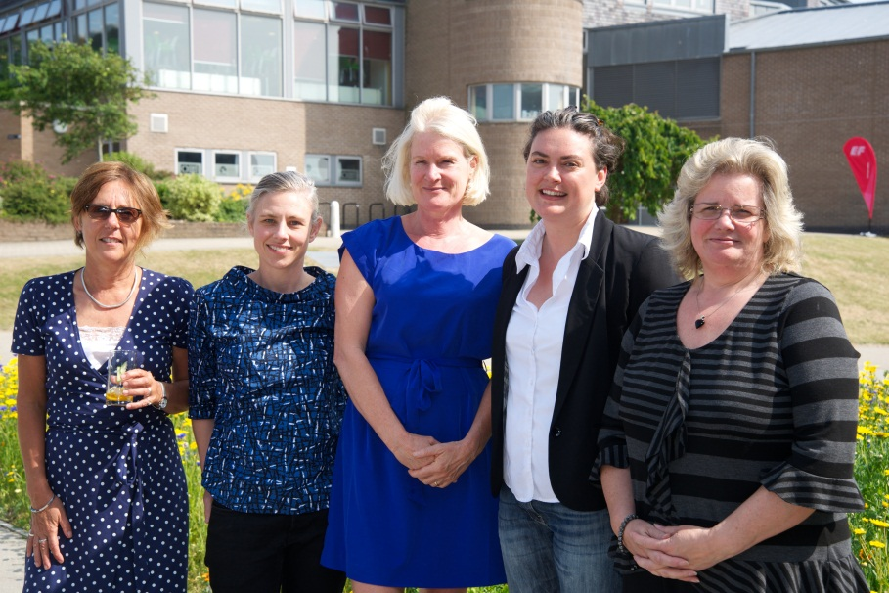
Some of our Excellence in Facilitating and Empowering Learning award winners taken at the Learning and Teaching Conferences

Slide 196


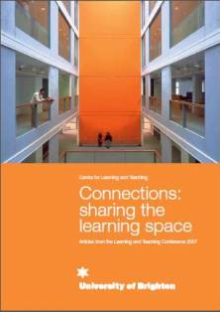

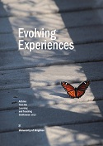
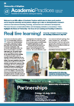
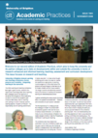
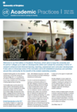
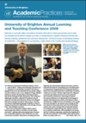
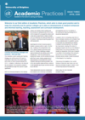
Some research and practice publication outputs

Slide 197
ppt etc materials freely downloadable oasis-for-learning.net

Slide 198
Some more

Slide 199
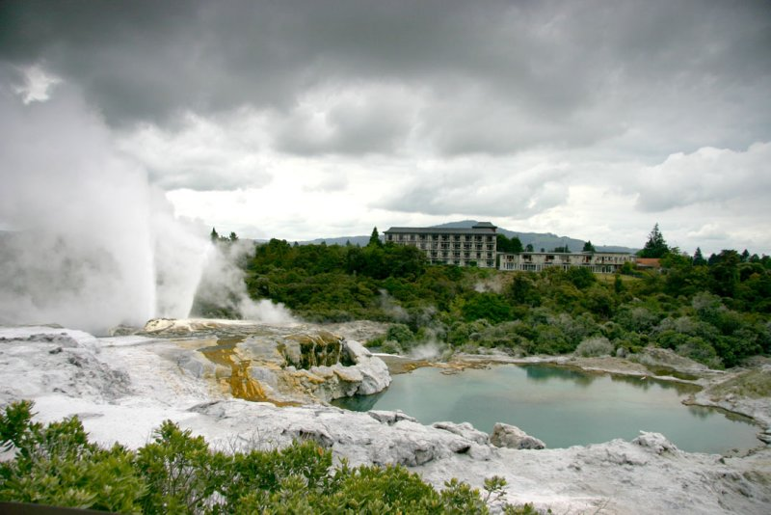

Slide 200

Questions
What are the benefits and challenges of a parity of esteem for and a drive to support and develop research and research informed teaching (SoTL)?
What do you do or could you do to further develop research into and the scholarship of teaching and learning at Nottingham university?
A community of SoTL researchers and practitioners?

Slide 201

Curricula need to become a series of open-ended spaces rather than a series of permissions to proceed that focus on compliance and rule-based models.
Such open-ended curricula will be provisional, unstable and uncertain, and will reflect the translocational state of the university of the future.

Slide 202
Developing a research and writing career
Addn materials

Slide 203
Developing grant proposals and strategies for raising funds to support academic programmes and activities. Bidding for funding for research and development activities

Slide 204
grant proposals and funding bids
As leaders of research and development we are increasingly expected to find funding which brings income, recognition, and sometimes communities.( and sometime just stress)
What grant proposals and development funding bids have you been involved with?
What worked?
What did not work so well?
What lessons have you learned to share and
What suggestions do you have?

Slide 205
Please share experiences - what experiences have you had with research and development bids?
What have you learned from any research and development bids you have been involved with?

Slide 206
Steps
Find the sources of bids- networks, online, regular providers, through Government and national or international bodies and funders – from the ESRC to the wellcome trust, charitable trusts, current associates local, national and international links
Don’t try bidding for something which is out of your field the new seems easy, it isnt there are experts out there- unless you can nuance the field differently in a convincing fashion

Slide 207
What outcomes do you seek –locally personally institutionally, nationally, internationally in terms of the discipline and focus?
Why bid for this now? Is it a priority? topical?
What are your strengths likely to be?

Slide 208
Find internal and external partners you can trust to do the work - preferably with a profile.-from whom you can learn, wit whom you can work as equal partners.
You are going to need researcher support or do it yourself
You re going to need admin support
Beware of colonialism and imperialism

Slide 209
Writing the bid
Address the criteria!! Use them as headings and work to them, in stages
Use their key terms
Establish your credibility to do this work and the credibility of your diverse team
Use research based underpinning and claims in your arguments as you develop a mini lit review ,methodology and methods etc (*this is research territory-this is like PhD proposal with finance, and previous credibility)
Develop a logical and convincing narrative

Slide 210
Don’t overclaim what you can do in the time available, for the cost, they wont believe you and it undermines the rest of the bid
Make your intended outputs and outcomes clear and focused on the bid, measurable (targets ) and in line with its aims-
Don’t add in people as partners who are not likely to work with you-always ask in advance
Select a few people to partner with who have a track record and credibility in the field
Co develop with others -this means you have constant peer review and enhances the quality, adds their skills in , enables their buy in and engagement.

Slide 211
Cost your time and that of others accurately but for viable activities and resources - is it FEC??(full economic costing) or can your unit dept school etc cover some of the costs ?
How will you fit this work in with your own time should you win the bid?

Slide 212
Central university/college peer review builds ins and enhances quality so likelihood of success.
Do get your writing checked and counterchecked by the research office (or similar), and peers who have been successful previously
Present it well-all of this signals a quality product

Slide 213
Review of a bid
Please review this bid for the Staff and Educational Development Association small grants
(£1000) a yearly opportunity – usually 5 are awarded this year we had 34 bids
A team (the committee) of 6 or 7 read them through( 2 people read each of them, only the chair reads all of them )
Successful bidders get a mentor to support the work
They are expected to publish in SEDA publications and
Deliver at SEDA conferences

Slide 214
Questions for scrutiny
First see if it addresses the criteria
Is it well planned?
Well written?
Are the bidders credible enough- as researchers or developers, in the field ?
Well costed financially ?
Well costed in terms of time?
Are there achievable outcomes and outputs?
Might there be any other things to take into account which are not on the list of criteria? What should NOT sway you in your decisions?
Addn material

Slide 215
Thoughts and plans
Following our discussions- what are
the implications for you and
writing bids, and
carrying out the work?
What key tips have you
for those undertaking research and development bids
For yourself next time?

Slide 216
supervision
Supervising students' research work / project work - Honours, Masters, PhD
Research informed insights into successful supervision
Approaches and insights for guiding and supervising research students successfully-managing expectations, planning, building and maintaining good working relationships
What is a good supervisor? personal learning and institutional dimensions of the role
Supervising the project –questions, conceptual frameworks, and working at a conceptual level
Students’ engagement in a ‘dialogue’ with the field, making a contribution to knowledge
Addn material

Slide 217
Leadership revisited-
Leadership and management of academic programmes, departments and institutions, people, processes, –styles, challenges , choices in context- revisited-
Your roles, planning ……moving forward and up or sideways

Slide 218
In a week in my role ------which is leadership, management, other?
Working on the learning and teaching strategy with the pvc pulling together groups to advise –
Sharing and contributing ideas round the sector concerning changes in HE (white paper consultation) email, London meeting.
Agreeing maternity leave for one staff member, and reduction in time towards retirement for another- planning and actioning replacements
Budget meeting with coordinator and finance person
Supervising PhD student,
Teaching undergraduate seminar
Continuing to write a research bid –costings, theoretical framework
Meeting about research excellence framework-my centre’s inputs
Some writing
Running a writing workshop

Slide 219
A week in your role? Which is leadership, management, other?please discuss

Slide 220
Leadership
types of leadership
vertical, horizontal and distributed or blended leadership

Slide 221
Some analogies and definitions
Authoritarian — strong on tasks, weak on people skills
Country Club — strong on people skills, weak on tasks
Impoverished — weak on tasks, weak on people skills
Team Leader — strong on tasks, strong on people skills

Slide 222
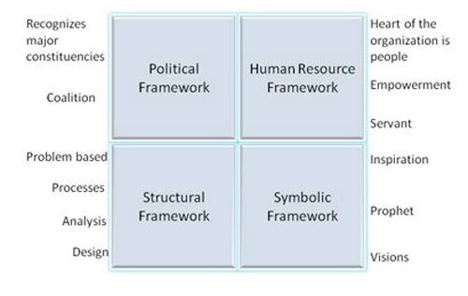
Bolman and Deal's Four Framework Approach to Leadership

Slide 223
What kind of a mixture of leadership and management is your current role?
What are your strengths in these various areas?
What would you like to strengthen? What role would you like to move into?

Slide 224
Times are changing
McKinsey’s six leadership lessons for hard times
1. Confront reality
2. Put strategy centre stage
3. Be transparent with employees
4. Communicate with investors
5. Build and protect the culture
6. Keep faith in the future
(management consultants, 2009 in Middlehurst 2010 p 84)

Slide 225
In September 2009, McKinsey conducted an online survey of executives
representing a range of regions, industries and functional specialties; they
received 763 responses, 434 from men and 329 from women (Desvaux et al.,2009). The survey reports on the respondents’ views of the organisational capabilities and leadership behaviours needed to move through the crisis to recovery. Two sets of capabilities were rated as most important for managing companies through the crisis.
These are leadership (having leaders who can shape and inspire the actions of others to drive better performance) and direction (the capacity to articulate where the company is heading and how to
get there, with the ability to align people appropriately). These organisational capabilities remain important for recovery, along with innovation.

Slide 226
At an individual level, the kind of leadership behaviours needed during and after the crisis were the same, namely,
presenting an inspiring vision,
Defining expectations and
rewarding achievement. In addition
“challenging assumptions and encouraging risk-taking and
creativity” as a leadership behaviour needed to reinforce innovation.
in the post-crisis era – described as “the new
normal” – organisations require far greater flexibility and a different way of
working among members of the top team.

Slide 227
Furthermore, the more hierarchical and
less collaborative the organisation, the bigger the challenges of change will be.
“Dynamic management” or decision-making-under-uncertainty (Lowell,
2010) requires the use of different techniques such as scenario planning and
decision trees (to structure and sequence decisions) as well as the ability of key
decision makers to share information and debate issues in order to make timely
decisions. Corporate processes and protocols (including the timing, format and
length of meetings, decision-making rights and required attendees) need to be
redesigned, as do budgeting processes and financial planning, if they are to
support “just-in-time decision-making”. “Organisational agility” (Sull, 2010) is
needed at three levels. Strategic agility requires an effective combination of
patience and boldness to recognise and seize those opportunities that can
create significant value; this capability can develop from having a variety of

Slide 228
small-scale activities to explore potential opportunities. The second level,
portfolio agility, involves the capacity to move and reallocate resources across a business or businesses. The key is to invest in developing general
management capabilities so that there is a cadre of managers who can be
redeployed in line with emerging opportunities. The source of the third
capability,
operational agility, rests on being able to increase revenues and cut
costs within the core business more quickly and effectively than rivals. Having
access to market data and sharing this widely is one source of advantage;
another is translating corporate priorities into individual objectives and
focusing attention, resources and effort on those that are truly critical. Such a
performance-oriented culture requires “constant injections of urgency, effort
and enthusiasm” (Sull, 2010, p. 56).
The contribution of leadership development to building adaptive
and generative responses
Leading in challenging times places a premium on qualities of courage,
determination and emotional resilience. Organisational leaders need to overcome fear, denial and blocks to learning, in themselves, within their top teams and more widely in the organisation (Dean, 2010). In UK higher education, few heads of institutions, their top teams and other leaders in the
institution have experienced the economic context, competitive pressures and levels of uncertainty that are likely to persist in the immediate future. There are a range of different types of developmental interventions and learning opportunities that can assist leaders, managers and governors of institutions, individually and collectively in these challenging times (p 85-6)

Slide 229
For individuals in leadership, management and governance positions who are in the front line of change, the going is likely to be tough and to get tougher. Yet these leaders will be called upon to stimulate, inspire, and engage colleagues if they are to succeed. Therefore, a capacity-building agenda is needed at both the institutional and individual levels. Developmental opportunities should offer new ideas that stimulate the imagination and energise leaders. They should also seek to build confidence, create networks and offer guidance and support to those facing significant personal as well as professional challenges.
Through engaging with leaders, managers, governors and their institutions and working across sectors and countries, it is possible to promote and develop the kind of “re-generative” leadership that is needed both to address Clark’s “demand-response imbalance” and to build new models of HE for “a
world utterly changed”. P89 Robin Middlehurst ‘SUSTAINING LEADERSHIP IN CHALLENGING TIMES’ Higher Education
Management and Policy journal 22/3 2010

Slide 230
Building confidence to lead and manage change
Strengthening governance
Positioning, leading and managing “the agile university”
Widening horizons and developing new ways of working

Slide 231
Many of these sound like operating under crisis (war, economic meltdown) though some sound normal
How long can one work at the pitch level of crisis?
and if you can, can those working to your role?

Slide 232
Distributed leadership
‘In comparatively recent years, universities
have started to take the business of leadership training more seriously. But this has
tended to be bounded by the conventions of ‘great man’ theory and only those
holding formal, senior positions are usually invited. If leadership is genuinely distributed
what does this mean for leadership development?’ (Bruce Macfarlane, 2013)

Slide 233
Bruce McFarlane challenging leaderism
Distributive leadership now mainstream -how do academics react?
‘Interest in distributed leadership in higher education is not in itself anything new
and has featured in the work of Whitchurch, on the ‘third space’ professional (2008),
and Bolden, Petrov, and Gosling, in their multi-level analysis of professional practice
(2008). The role of full university professors who as ‘intellectual leaders’ may not
necessarily hold a formal managerial position has also become the subject of recent
attention and enquiry (Macfarlane, 2012;). What does
appear to be new is that distributed leadership has now become a mainstream, and
even perhaps dominant, mode of analysis …It is no longer an alternative or marginalized way of understanding leadership in higher education. Contesting who counts as a leader in this way has both
practical as well as theoretical implications. In comparatively recent years, universities
have started to take the business of leadership training more seriously. But this has
tended to be bounded by the conventions of ‘great man’ theory and only those
holding formal, senior positions are usually invited. If leadership is genuinely distributed
what does this mean for leadership development? We will know that distributed
leadership has started to have a real impact when university development programmes
start to considerably broaden their pool of recruits.
Distributed leadership represents part of a broader challenge to what has been
termed ‘leaderism’ or the ‘leaderist turn’ (Morley, 2013; O’Reilly & Reed, 2010).
This critique suggests that leadership has turned into a dominant discourse in the
public sector, including higher education, in the heroic mould of ‘great man’ theory.

Slide 234
Some current versions, issues and developments
Distributive leadership – sets out to involve everyone in decision making, and ownership and so practice and responsibility of these decisions. Perceived as democratic sometimes perceived as passing the work down.
Loved – involvement , and
Resented- busy research and teaching academics don’t want to take this role on too.

Slide 235
Please consider
What are the main issues indicated in the literature in relation to leadership and management currently?
What are the challenges and tensions in your context?
kind of a leader and manager are you?/do you think your organisation needs you to be?

Slide 236
Which of the dimensions and versions of leadership or management would you use to sort out these scenarios
1) You have just taken over a new role leading a centre/unit/department. The people you will lead and manage keep saying ’ it doesn’t work like that here’ and are actively unwilling to engage with your suggestions for new development s in the work you all do (and which you were explicitly hired to introduce) eg introducing a research informed element, changing some responsibilities, bringing in workload management.

Slide 237
2 You are leading a research team. The data is collected, and you need to present on it at a major conference . The researchers both say it is not ready, and they wont let you use it .
3 One of your colleagues has just finished their doctorate , which you ensured was funded, with time and money. It is a very interesting piece .He tried to publish one article but when the feedback was negative he stopped working on it and since then has refused to try and publish. This means he is not research active so cannot supervise , examine research work…

Slide 238
4 Your new line manager, the pro vice chancellor for teaching and learning (or research or..) wants you and your team to lead on a major change project across the university eg turning the curriculum over to problem based learning or changing module size from 15/30 to 20.Who will need to be part of this?how can you work with them? What are the issues and practices for you as leader?

Slide 239
Developing- yourself
It is important that you set challenging goals for yourself
You determine your own means of achieving these goals
The goal is important to your self-concept
You actually attain these goals (Hall 1976)
One thing you want to go off and do NOW to develop as a
Leader/manager
Researcher
Teacher

Slide 240
Strategies for academic workload management
Managing colleagues, time and work.

Slide 241
Planning and strategizing your career (from day 1) -milestones

Slide 242
Working with and developing your own examples of leadership and management of teaching and learning and people.-Models

Slide 243
Topical issues and tensions
Reflection
Your choices and planning

Slide 244
Workload planning
Is workload planning of your own work and others part of your job?
In your institutional context what is the workload planning model?
Against agreed needs and targets
proportions and % of peoples hours
Be aware of the total hours allocated for a role (at UoB its @550 for teaching within a 1600 hr workload and all academic staff have 20% for scholarship/research and in CLT we have 0.5% for admin)
Negotiate workload planning with those involved but still retain control of the decisions made since you have to make the overall workload balance.

Slide 245
In my centre we then operate in relation to the agreed themes which are built from the learning and teaching strategy
Professionalisation
e and blended learning
curriculum fit for purpose
research and teaching links/ students as active learners and researchers
student engagement
Peoples hours are agreed and allocated in relation to the themes as proportions of the whole-through negotiation

Slide 246
overall context
any rules
Negotiation
flexibility

Slide 247
How do you plan workloads or how would you plan them?
What important issues, and concerns and problems will/ might you encounter?
Problem solving and crisis management

