Slide 1
Academic writing workshop – supporting your students’ writing for postgraduate submission and publication
Gina Wisker
University of Brighton

Slide 2
How can we support and enable postgraduate student writing? In this workshop we will look at
supervising students’ writing from research question to submission, considering
Different forms of writing in the thesis
Managing time and planning the writing
Overcoming writing blocks
Supporting the writing of a sound abstract
Developing a dialogue with the literature and writing the literature review
Helping students develop their own confident voice
Writing the methodology and methods and data analysis sections

Slide 3
Developing themes and structuring coherent chapters
Writing using argument and story
Conclusions and beyond
Giving useful feedback
Setting up writing groups, and reflective writing
Throughout we will be considering both the PhD and MA by thesis and by publications.
The final section will be advising and supporting students through publication politics .
Please bring with you a piece of your student’s work or your own. We will also look at ways of supporting and improving this piece of writing. ????

Slide 4
Brighton Palace Pier

Slide 5
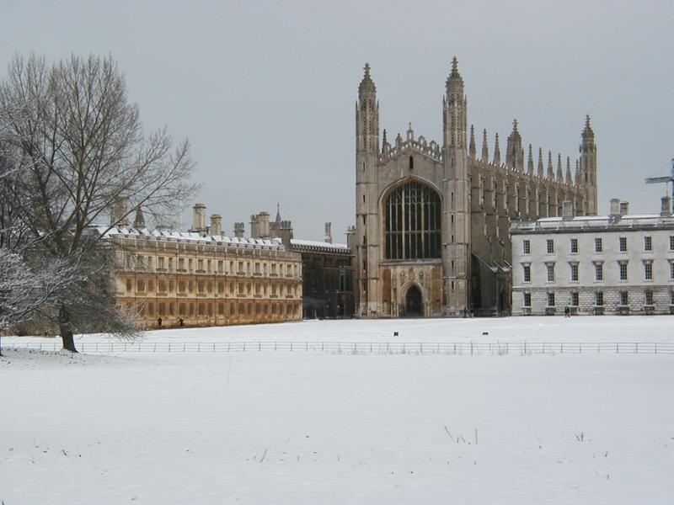
King's College Chapel
 | C

Slide 6
ppt etc materials freely downloadable at oasis-for-learning.net

Slide 7
Outcomes and Issues
What outcomes do you want from the workshop?
What
issues
challenges and
stories do you bring about your writing,
and supporting your students’ writing?

Slide 8
outcomes
Improve my writing skills esp in English
Encyclopedia entry shape –shapes –writing for different outlets
How to write logically-to a structure-rewriting and finding the patterns helps
Coherence , conclusions and synthesis in each chapter -eg finding link words and phrases
Translating the PhD into articles
Methodology and methods chapters
Its all a struggle! But how to write…esp litreview
Incorporating and backing up opinions with scholarship
Discussing the data and the phrases to use
‘It was colourful and musical and now it is painful and quiet’ –Makhosazana
Data-collect- Select -pattern and theme- variation- interpret – findings-= so?? –implications and contribution( so what? Why bother?what can I do with it or take away from it?)

Slide 9
Issues and challenges
Referencing fundamental thinkers and main contributors- and themes- then up to date – but only what’s relevant

