Slide 2
" Learning Outcomes" in program planning, delivery and evaluation based on National Qualifications Framework
National Commission for Academic
Accreditation and Assessment
Facilitators: Prof Gina Wisker & Gabriel Jezierski
Conveyor:
National Commission for Academic Accreditation & Assessment
& the British Council
October 2012

Slide 3
Who are we?
Professor Gina Wisker -Head of Centre for Learning and Teaching, Professor higher education & contemporary literature, University of Brighton: National Teaching Fellow, Fellow Royal Society of Arts, Senior Fellow Staff &Educational Development Association, Fellow English Association; University’s Academic Standards committee; Editor Innovations In Education and Teaching International journal .
Gabriel Jezierski – Worked in Scotland, Wales, Northern Ireland and England. National level Quality Improvement: Former Head of Policy and Partnerships (Wales and Northern Ireland) Higher Education Academy working with the QAA; Head of Learning and Teaching; Fellow of the Higher Education Academy; Member of the University Academic Quality and Standards Board and Senior Management Group. Director Open Learning Foundation. Professional Coach.

Slide 4
Relationship? How do you build?
How do YOU STRUCTURE and package these?
i.e. specify the program - ‘field of study’?
SUBJECT MATTER
EXPERT
Outcome ?
How do you describe
what happens here?
Year 1
Year 2
Year 3
WHAT attributes do you
expect a student to
have as a result of
studying and learning?
Start
Finish
Program
Course
Any program …
How do you assess?
How do you map?
A subject
Medical Sciences
SUBJECT DOMAIN
How do you know you
have achieved?
Engineering
Postgraduate?
Undergraduate?

Slide 5
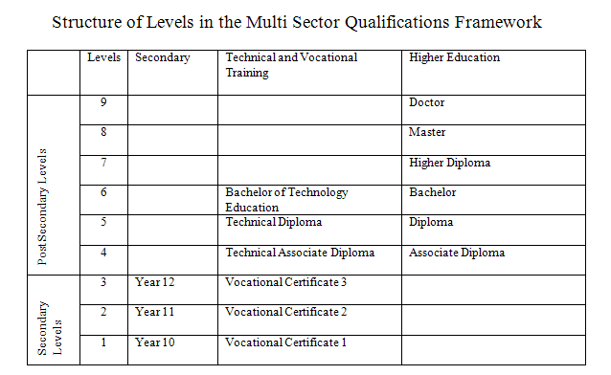
Relationship? How do you build?
Any program …
Level 5
A subject
Level 4
Level 3
Start
Finish
Level 2
Level 1

Slide 6
How do they make informed decisions about ..
(i) what to study at university? (ii) the level they are aiming to achieve?
BSc Bioinformatics
MSc Opthalmology
BAMass Communication
Their understanding ..?

Slide 7
How do you Manage the Quality of an Outcomes-based approach to Learning?
The National Qualifications Framework
How can you ensure consistency within the Kingdom in
the standards of student learning outcomes
regardless of institution attended?
Benchmark?

Slide 8
LEARNING OUTCOMES: The ‘Big Picture’
Teaching and learning strategies
Manage Quality
Learning ?
LEARNING OUTCOMES
AIMS
PROGRAM
(The curriculum)
THE SCHOOL OF …
Course Aims and Objectives
PROGRAM SPECIFICATION
Mission
ASSESSMENT
PROGRAM DESIGN
practices
Constructive alignment

Slide 9
What are we trying to achieve from this workshop? (1)
So ..
Participants will:
obtain a better understanding of the concept of learning outcomes
learn how the use of learning outcomes relates to broader questions about student learning
have the opportunity to develop learning outcomes within their own institutional context

Slide 10
What are we trying to achieve from this workshop? (2)
Learn how course LOs can be mapped to show the LOs for an entire programme
Consider how students’ achievement of LOs can be assessed
Examine the quality assurance questions related to the use of LOs with particular focus on NCAAA Standard 4 and related documents
Reflect on the 5 themes and lessons of UK best practice from QAA Institutional Audit

Slide 11
The Learning Outcomes of the Workshop
On successful completion of this workshop you will be able to:
Discuss and explain new theories, issues and best practices related to developing and approving ILOs at program and course levels for the different disciplines.
Refer to and use subject-benchmarks and professional standards and resources to develop, implement, and monitor program ILOs and curriculum considering NCAAA and international requirement.
Provide support and guidance for faculty, support groups and related committees in planning and developing ILOs for programs and courses in specified fields of study, mapping them across levels, skills, and courses.
Design, implement and monitor T, L & Astrategies for the different ILOsat program and course levels that are appropriate for specified disciplines using NCAAA specification and reporting templates.

Slide 12
LEARNING OUTCOMES: Summary Overview
DAY 1
DAY 2
The rationale
WHAT are they and WHY are they important? (i.e. Outcomes-based education in Teacher Education)
Subject domains, knowledge construction and student learning
Key concepts ….
The process and use of learning outcomes in Program and Course level Planning
( NCAAA Standard 4)
[Program Specifications]
Principal Elements in the Qualifications Framework
Evidencing the achievement of Learning outcomes: Assessment
Use of the Domains in Program Planning and Student Assessment
Curriculum and Assessment Mapping
Quality assurance of the outcomes-based approach
Verifying Consistency with the Qualifications Framework –
Action Plans - Moving to and Managing an Outcomes Based Model
Summary/Conclusions

Slide 13
Activity 1: Your expectations …
Write down your objectives (outcomes) for the workshop
By the end of this workshop I want to ….
Write down what you consider learning outcomes to be.
Learning outcomes are ……

Slide 14
Audience analysis

Slide 15
Gina
SESSION 1
9.0 – 10.30
What is Outcome-Based Learning (OBL) and how is it being developed and used in KSA?

Slide 16
What do Learning Outcomes look like? Example from statistics/mathematics course
On successful completion of this course students will:
be capable of selecting, carrying out and interpreting the results of appropriate statistical methods for describing and analysing data sets, in the context of their own research interests;
be able to make use of appropriate software packages to carry out statistical analysis, and to interpret their output in terms relevant to the research field;
demonstrate an understanding of the concepts of sampling variability, bias, sampling error and statistical significance, and their impact on the interpretation of research findings;
have an appreciation of a range of multivariate methods and their use and limitations in a research context.

Slide 17
What do Learning Outcomes look like? Example from statistics/mathematics course
On successful completion of this course students will:
be capable of selecting, carrying out and interpreting the results of appropriate statistical methods for describing and analysing data sets, in the context of their own research interests;
be able to make use of appropriate software packages to carry out statistical analysis, and to interpret their output in terms relevant to the research field;
demonstrate an understanding of the concepts of sampling variability, bias, sampling error and statistical significance, and their impact on the interpretation of research findings;
have an appreciation of a range of multivariate methods and their use and limitations in a research context.

Slide 18
What do Learning Outcomes look like? Generic outcomes
be able to plan and improve their own performance
be able to research new areas of knowledge using both library and online resources
show evidence of having worked in groups and developed group working skills
be able to plan and deliver an effective presentation

Slide 19
What do Learning Outcomes look like? - program-level outcomes
apply….quantitative science and engineering tools to analyze problems (Engineering)
identify and assess central arguments, themes, perspectives, and theoretical frameworks of secondary sources (History, Humanities)
apply the principles, skills and knowledge of evidence-based medicine (Medicine)

Slide 20
What do Learning Outcomes look like? Course-level outcomes in Humanities
By the end of the course, students should have gained: a) a broad experience of reading 18th-century and Romantic writing; b) a sense of major literary developments within the period in relation to their social and aesthetic contexts; c) skills of analysis which are sensitive to the theoretical and critical issues emerging from the literature of the period.
(Module ‘Restoration to Romantics’, English Literature major)

Slide 21
What do Learning Outcomes look like? Course-level outcomes in Medicine
Upon completion of the course the student will be able to:
explain the meaning of key concepts in parasite epidemiology
describe and apply techniques used in epidemiological surveys
critically analyze and interpret ecological and epidemiological data
(Module ‘Parasite Epidemiology’, School of Tropical Medicine, University of Liverpool)

Slide 22
So, why Learning outcomes are important: The Rationale
“Meaningful learning is most likely to be successful if it is goal oriented – i.e., if the learner is aware of the goal (at least in a general sense) toward which he or she is working and possesses expectations appropriate for obtaining the desired outcome”
Shuell

Slide 23
Defn.
“Learning outcomes, naturally enough,
are the performances made possible
by learning – that is, they are what
the learner is able to do
when learning is completed”
Wager and Gagne

Slide 24
5 Types ..
Intellectual skills
Verbal information
Cognitive strategies
Motor skills
Attitudes
Gagne (1984, 1985) and Gagne and Briggs (1979)

Slide 25
What is Outcomes-based Education (OBE)?
An approach to student learning which specifies what the student should be able to do in order to demonstrate that the intended learning has taken place
Contrasts with the ‘traditional’ model which focuses on the material which will be provided by the teacher.

Slide 26
OBE vs traditional model
OBE – student centred – output oriented (hence ‘learning and teaching’)
traditional – teacher centred – input oriented (hence ‘teaching and learning’)

Slide 27
Drivers for the growth of OBE
increased pressure for transparency from students;
employers requiring greater clarity as to what graduates can be expected to know/do;
requirement from governments and media for greater public accountability by universities.

Slide 28
Advantages of the OBE approach
help to guide students in their learning in that they explain what is expected of them, in turn helping them to succeed in their studies.
help staff to focus on exactly what they want students to achieve in terms of both knowledge and skills.
provide a useful guide to inform potential candidates and employers about the general knowledge and understanding that a graduate will possess.

Slide 29
Advantages of the OBE approach
improved communication between teacher and student – shared understanding of course objectives;
more active student engagement; help to guide students in their learning in that they explain what is expected of them, in turn helping them to succeed in their studies.
better communication between teachers – standards and expectations made explicit, inter-relationship of courses better understood;
improved student performance – due to better understanding of what is expected/what will be assessed.

Slide 30
Advantages of the OBE approach The student learning experience
“There is ample evidence in reports that students valued the clarity that the use of learning outcomes had brought to the overall purpose of their programme, the interrelationship between parts of the programme and the nature and purpose of assessment tasks.”
QAA

Slide 31
Perceived disadvantages for staff
can be seen as onerous, involving ‘bureaucracy’, ‘form-filling’ etc ..;
alters the balance of power between student and teacher;
can appear to produce excessive standardisation and stifle innovation;
may appear to reduce the scope for professional academic judgement.

Slide 32
Criticisms of OBE
reduces learning to the achievement of a long list of small outcomes
fails to recognise that ‘the whole may be greater than the sum of the parts’
assumes that all desired learning can be assessed and measured

Slide 33
Outcome Based Learning
It is a “design down” approach to curriculum development. It starts with what students are expected to learn, then focuses on the creation of teaching and learning environments that will assist students to reach the desired learning and finally involves the use of assessment that can provide feedback about the level of learning that has been achieved.
Notes:
There are different elaborations of this approach and multiple levels of outcomes. Yet at the core of OBL is the focus on what student should learn. It is this learning, often expressed in the form of learning outcomes that becomes the guiding principle in curriculum design.

Slide 34
Outcome-based Education
OBE is neither a new concept nor a passing phase in educational technology and is equally applicable throughout the educational continuum from primary school to postgraduate training.
OBE focuses on the end-product and defines what the learner is accountable for. It is not about telling teachers how to teach or students how to learn.
LOs determine what is taught and assessed and can help to identify what is and is not essential. Having a clear idea of the desired outcomes does not necessarily have to be restricting as the methods of achieving the outcomes are still flexible.

Slide 35
OBE in KSA
NCAAA Standard 4 - NQF: Learning and Teaching requires the adoption of an outcomes-based approach, with a range of associated requirements;
Standard documents are provided for course planning, students’ evaluations, etc.

Slide 36
Exercise 1: Group discussion
Consider the NCAAA documents provided, particularly the Course Report, the National Qualifications Framework, and the Course Planning Matrix.
To what extent are these already being used in your institution?
How would you assess awareness of this material in your institution?
What changes need to be made in order to fully implement the NCAAA model in your institution?
10.30

Slide 37
SESSION 2
10.45 – 12.00
Some concepts related to
Outcomes-based Learning

Slide 38
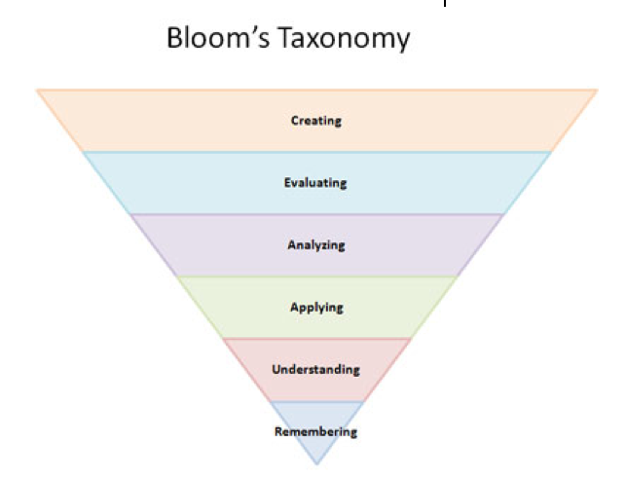
How do you come to understand a subject – your subject?
i.e. how does a student learn it and how do you teach it?
We need look at learning theory

Slide 39
OBE in context
In planning a program / course we need to plan the sequence and structure of the knowledge but we also need to consider it in relation to the learner and cognitive learning processes
For OBE to be fully effective, a change in the philosophy of learning and teaching is required;
In particular, there are significant implications for assessment;
It is important that the use of learning outcomes is not adopted in a mechanistic fashion.
Organizing and structuring knowledge

Slide 40
Relevant concepts
Models for the implementation of OBE
Constructive alignment
Deep and surface learning
Active learning and learning styles

Slide 41
Models for OBE (Based on Hager (1993)
Behaviourist or ‘specific task’ approach
Attribute or ‘generic skills’ approach
Integrated or ‘task attribute’ approach

Slide 42
 | 1 | 2 | 3
Approach to outcomes | Performance is defined as outcome | General attributes predict future performance | Achievement of outcomes inferred from performance
Nature of approach | Can be reductive, mechanistic, routine | Can be abstract, remote from practice | Holistic, captures richness of practice
Effect on curriculum | Leads to a ‘doing’ curriculum | Fragments curriculum into ‘subjects’ | Powerful device for improving all aspects of curriculum

Slide 43
Number of outcomes | Large number of very specific outcomes | Small number of generic outcomes | Manageable number of key outcomes
Approach to assessment | Uniformity, ‘one right way’ | Diversity, may be many ‘right’ ways | Diversity, may be many ‘right’ ways
Control of curriculum | Central | Provider | Joint (including input from students)
Assessment | ‘Checklist’ approach | Requirements may be vague, not clearly specified | Needs careful planning, diversity of methods

Slide 44
Constructive alignment
Developed by Biggs (see Biggs 2007);
‘Constructive’ refers to the way the learner constructs meaning by engaging in relevant activities;
‘Alignment’ refers to the way the teacher ensures that teaching methods and assessment tasks are aligned with intended LOs.

Slide 45
Basic idea
Set objectives
Objectives and Learning Outcomes
Design learning activities
Evaluate results

Slide 46
More detailed model (after Biggs, 2003)
Teaching/learning activities | Curriculum objectives | Assessment tasks
Designed to generate/develop desired ‘verbs’ | Highest level: hypothesise, apply to completely unfamiliar situations, etc | How well are the desired ‘verbs’ displayed?
May be teacher-controlled, peer-controlled, student-controlled | Very good (explain, compare, solve, analyse)
As appropriate to context | Quite satisfactory (classify, cover topics x and y, etc)
 | Just satisfactory (list, describe)

Slide 47
An Instructional Design perspective
“… an intellectually disciplined step
must be taken by the (instructional) designer to infer the nature of the performance that is expected to be attained as a result of learning
i.e. determining what is to be learned is the first step in instructional design ”
Wager and Gagne
STEP 1
in designing
instruction
Identification of expected type of learning outcome

Slide 48
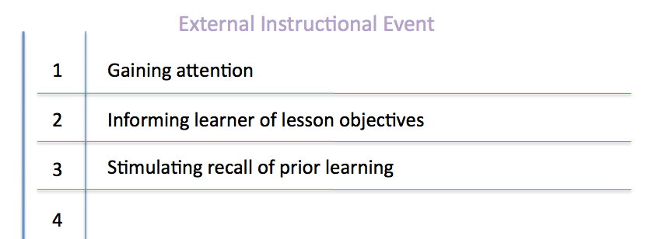
Internal Learning Process
1
2
3
4
Alerting the learner to receive information
Acquiring an expectancy of the results of learning
Retrieval of items in long term memory to the working memory
Selective perception of the patterns that enter into learning
STEP 2
in designing
instruction
9 events of instruction (Gagne & Briggs)
How to arrange the events that will make learning readily occur

Slide 49
Internal Learning Process
1
2
3
4
5
6
7
8
9
Alerting the learner to receive information
Acquiring an expectancy of the results of learning
Retrieval of items in long term memory to the working memory
Selective perception of the patterns that enter into learning
Semantic encoding of presented material, to attain a form
for long-term storage and ready retrieval
Responding with a performance that verifies learning
Reinforcement, by means of which the results of learning
are established
STEP 2
in designing
instruction
Providing cues that are used in recall
9 events
of instruction
(Gagne & Briggs
Generalizing performance to new situations
How to arrange the events that will make learning readily occur

Slide 50
External Instructional Events
1
2
3
4
5
6
7
8
9
Gaining attention
Informing learner of lesson objectives
Stimulating recall of prior learning
Presenting stimuli with distinctive features
Providing learner guidance
Eliciting performance
Providing feedback
STEP 2
Assessing performance
Enhancing retention and learning transfer
in designing
instruction
9 events
of instruction
(Gagne & Briggs
How to arrange the events that will make learning readily occur

Slide 51
The ‘hidden curriculum’
Rowntree, 1987;
Students may adopt ‘instrumental’ approaches;
If ‘overt’ curriculum and nature of assessment are not aligned, students will ‘construct’ their own version of the curriculum to meet assessment needs.

Slide 52
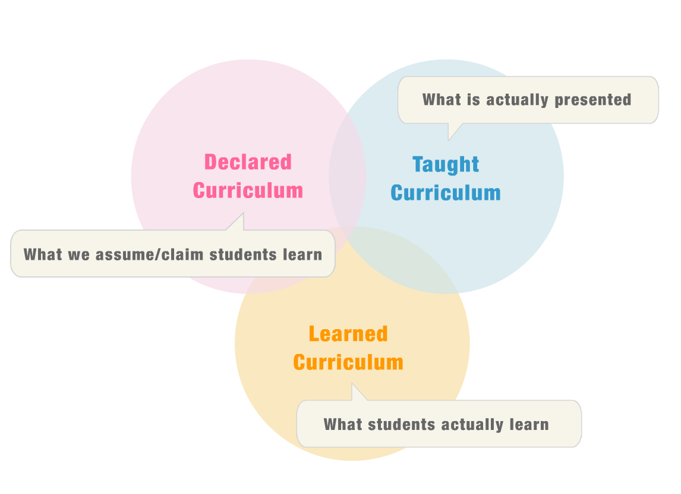
What is Curriculum Alignment? Consistency and Intentionality
Harden, R.M. (2001). AMEE Guide
No. 21. Curriculum mapping:
a tool for transparent and authentic
teaching and learning.
Medical Teacher, 23 (2), 123-137.
Hobson, E.H. (2005). Changing pedagogy.
Presentation at SACS-COC Institute on Quality
Enhancement and Accreditation,
Orlando, FL, July 24-27, 2005.
Notes:
Curriculum Alignment is an iterative process involving systematic study (curriculum mapping, analysis, and interpretation) of curricular components to determine the degree of consistency between what faculty expect students to learn, what faculty think they teach, and what students learn as a result of their educational experiences. Curriculum Alignment ensures that
Faculty teach what they claim they teach
Student learn what they are supposed to learn
English (1978) described the “fictional curriculum”. This is the declared curriculum – what it is assumed the student is learning. This may different from the ‘real” or taught curriculum – that is, the curriculum as it is delivered to the student. It may also be different from the “learned” or “tested” curriculum – what students actually learn.
In a perfect, ideal world, these three circles will be perfectly aligned, that is there will be one circle.
Curriculum Intentionality is a deliberate and systematicalignment of intended program learning outcomes with course-level pedagogies and instructional and learning activities.
Three Intentionality questions:
“Are we teaching what is being tested”? (opportunities to learn)
“Is what we are teaching being tested?” (Content coverage)
“Does assessment measure student progress in achieving intended learning outcomes?” (content validity)

Slide 53
Deep vs surface learning
Ramsden, 1988 and others;
Some authorities also include ‘strategic’ learning;
Not attributes of students – the same student may adopt different approaches at different times.

Slide 54
Deep | Surface
Focus on ‘what does this mean?’ | Focus on the surface signs
Relates new knowledge to previous learning | Learning consists of unrelated parts
Relates theoretical ideas to everyday experience | No reflective relationships

Slide 55
Deep | Surface
Can distinguish evidence from argument | Basic concepts not differentiated from examples
Structures content into a coherent whole | Matches content to imposed ‘tasks’
Driven internally by student’s wish to learn | Driven externally, by assessment

Slide 56
Implications for LOs
LOs should be set in order to encourage deep learning;
Assessment methods should require ‘deep’ approaches to be deployed.

Slide 57
Kolb Learning Cycle
Concrete Experience
Reflection
Conceptualization
Active experimentation
Kolb 1976

Slide 58
Kolb’s learning styles
Observers – focus on facts, like practical examples, not so good with theory;
Thinkers – like theory, concepts, influenced by expert opinion, may lack ‘common sense’;
Deciders – like clear structures and ‘rules’, not so good with ‘messy’ situations;
Doers – learn by trying things for themselves, by making mistakes, inclined to be uncritical of received wisdom

Slide 59
Implications for LOs
Different LOs will suit/require different learning styles;
LOs should be selected to suit a range of learning styles;
Teaching should encourage students to explore their own learning styles and address their weaknesses;
Assessment methods should cover a range to suit all types of learner.

Slide 60
Summing up
This has been a very rapid overview of the inputs of some key thinkers into learning theory;
These views are contested by others – this is a developing field;
Do not neglect the importance of the subject element.

Slide 61
Exercise 2:
In your subject or specialization group, write four student learning outcomes; list the SLOs in order of progression.
12.0

Slide 62
SESSION 3
12.30 – 14.00
Setting Outcomes at
Program and Course level

Slide 63
How to write LOs?
Questions of level and standard (with reference to the NCAAA Qualifications Framework).
The language of Outcomes.

Slide 64
What are learning outcomes?
Learning outcomes are the specific intentions of a program or course, written in specific terms. They describe what a student should know, understand, or be able to do at the end of that program or course.
A statement of learning outcome is a tool used to describe the learning to be achieved by a student in higher education. Learning outcomes are linked by definition to the credit that is attributed to courses.

Slide 65
Credits, Levels and Domains of learning..
Relationship? How do you build?
Outcome ?
How do you describe
what happens here?
Year 1
Year 2
Year 3
Start
End
Course
How do you assess?
How do you map?
Any program …
A subject

Slide 66
Standard 4: Learning and Teaching
4.2 Student learning outcomes must be clearly specified, consistent with the National Qualifications Framework and requirements for employment or professional practice.
Standards of learning must be assessed and verified through appropriate processes and benchmarked against demanding and relevant external reference points. (e.g. NCAAA)
Teaching staff must be appropriately qualified and experienced for their particular teaching responsibilities, use teaching strategies suitable for different kinds of learning outcomes and participate in activities to improve their teaching effectiveness.
Teaching quality and the effectiveness of programs must be evaluated through student assessments and graduate and employer surveys with evidence from these sources used as a basis for plans for improvement.

Slide 67
How do we use learning outcomes?
A learning outcome statement is defined as:
‘an expression of what a student will demonstrate on the successful completion of a course. LOs are related to the level of learning; indicate the intended gain in knowledge and skills that a typical student will achieve and should be capable of being assessed.’
LOs should be written in a manner whereby the learning can be assessed through use of an assessment method. This link with assessment is crucial for quality assurance.
It is also important to note that learning outcomes are linked to level descriptors. The words used imply that the learning is at a particular standard. Linking LOs to level descriptors ensures that we build progression into programs.

Slide 68
The Bologna Process – designed to create a barrier free European Higher Education Area. The use of OBL in the context of the EU is regarded as a move towards a more integrated higher education system.
“The change in emphasis from the traditional teacher-centered to a student-centered learning produces a focus on the teaching – learning – assessment relationship and the fundamental links between the design, delivery and measurement of learning.”
Adam (2004)

Slide 69
Harmonising Learning Outcomes across Europe:
Medical Sciences

Slide 70
Aims, objectives and outcomes (what’s the difference?)

Slide 71
What are Learning Outcomes?
LOs are statements that describe”
(i) what a learner will be able to do as a result of learning.
(ii) the nature of the performance that is expected to be attained as a result of learning
LOs are also statements that describe what a learner will be able to do as a result of teaching.
Some definitions stress that LOs is a sort of contract that teachers make with learners that describes what they will be able to do after learning that they could not do before, the 'added value' of teaching.
-------------------------------------------------------------------------------------
However the connection between teaching and learning is not a simple one. Just because knowledge or skills are taught does not mean that particular knowledge or skills are learned. Many factors can interfere with the achievement of outcomes: the existing knowledge of the learner, the relevance or usefulness of the material presented, the skills of the teacher.

Slide 72
Difference between Aims and Outcomes?
Aims are general statements concerning the overall goals, ends or intentions of teaching.
Outcomes are the individual stages that learners must achieve on the way in order to reach these goals.
For example, to be able to take blood pressure using a sphygmomanometer, the student has to achieve a series of outcomes, e.g., to explain procedure to patient, to position cuff correctly, to inflate to correct pressure etc, etc.

Slide 73
Aims, objectives and outcomes
The difference
aims are written in terms of teaching intention and indicate what it is that the teacher intends to cover in the block of learning (curriculum coverage).
Learning outcomes are descriptions of what the learner is expected to learn in the period of learning defined.
Aims are therefore more about teaching and the management of learning, and learning outcomes are more about the learning that is actually to be achieved by the learner.

Slide 74
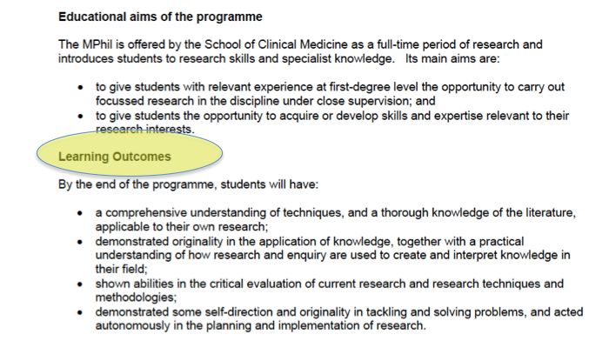
Aims, objectives and outcomes (Example)

Slide 75
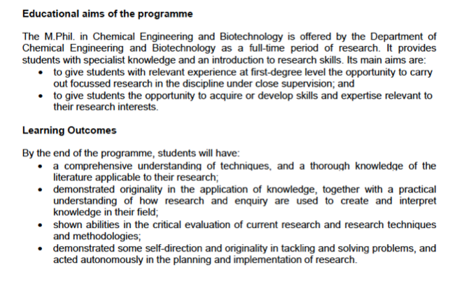
Aims, objectives and outcomes (Example)
M. Phil Chemical Engineering and Biotechnology

Slide 76
Aims, objectives and outcomes (Example)

Slide 77
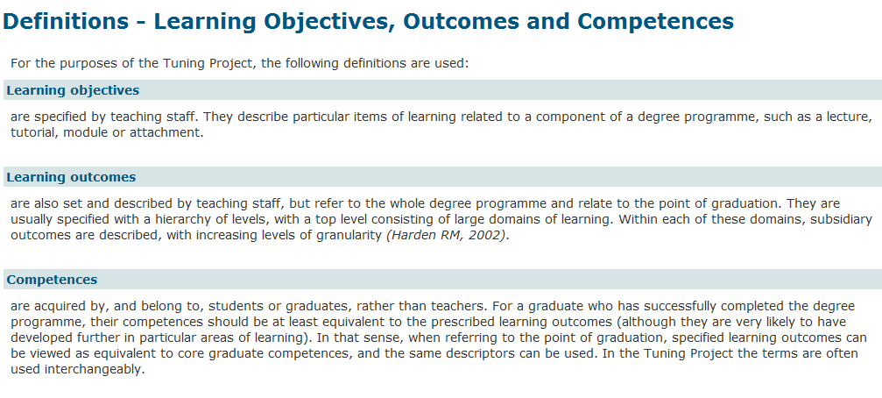
Aims, objectives and outcomes and ??

Slide 78
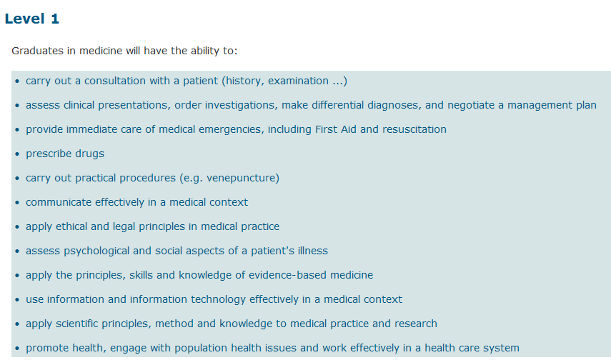
Aims, objectives and outcomes and ??

Slide 79
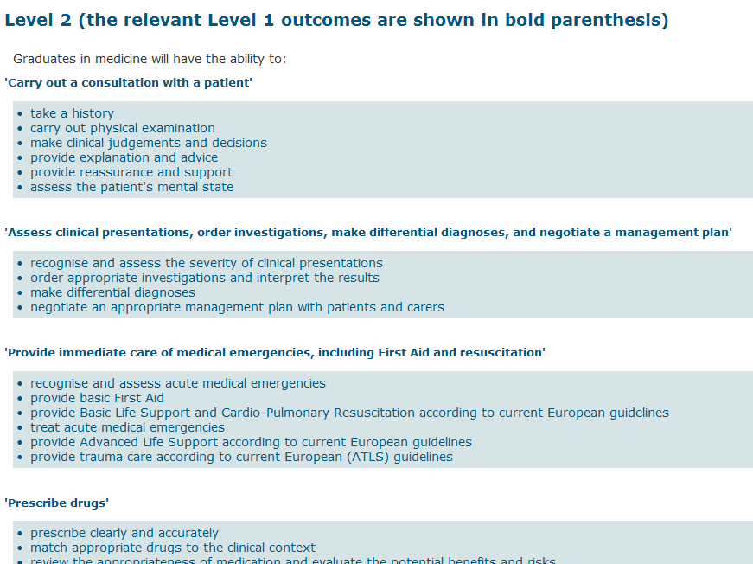
Aims, objectives and outcomes and ??

Slide 80
We have course objectives, why do we need outcomes for individual teaching sessions?
From a curriculum perspective the learning objectives from each taught session should fit together coherently, building towards the overall aims of each module and the whole curriculum. If learning objectives are not known for each session then it is impossible to see how the whole curriculum fits together. It becomes impossible for teachers in different phases of the curriculum to see what students have learned in other areas making managing and auditing the curriculum more difficult.

Slide 81
Constructing Learning Outcomes (LO)
An LO should ideally contain three parts that deal respectively with:
1. BEHAVIOUR: an action verb to describe what participants will be able to do as a consequence of a learning activity
2. CONDITION: an environment or situation in which the student will perform the behaviour or the tools/information they will be given when they demonstrate their learning
3. CRITERIA: describing the limits or range of an acceptable response, i.e. addressing the question of how well the learner has to perform for one to be able to say that the LO has been achieved?

Slide 82
Learning Outcome: Example 1
“Given a set of data the student will be able to compute the standard deviation.”
Condition - Given a set of data
Behaviour - the student will be able to compute the standard deviation
Criterion (implied) - the number computed will be correct.

Slide 83
Learning Outcome: Example 2
“At the end of this study-unit, students will be expected to be able to analyse and interpret a text in detail, using different approaches from literary, rhetorical and/or linguistic theories.”
Condition- a text is provided for analysis and interpretation
Behaviour- analyse and interpret
Criterion- detailed analysis/interpretation using different approaches

Slide 84
Can I modify LOs to make them more demanding?
LOs can be made more difficult or demanding depending on the degree of understanding or levels of experience of learners. You can change the active verb to a more complex one or you can add specific conditions or limits.
For example, simple LOs might be to list or state facts, formulae or definitions. More complex LOs might ask learners to apply or use knowledge in a particular context that might not have been met before. This is more cognitively demanding and really tests whether learners have deeply understood concepts. Finally the highest levels of LOs ask learners to solve complex problems by, for example evaluating or analyzing evidence or synthesizing information. To critically evaluate the causes of something involves not only a deep understanding of detailed factual information but also an ability to make complex judgments about the validity of evidence.

Slide 85
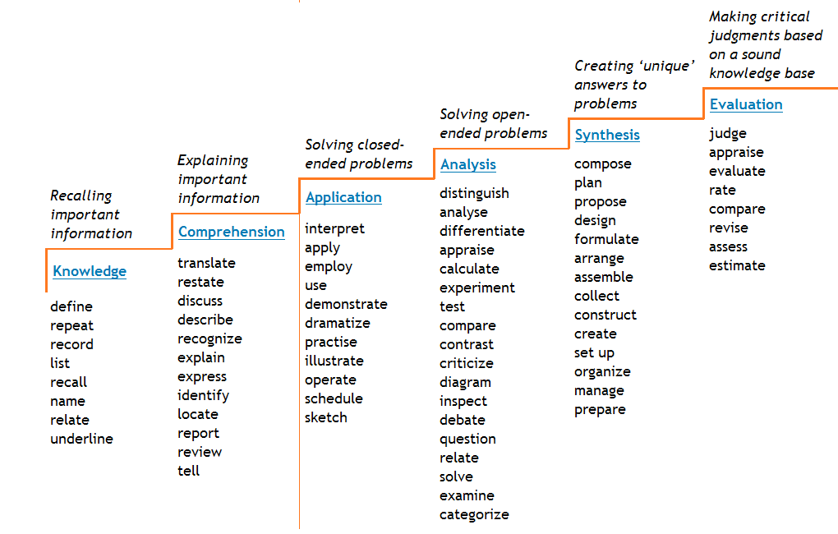
VERBS ..

Slide 86
Examples of Intended SLOs (1)
The Preliminary (Yr. 1) will enable you to:
Select topics of interest from a pre-defined list
Devise a search strategy using library and the internet
Access and search relevant databases and search engines used in clinical and scientific research
Appraise data (understand strengths and limitations) from the literature
Understand different forms of scientific literature (e.g. primary studies, review articles)
Produce a scientific written report of specified length that collates information gathered from the different sources
Summarise the report clearly and concisely in lay terms
Utilise appropriate software (including word processing, figures/tables and referencing) to produce a scientific written report
Understand what constitutes plagiarism and how to avoid it
Medicine – Manchester Medical School, 2011

Slide 87
Examples of Intended SLOs (2) – Engineering
INTELLECTUAL QUALITIES
I1 Apply proficiently engineering principles, quantitative methods and computer software to the analysis and solution of engineering problems taking appropriate account ant limitations of the approach.
I2 Demonstrate an ability to identify, classify and evaluate the performance of systems and components using analytical methods and modelling techniques and apply a systems approach to the solution of mechanical engineering problems.
I3 Investigate and define an engineering problem and identify associated constraints - environmental and sustainability limitations, health and safety and risk assessment issues.
I4 Be creative in the practical solution of problems, development of innovative designs and ability to work with technical uncertainty in unfamiliar situations.
I5 Manage competently the design process, appreciate customer and user needs, evaluate outcomes, assess commercial risk and manage cost drivers.

Slide 88
Examples of LOs (3)
Medicine - Year 5
At the end of the year, you should:
Feel confident about your prospective role as a FY1 Doctor (Self & Tutor Assessment)
Be able to recognise personal stress and know how to obtain support (Self & Tutor Assessment)
Be able to function as a team member (Self & Tutor Assessment)
Recognise your limitations in skills and knowledge and the importance of involving other people in these circumstances (Self & Tutor Assessment)
Understand how your attitudes to medical practice affect your approach and be able to explore these attitudes (Self & Tutor Assessment)
Be able to seek out information from a wide range of sources about clinical problems (Self & Tutor Assessment)
Be able to analyse critically the information that is retrieved, and apply it to a clinical problem, using reasonable judgement when dealing with uncertainty. (PMP/ Self & Tutor Assessment)
(Manchester University, Medical School, 2011)

Slide 89
Examples of LOs (4)
Business Supervision and Management
Identify the challenges and opportunities of being a manager in today’s high tech global economy.
Demonstrate proficiency in using latest Project Management technology tools and software.
Discuss good business ethics, social responsibility, and the vital role in the establishment of trust and honesty expected of supervisory/managers and leaders today.

Slide 90
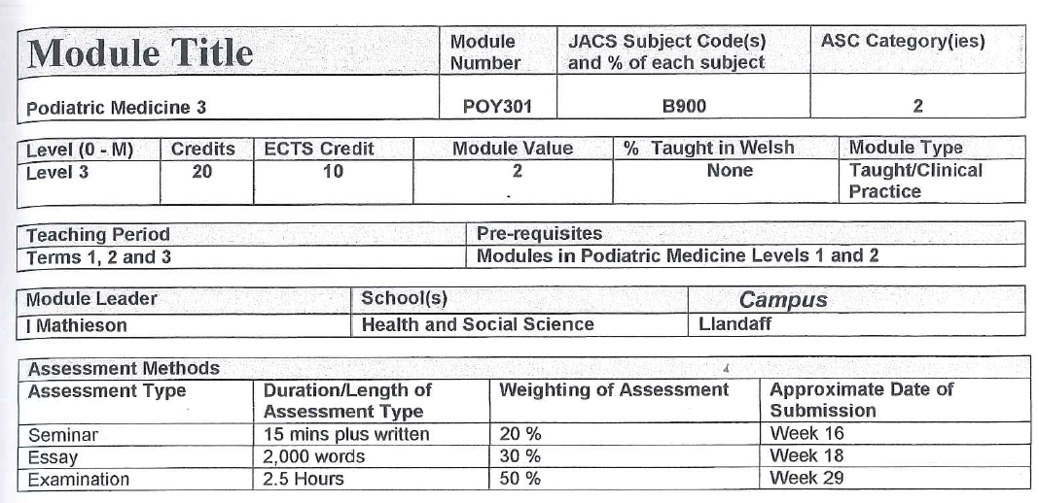
Medical Science - Podiatry (Case Study): Program documentation: Level 3

Slide 91
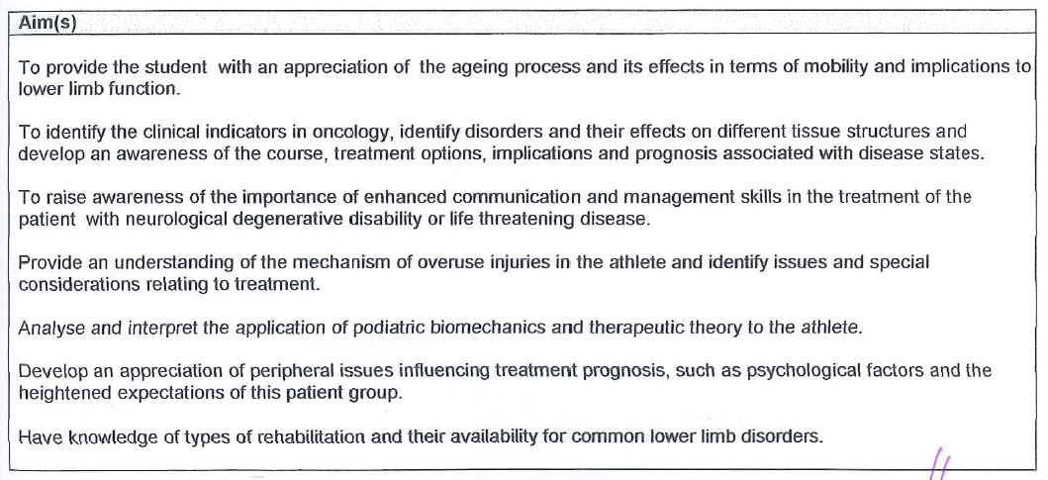
Medical Science - Podiatry (Case Study): Program documentation: Level - 3 Aims

Slide 92
Medical Science - Podiatry (Case Study): Program documentation: Level - 3 Learning Outcomes

Slide 93
Medical Science - Podiatry (Case Study): Program documentation: Level - 3 Learning Outcomes

Slide 94
The National Qualifications Framework
Part of the system for accreditationand quality assurance in the Kingdom of Saudi Arabia
is designed to ensure that the quality of post secondary education and training is equivalent to high international standards,
and is widely recognized as such in the international academic and professional communities.
It is intended
to ensure consistency within the Kingdom in the standards of student learning outcomes regardless of institution attended, and
to make clear the equivalence of those standards with those for equivalent qualifications granted by post secondary education institutions in other parts of the world.
The Framework will
help to provide appropriate points of comparison in academic and training standards for institutions in their planning and self review processes,
for external reviewers involved in program accreditation processes
and institutional reviews,
and for employers, in understanding the skills and capabilities of graduates they may employ.

Slide 95
Student Learning Outcomes and National Qualifications Framework
LOs must be consistent with the National Qualifications Framework, and with generally accepted standards for the field of study concerned including requirements for any professions for which students are being prepared.
To satisfy these requirements:
Should be consistent with the NQF.
Should develop learning outcomes that meet requirements for professional practice in the KSA.
Any special student attributes specified by the institution for its graduates, should be incorporated as intended learning outcomes in all relevant courses.
Use appropriate program evaluation mechanisms

Slide 96
Principal Elements in the Qualifications Framework
The principal elements in the framework are:
Levels: Levels numbered and linked to qualification titles to describe the increasing intellectual demand and complexity of learning expected as students progress to higher academic awards.
Credits: Points allocated to describe the amount of work or volume of learning expected for an academic award or units or other components of a program.
Domains of Learning: The broad categories of types of learning outcomes that a program is intended to develop.

Slide 97
Levels
The qualifications framework begins at an entry level, which is the successful completion of secondary education, and culminates with the degree of doctor.
The levels in the framework are:
Entry. Completion of secondary education.
Level 1. Associate Diploma
Level 2. Diploma
Level 3. Bachelor
Level 4. Higher Diploma
Level 5. Master
Level 6. Doctor

Slide 98
Domains of Learning Outcomes
The framework groups the kinds of learning expected of students into four domains and describes learning outcomes at each level in each of these groupings. The domains are:
knowledge, the ability to recall, understand, and present information, including:
knowledge of specific facts,
knowledge of concepts, principles and theories, and
knowledge of procedures.

Slide 99
Cognitive skills, the ability to:
apply conceptual understanding of concepts, principles, theories
apply procedures involved in critical thinking and creative problem solving, both when asked to do so, and when faced with unanticipated new situations
investigate issues and problems in a field of study using a range of sources and draw valid conclusions.

Slide 100
Interpersonal skills and responsibility, including the ability to:
take responsibility for their own learning and continuing personal and professional development
work effectively in groups and exercise leadership when appropriate
act responsibly in personal and professional relationships
act ethically and consistently with high moral standards in personal and public forums.

Slide 101
Communication, information technology and numerical skills, including the ability to:
communicate effectively in oral and written form
use information and communications technology
use basic mathematical and statistical techniques.

Slide 102
Psychomotor skills
involving manual dexterity are a fifth domain that applies only in some programs. They are extremely important in some fields of study. For example, very high levels of psychomotor skills are required for a surgeon, an artist, or a musician.

Slide 103
Writing Learning Outcomes
Programme Specifications, benchmark statements and the National Qualifications Framework define the student in terms of what they can do at the end of a programme or a particular level of study.
This is a change from the more traditional approach where academics tend to define courses in terms of what is taught, rather than what the student can do at the end of the module or programme.
There is also much discussion of whether all articulated learning outcomes should be assessed, or whether it is acceptable that some outcomes must be achievedwhilst others should be achieved.
There is no absolutely correct way of writing learning outcomes (Gosling and Moon, 2001)

Slide 104
Good Learning Outcomes
What are learning outcomes?
Learning outcome describes what a student should be able to do to complete a program of study. ‘Program of study’ might mean a whole degree; a year of study; or a course.
So, typically, from a program handbook: “By the end of the course you should be able to…..”
1. For a BSc in Computer Security: “By the end of the degree you should be able to analyse risks to computers and computer systems, and recommend, develop, implement and.”
2. From a BA Art, Event, Performance ‘critical contexts’ course: “You should be able to structure and communicate ideas effectively through both written and verbal, critical and creative outcomes.”

Slide 105
A course learning outcome would be more specific:
3. “...you should be able to advise parties to a case involving the sale of land of their rights and obligations, and justify your advice by reference to relevant regulations and cases.”
4. “...you should be able to plan, undertake, write up and then present and defend to a client a small-scale survey to establish likely market demand for a new consumer product or service.”

Slide 106
The Learning Outcome Process
Elements of the Program Specification |  |  | Process informed by: |  |  |  |  |  |  | Questions to ask yourself:
Aims of the program |  |  |  |  |  |  |  |  |  | What’s the purpose of the programme?
Learning Outcomes of the program |  |  | NCAAA NQF Level Descriptors |  |  |  |  |  |  | What should students know and be able to do on completion?
 |  |  | Subject Benchmarks
 |  |  | Professional Body Requirements
including: Knowledge & understanding Cognitive Skills Interpersonal Skills and Responsibility Communication, IT & Numerical Skills Psychomotor Skills
 |  |  |  | Outcomes for level attained through: |  | Attainment verified by: |  |  | Grades awarded according to:
Program learning outcomes broken down by level to ensure incremental attainment over duration of course |  |  |  | Course learning outcomes |  | Course assessment |  |  | Assessment criteria

Slide 107
From today’s activities – what are the key issues
And concerns
And questions you have
Please discuss then well share (a list from each table and well select )

Slide 108
Issues
Writing attitudinal LOs and assessment of
Competence based – spreading load across year!
Obstacles to achieve – time , resistance staff, resources
Language issues – translating!
Challenge of deciding number of outcomes
Triangulation Mission – Program - Course

Slide 109
Learning outcomes should:
be written in the future tense
identify important learning requirements
be achievable and assessable
use clear language easily understandable to students
When writing outcomes, it may be useful to use the following expression: At the end of this course you should be able to…….
Then follow with a verb. Useful ones include:
Analyse; appraise; apply; calculate; choose; compare; contrast; create; criticise; demonstrate; derive; describe; design; develop; differentiate; discuss; explain; evaluate; extrapolate; formulate; identify; list; measure; name; plan; plot; postulate; predict; present; propose; recall; recognise; use; utilise

Slide 110
A well-written learning outcome is likely to contain the following components:
A verb that indicates what the learner is expected to be able to do at the end of the period of learning.
Word(s) that indicate on what or with what the learner is acting. If the outcome is about skills then the word(s) may describe the way the skill is performed.
Word(s) that indicate the nature (in context or in terms of standard) of the performance required as evidence that the learning was achieved.

Slide 111
Good learning outcomes?
A good learning outcome is, among other things:
Active – it describes what students can do
Attractive – students want to achieve it
Comprehensible – students know what it means
Appropriate – to the student’s current goals and career plans
Attainable – most students will mostly meet it, with due effort
Assessable – we can see if it has been achieved
Visible – in the course booklet and on the VLE
The Dearing Report recommended . ‘that clear descriptions of programmes
Should be developed so that students are able to compare different offerings
And make sensible choices about the programmes they wish to take’
Dearing 1987

Slide 112
Pointers on knowledge and understanding outcomes
Avoid learning outcomes which are too broad in scope, such as ‘Recall the fundamental concepts of Structural, Mechanical and Electrical Engineering.’
Avoid learning outcomes which are too narrow in scope, such as ‘State the six categories in Bloom’s Taxonomy.’
Avoid overloading your modules with too much ‘content’: knowledge and understanding outcomes emphasize what your students will be able to comprehend and explain, but this isn’t as important as being able to use the information through application, analysis, synthesis and evaluation.

Slide 113
Cage or scaffolding or...
Good learning outcomes are scaffolding on which you and your students build their studies and their learning.
Outcomes do constrain. But they are visible, and so subject to review and improvement.
Without visible outcomes, students and staff guess at or build their own constraints. And these are more confining because they are invisible, implicit, secret. It’s hard to improve the invisible.

Slide 114
Learning outcomes (Medicine)

Slide 115
Exercise 3: Discipline-specific exercise Overnight task on writing learning outcomes; mapping the curriculum
Science
Draft three common programme-level outcomes which in your view would apply to all Bachelor-level Science programmes
Humanities
Can you agree three key skills which should be acquired by all Bachelor-level students of humanities, irrespective of their specialism?
END DAY 1

Slide 116
DAY 2
SESSION 1
9.0 – 10.30
Evidencing the achievement
of Learning Outcomes: Assessment

Slide 117
Evidencing the achievement of Learning outcomes: Assessment
Use of the Domains in Program Planning and Student Assessment
Curriculum and Assessment Mapping
Quality assurance of the outcomes-based approach
Verifying Consistency with the Qualifications Framework –
Action Plans - Moving to an Outcomes Based Model
Summary/Conclusions
Review day 1
Feedback on
overnight work
- outcome mapping
Overview Day 2

Slide 118
Evidencing the achievement of Learning outcomes: Assessment
Assessment modes and their relationship to the different categories of LO, and to students’ learning styles;
Writing outcome-related assessment criteria;
using criteria to motivate students;
linking criteria to feedback on assessment; assessment mapping to ensure coverage of LOs.

Slide 119
Student Assessment – (1)
Student assessment processes must be appropriate for the intended learning outcomes and effectively and fairly administered with independent verification of standards achieved.
To satisfy this requirement:
Student assessment mechanisms should be appropriate for the different forms of learning sought.
Assessment practices should be clearly communicated to students at the beginning of courses.
Appropriate, valid and reliable mechanisms should be used for verifying standards of student achievement in relation to relevant internal and external benchmarks.

Slide 120
Student Assessment – (2)
The standard of work required for different grades should be consistent over time, comparable in courses offered within a program and college and the institution as a whole, and in comparison with other institutions.
Grading of students tests, assignments should be assisted by the use of matrices or other means to ensure that the planned range of domains of student learning outcomes are addressed.
Arrangements should be made within the institution for training of teaching staff in the theory and practice of student assessment.
Policies and procedures should include action to be taken to deal with situations where standards of student achievement are inadequate or inconsistently assessed.

Slide 121
Student Assessment – (3)
Effective procedures should be used to ensure that work submitted by students is actually done by the students concerned.
Feedback to students on their performance and results of assessments during each semester should be given promptly and accompanied by mechanisms for assistance if needed.
Assessments of student work should be conducted fairly and objectively.
Criteria and processes for academic appeals should be made known to students and administered equitably.

Slide 122
Choosing assessment measures

Slide 123
Use of the Domains in Program Planning and Student Assessment – (1)
Learning outcomes included in the first two domains, knowledge and cognitive skills, are directly related to the occupation, field of study or profession for which students are being prepared.
The framework describes the level of knowledge and skill expected in general terms that can be applied to any field, but in planning a program it is necessary to identify the specific knowledge and thinking skills that are expected in that field of study.

Slide 124
Use of the Domains in Program Planning and Student Assessment – (2)
The third and fourth domains, interpersonal skills and responsibility, and communication, information technology and numerical skills, are general capabilities that all students should develop regardless of their field of study. Development of these abilities can be provided for in specially designed courses or integrated into a number of courses throughout a program.

Slide 125
Linking Learning Outcomes to Assessment (SLOs & curriculum mapping; assessment mapping)

Slide 126
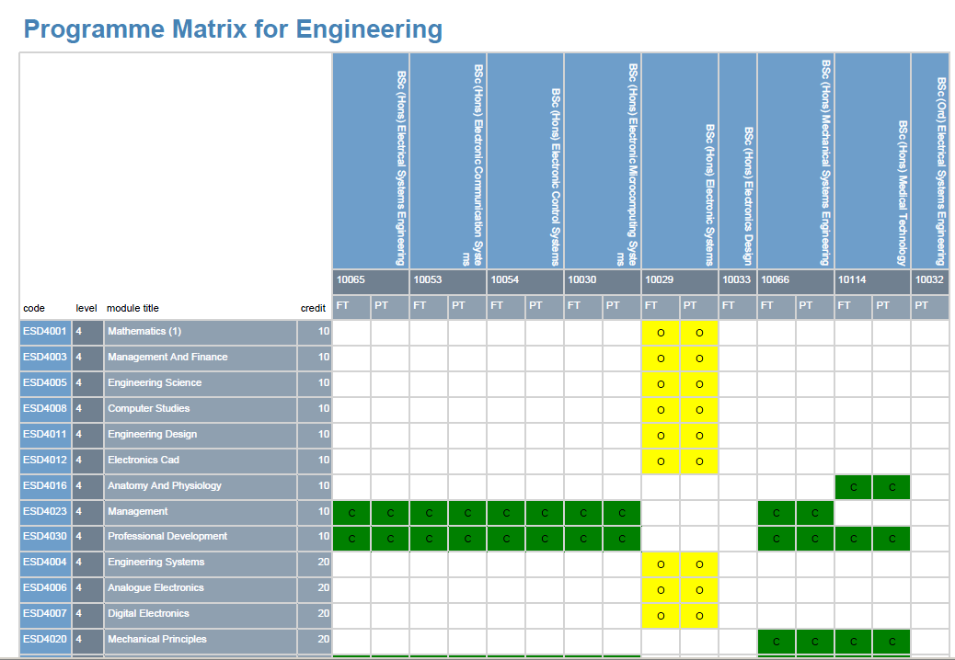

Slide 127
Allocation of Responsibilities for Learning Outcomes to Courses
√ Major Responsibility x Minor Responsibility
(Note: Add additional sheets if necessary to provide for all required courses in the program including any courses offered by other departments)
Learning Outcomes | Courses
Course Code and Number
Knowledge Facts Concepts, theories Procedures
Cognitive Skills Apply skills when asked Creative thinking and problem solving
Interpersonal Skills and Responsibility
Responsibility for own learning
Group participation and leadership
Act responsibly-personal and professional situations
Ethical standards of behavior
Communication IT and Numerical Skills
Oral and written communication
Use of IT
Basic maths and statistics
Psychomotor Skills

Slide 128
Allocation of Responsibilities for Learning Outcomes to Courses
√ Major Responsibility x Minor Responsibility
Learning Outcomes | Courses
Course Code and Number | Chem 101&102 | Chem 223 |  | Chem 323 |  | Chem 201 & 202 |  | Chem 303 |  | Chem 212 & Chem 311 |  |  | Chem 331 & Chem 332 | Chem 479 |  | Chem 471 & chem. 472 |  | Chem 399 |  | Math 101 &102 |  | Phys 101 & 102 |  | ICS 101 |  | Engl 101&102 | Engl 214 |  | IAS 212 |  | IAS 322 |  | IAS 101 |  |  | IAS 201 |  | IAS 301 |  | PE 101
 | General Chem | Anal chem |  | Inst. Analysis |  | Org. chem |  | Qual org.chem |  | Phys. Chem |  |  | Inorg. Chem | Chem seminar |  | Chem Project |  | Summer training |  | Calculus |  | Physics |  | Computer prog. |  | English | English |  | Professional ethcs |  | Human rights in Islam |  | Practical Grammer |  |  | Professional Writing |  | Oral comm. skills |  | Physical education
Knowledge Facts Concepts, theories Procedures | √ √ √ | √ √ √ |  | √ √ √ |  | √ √ √ |  | √ √ √ |  | √ √ √ |  |  | √ √ √ | X X X |  | X X X |  | X X X |  | √ √ √ |  | √ √ √ |  | √ √ √ |  | X X X | X X X |  | X X X |  | X X X |  | X X X |  |  | X X X |  | X X X |  | X X X
Cognitive Skills Apply skills when asked Creative thinking and problem solving | √ √ √ | √ √ √ |  | √ √ √ |  | √ √ √ |  | √ √ √ |  | √ √ √ |  |  | √ √ √ | √ √ X |  | √ √ √ |  | √ √ √ |  | √ √ √ |  | √ √ √ |  | √ √ √ |  | X X X | X X X |  | X X X |  | X X X |  | X X X |  |  | X X X |  | X X X |  | X X X
Interpersonal Skills and Responsibility
Responsibility for own learning | X | X |  | X |  | X |  | X |  | X |  |  | X | √ |  | √ |  | √ |  | X |  | X |  |  | X | X | X |  | X |  |  | X | X |  | X |  | X |  | √
Group participation and leadership | X | X |  | √ |  | X |  | √ |  | √ |  |  | √ | √ |  | √ |  | √ |  | X |  | X |  |  | X | X | X |  | X |  |  | X | X |  | X |  | X |  | √
Act responsibly-personal and professional situations | X | X |  | √ |  | √ |  | √ |  | √ |  |  | √ | X |  | √ |  | √ |  | X |  | X |  |  | X | X | X |  | X |  |  | X | X |  | X |  | X |  | √
Ethical standards of behavior | X | X |  | √ |  | X |  | √ |  | X |  |  | X | X |  | √ |  | √ |  | X |  | X |  |  | X | X | X |  | √ |  |  | √ | X |  | X |  | X |  | √
Communication IT and Numerical Skills
Oral and written communication | X |  | X |  | √ |  | √ |  | √ |  | √ | √ |  |  | √ |  | √ |  | √ |  | X |  | X |  | X | √ |  | √ |  | X |  | X |  | √ | √ |  | √ |  | X
Use of IT | X |  | X |  | √ |  | X |  | X |  | √ | X |  |  | X |  | √ |  | √ |  | X |  | X |  | √ | X |  | X |  | X |  | X |  | X | X |  | X |  | X
Basic maths and statistics | X |  | X |  | √ |  | X |  | X |  | √ | X |  |  | X |  | √ |  | √ |  | √ |  | √ |  | X | X |  | X |  | X |  | X |  | X | X |  | X |  | X
Psychomotor Skills

Slide 129
Curriculum Mapping and Learning Outcomes

Slide 130
Assessment Map

Slide 131
Assessment Map – introductory level

Slide 132
Assessment Map – intermediate level

Slide 133
Strategies
Check the assessments against the domains of learning
Checked which methods were appropriate- on the map eg practical....
****
Development of skills over time- in different disciplines
early work case study– then later years presentation
early simple essay test—later advanced essays
Lab work yr 1 yr 2 project yr 3 poster presentation
yr 4 by the OSCE

Slide 134
Exercise 4:
Using the LOs which you developed yesterday, consider how an appropriate assessment strategy might be developed.

Slide 135
Learning outcome | Assessment form | Person responsible for assessment | Which semester and year | Weighting/%of mark as a part of final mark | Threshold-what mark must be achieved to pass /is it compulsory to pass this assessment to pass the module?

Slide 136
DAY 2
SESSION 2
10.45 = 12.00
Quality assurance of the
Outcomes-based Approach

Slide 137
The role of outcomes in course development, evaluation and monitoring.
Assuring the quality of outcomes-based assessment.

Slide 138
Quality Assurance (UK): Demonstrating the achievement of Learning Outcomes: Assessment
“In many cases, audit teams were unable to find an explicit linkage between learning outcomes and assessment”
QAA Outcomes from Institutional Audit: The adoption and use of learning outcomes
and this sometimes led to recommendations. Occasionally, this absence could be related to the lack of an institutional assessment policy or to guidelines that were in need of review

Slide 139
Program development
NCAAA Standard 4, paragraph 4.2:
Programs must be planned as coherent packages of learning experiences in which all courses contribute in planned ways to the intended learning outcomes for the program.

Slide 140
Relationship? How do you build?
How do YOU STRUCTURE and package these?
i.e. specify the program - ‘field of study’?
SUBJECT MATTER
EXPERT
Outcome ?
How do you describe
what happens here?
WHAT attributes do you
expect a student to
have as a result of
studying and learning?
Year 1
Year 2
Year 3
Start
Finish
Course
Any program …
How do you assess?
A subject
How do you map?
Medical Sciences
SUBJECT DOMAIN
Engineering
Postgraduate?
Undergraduate?

Slide 141
Evidencing the achievement of Learning outcomes: Assessment
“if all of the Learning Outcomes of all of
the compulsory modules of a programme
have been attained and demonstrated by a student
(i.e. assessed), then it is judged that
all of the Programme Outcomes have been demonstrated”

Slide 142
This requires...
Proper structured programme planning procedures, which include planning of teaching and learning and assessment strategies
Use of programme specifications in a consistent format
Use of course specifications in a consistent format
A shared understanding of terminology

Slide 143
The National Qualifications framework
SUBJECT DOMAIN
PROGRAM DESIGN
SPECIFICATION
A Subject
Course 1
Course 2
Course x
Course team awareness
of Learning Outcomes ?
Course 1
Course 2
Course x
Course 1
Course 2
Course x

Slide 144
and...
input from professionals in the field (where a professional subject is involved) and/or from senior academics in other institutions to ensure LOs are appropriate
mapping of course learning outcomes across the programme, and of LOs to assessments
a defined approval process by a senior academic committee within the institution.

Slide 145
Programme evaluation and review
NCAAA standard 4, paragraph 4.3:
The quality of all courses and of the program as a whole must be monitored regularly through appropriate evaluation mechanisms and amended as required, with more extensive quality reviews conducted periodically.

Slide 146
Programme evaluation and review – whose responsibility?
MODELS OF UNIVERSITY MANAGEMENT OF QUALITY
Program teams?
Central function
e.g. Quality Unit?

Slide 147
This requires...
systematic collection of feedback from students, which includes their views on the clarity of LOs and the extent to which they have been achieved
properly specified annual review processes, requiring reflection informed by evidence such as student feedback, assessment pass rates, changes in the professional environment, etc,
Resulting action plan and monitoring actions implemented

Slide 148
and...
‘ownership’ of the programme review by all staff involved in teaching
consideration of annual reports by a senior academic committee of the institution, with feedback to programme teams on key points including appropriateness and coverage of LOs

Slide 149
Periodic review
NCAAA Standard 4, paragraph 4.3.8:
4.1.1 In addition to annual evaluations a comprehensive reassessment of the program should be conducted at least once every five years. Procedures for conducting these reassessments should be consistent with policies and procedures established for the institution.

Slide 150
This requires...
systematic procedures to be set up by the institution, with a rolling programme which ensures that all programmes are regularly reviewed (5 or 6 years are common intervals)
It is good practice to involve external input into periodic reviews
All LOs should be revisited, and where necessary revised, as part of the review

Slide 151
Assessment
NCAAA Standard 4, paragraph 4.4:
Student assessment processes must be appropriate for the intended learning outcomes and effectively and fairly administered with independent verification of standards achieved.

Slide 152
This requires...
that a range of assessment methods is used, so as to cover different LOs and different learning styles
that specifications for assessment, and criteria for grading, are transparent and appropriate to the level of the course within the NQF
that second-marking or moderation is routinely used
that there is clarity about the grounds on which students may appeal a mark, and that students are aware of this

Slide 153
and...
that deadlines for the return of marked work are published and adhered to
that full and constructive feedback on assessments is provided to students, linked to the LOs and to the assessment criteria
that guidelines for dealing with plagiarism, and with requests for time extensions and mitigating circumstances, are clear and are adhered to

Slide 154
Quality assurance of assessment of LOs
May be achieved:
by direct observation – inspection of assessments before they are set, and of samples of marked work
indirectly – by examining the specification of assessment processes
via feedback – from students, from employers, from professional bodies...

Slide 155
FEEDBACK FROM STUDENTS

Slide 156
Teaching quality
NCAAA Standard 4, paragraph 4.6:
Teaching must be of high quality with appropriate strategies used for different categories of learning outcomes.

Slide 157
Teaching and Learning Strategies
NCAAA Domains of Learning | Strategies
Knowledge Facts Concepts, theories Procedures
Cognitive Skills Apply skills when asked Creative thinking and problem solving
Interpersonal Skills and Responsibility Responsibility for own learning Group participation and leadership Act responsibly-personal and professional situations Ethical standards of behavior
Communication IT and Numerical Skills Oral and written communication Use of IT Basic maths and statistics
Psychomotor Skills

Slide 158
Assessment Strategies
NCAAA Domains of Learning | Strategies
Knowledge Facts Concepts, theories Procedures
Cognitive Skills Apply skills when asked Creative thinking and problem solving
Interpersonal Skills and Responsibility Responsibility for own learning Group participation and leadership Act responsibly-personal and professional situations Ethical standards of behavior
Communication IT and Numerical Skills Oral and written communication Use of IT Basic maths and statistics
Psychomotor Skills

Slide 159
This requires...
structured training for new and inexperienced staff, which includes training in the use of LOs and their assessment
regular appraisal of staff performance
ideally, peer observation of teaching on a regular basis

Slide 160
and...
the identification of staff development needs, and provision of support for staff development
a policy for quality enhancement which ensures that teaching strategies are regularly reviewed and that advances in pedagogic practice are disseminated

Slide 161
Programmes, Graduate attributes and Outcomes
Characteristics of the Program
Characteristics of the Graduate
Students Learning Outcomes: Program, Level and Course

Slide 162
3.11 Verifying Consistency with the Qualifications Framework – Requirement 3. Page 11 The program objectives should develop learning outcomes in all of the required domains of learning. To provide evidence that this is done:
Learning objectives specified for the program should include outcomes in all of the domains.
Responsibility for achieving these learning outcomes should be distributed appropriately across the courses within the program and included in course objectives.

Slide 163
Program and course specifications should include methods of teaching and student activities that are appropriate for the learning outcomes in each of the domains.
Tests, examinations and other required assessment tasks should include appropriate forms of assessment of learning in each of the domains.
Program evaluations, including student, graduate or employer surveys and/or other mechanisms should include attention to learning outcomes in each of the domains.

Slide 164
Characteristics of Programs and Expected Learning Outcomes at Each Level in the Framework Page 15
Example – Bachelor Degree

Slide 165
5.3 Level 3. Bachelor 5.3 Characteristics of Programs
An award requiring a minimum of 120 credit hours, normally following four academic years of full time study or equivalent. There are differing expectations for length of programs in different fields of professional study and programs.
A bachelor degree program is designed to develop a comprehensive understanding of a broad field of study, with some studies taken to considerable depth and involving critical analysis of the latest developments and research. Students should be aware of relevant knowledge and theory in other related fields of learning.
A bachelor degree is the basic qualification for entry to a number of highly skilled professional fields and programs in these fields should develop both the knowledge and skill to practice in those professions, and the background in practical and theoretical knowledge and research to proceed to further study.

Slide 166
Characteristics of Graduates
Holders of a bachelor degree should have demonstrated:
Knowledge of a comprehensive, coherent and systematic body of knowledge in a field of enquiry and of the underlying theories and principles associated with it;
The ability to investigate complex problems and develop creative solutions with limited guidance, using insights from their own and other related fields of study;
The ability to identify and use appropriate mathematical and statistical techniques in the analysis and resolution of complex issues, and select and use the most appropriate mechanisms for communicating the results to a variety of audiences;
Capacity to provide leadership and willingness to cooperate fully with others in joint projects and initiatives;
In the case of a professional program the full range of knowledge and skill required for effective practice in the profession concerned;
In the case of an academic program not geared to professional practice, in depth knowledge and understanding of research literature in a field, and ability to interpret, analyze and evaluate the significance of that research in extending knowledge in the field.

Slide 167
Graduate Characteristics
Learning and Teaching Strategies
Assessment
Intended
Learning Outcomes

Slide 168
Issues we need to recognize:
Outcomes can be defined at different levels for different purposes.
Outcomes are complex, based on the integration of knowledge, skills and values.
Multiple outcomes need to be integrated and treated holistically
The outcomes will provide the springboard for students to become active learners.
The process for creating outcomes at different levels needs to be collaborative and open. It needs to involve a broad range of stakeholders.
Staff development and support will be necessary to assist individuals and teams at different levels to define learning outcomes that are significant.
Assessment needs to be in place at different levels to monitor students’ progress in their learning and provide constructive feedback.
Assessment’s primary role is to promote learning.

Slide 169
Exercise 5:
Taking account of what you have heard today, if you were to write a new learning, teaching and assessment strategy for your institution or department, what are the most important aspects of this strategy?

Slide 170
DAY 2
SESSION 3
12.45 – 14.00
Managing the move to Learning Outcomes
- a possible approach

Slide 171
Reflections on 5 themes from UK QAA Institutional Audit
The adoption and use of learning outcomes
Institutional approaches to learning outcomes
The use of external reference points
Programme design
Assessment
Information provided to students

Slide 172
Reflections on 5 themes from UK QAA Institutional Audit
Key messages
Each institution must reflect and find its own approach (not emulate)
“There is ample evidence in reports that students valued the clarity that the use of learning outcomes had brought to the overall purpose of their programme, the interrelationship between parts of the programme and the nature and purpose of assessment tasks.”

Slide 173
Reflections on 5 themes from UK QAA Institutional Audit
Key messages
Stimulated institutional approaches to looking closer at the relationship between teaching, learning and assessment practices and how these managed
Old processes not always fully explicit
Discipline self evaluation invariably used external reference points (FHEQ)
Weakness in differentiation between batchelor’s and master’s levels (eg BEng and MEng)

Slide 174
Reflections on 5 themes from UK QAA Institutional Audit
Key messages
Mapping: ‘ the extent to which intended learning outcomes at module or unit level allow the learner to achieve programme level intended learning outcomes’
Relationship between learning outcomes and assessment not systematically applied
Connections are not systematically made to the ‘big picture’ and information is not communicated to students e.g. in handbooks.

Slide 175
Action Plan: Managing the move to Learning Outcomes – a possible approach
DAY 2 Session (6) 12.30 – 14.00
Central University policy – usually starts from Teaching and Learning Strategy, Assessment policy
Faculties/Schools then develop their T&L strategy and LOs for programmes
Individual module teams develop their LOs in the light of Faculty and University policies
Mapping takes place to ensure that all programme-level LOs are being achieved
In professional fields, due note is also taken of accreditation requirements
LOs published to students
Annual and periodic reviews ensure that policies are being maintained

Slide 176
Managing the move to Learning Outcomes – critical success factors
Strict deadlines for completion of each stage need to be set and adhered to
Commitment from the highest level of management is essential
‘Champions’ should lead development at faculty, programme, module level
Staff development should support the project at every stage
Proper reporting lines through committees should maintain oversight of the project, with regular updates

Slide 177
Managing the move to Learning Outcomes – the key point
The change is unlikely to be successful if it is cosmetic/driven by external requirements/minimalist
The change is most likely to succeed if it is driven by the wish to enhance the student experience

Slide 178
Why LOs important? The student learning experience
Do you have an institutional learning outcomes based
approach to provision? (i.e. on all modules taken?)
i.e. define student attainment in terms of achieved learning
outcomes. (p5 QAA)

Slide 179
Activity: Action Plan:
Reflecting on what you have learned in the workshop draft some key actions (i.e. how you will apply what you have learned and make use of it when you go back).

Slide 180
Activity 1: Your expectations … ?
Have your objectives (outcomes) for the workshop been met?
In what way has your knowledge and understanding of LOs improved?

Slide 181
Summary and conclusion ..

Slide 182
We wish you every success with your work
Thank You

Slide 183
Useful references (UK)
Quality Assurance Agency (QA)
Higher Education Academy (QI/QE)
HEA Engineering
Very generic learning outcomes for medicine are given at that Tuning Project website (seeking to find a level playing field across Europe) http://www.tuning-medicine.com/
The Scottish Doctor, very closely related to the Tuning Project but more UK focused and for Scottish institutions.

