Slide 1
Some quality cycle planning monitoring and sharing examples

Slide 2
Exploring examples of institutional planning and response to quality feedback
3 year institutional planning – developing strategic plans and sharing them ; ensuring the vision is owned and taken into practice
National student survey responses feeding into planning – long term changes and ‘quick wins’ ie actions which can cause some rapid improvement.

Slide 3
3 yr cycle planning and replanning built on awareness of context of HE monitoring and sharing –
strategic plan, strategies, collegial shared development and ownership
Communication via website, open meetings, materials
Changes to practice and to the plans
Monitored by KPIs

Slide 4
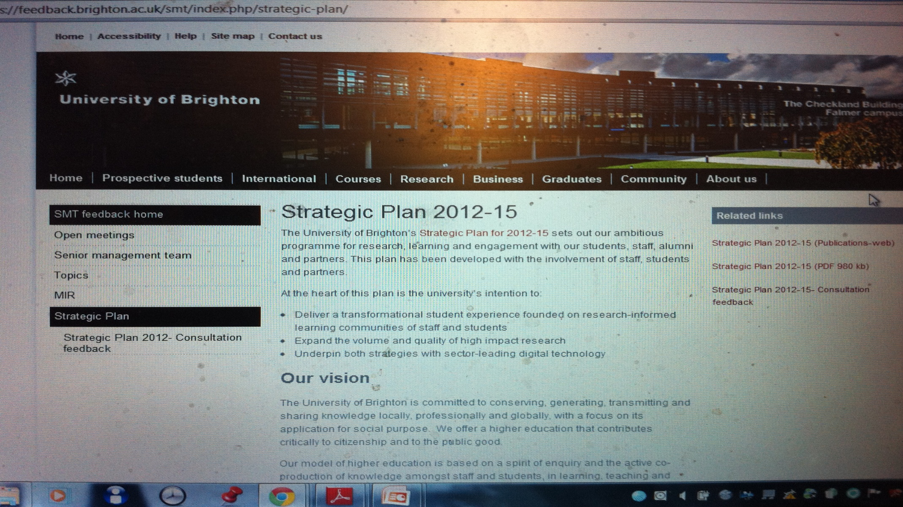
On staff central – to share

Slide 5


Slide 6


Slide 7


Slide 8


Slide 9
The sharing of the strategic plan enables shaping, ownership and commitment to action.
As each leading theme underpins actions, so it is measured through KPIs, over time.

Slide 10
NSS national student survey- a glimpse
The national NSS enables us to find out what our 3rd year students feel about their experiences of teachign and learning, assessment, organisation ad management, and their overall student experience. It is used to provide one set of information for universities to measure their performance, and to feed into continual improvement.
Yearly 3rd yrs asked questions about teaching and learning, learning support and environment etc
Information for whole uni, for different courses- shared with leaders and practitioners and students cooperative collegial decisions about changes
Improvement year on year- affects ratings of university nationally .

Slide 11
Sharing the National student survey
University of XXXX
NSS 2012 Analysis – Report Free Text Comments
School of XXXX
Free Text Comments
Introduction
As part of the dissemination of the results from the NSS 2012, the students’ free text comments are made available for internal use only. The comments are anonymous. The respondents are asked the following:
‘Looking back on the experience, are there any particularly positive or negative aspects of your course you would like to highlight? (Please use the boxes below.) Please ensure that your comments do not identify you individually.’

Slide 12
NSS scores are provided for the categories ‘learning and teaching’, ‘assessment and feedback’, ‘academic support’, ‘organisation and management’, learning resources’, and ‘personal development’. This allows a comparison of the NSS quantitative score with the frequency of comments by category. This should highlight areas of good practice or of concern, and provide supporting evidence and clearer understanding through the comments themselves.

Slide 13
How can you share and What could you DO about these comments?
BA xxxxxxxxx
Lively and enthusiastic staff make the subjects interesting.
Differentiation and multicultural considerations should be embedded in each subject more.
There should be more of the key texts available in the library for assignment use.

Slide 14
1 Share the praise and use it to support development of staff- students value enthusiasm and dedication as well as skill.
2 There is a message for some longer term development in modules.
3 This can be enabled quite easily it is a ‘quick win’ to enable change and improvement for the student learning experience.

Slide 15
Quality cycles and sharing
How could these comments and monitoring and evaluation information feed into
The strategic plan
KPIS and developments
And effects monitored and evaluated?

