Slide 1
Staff survey

Slide 2
What questions would you expect on a staff survey?
How could you involve staff in the survey?
How would you use what they said to improve?

Slide 3
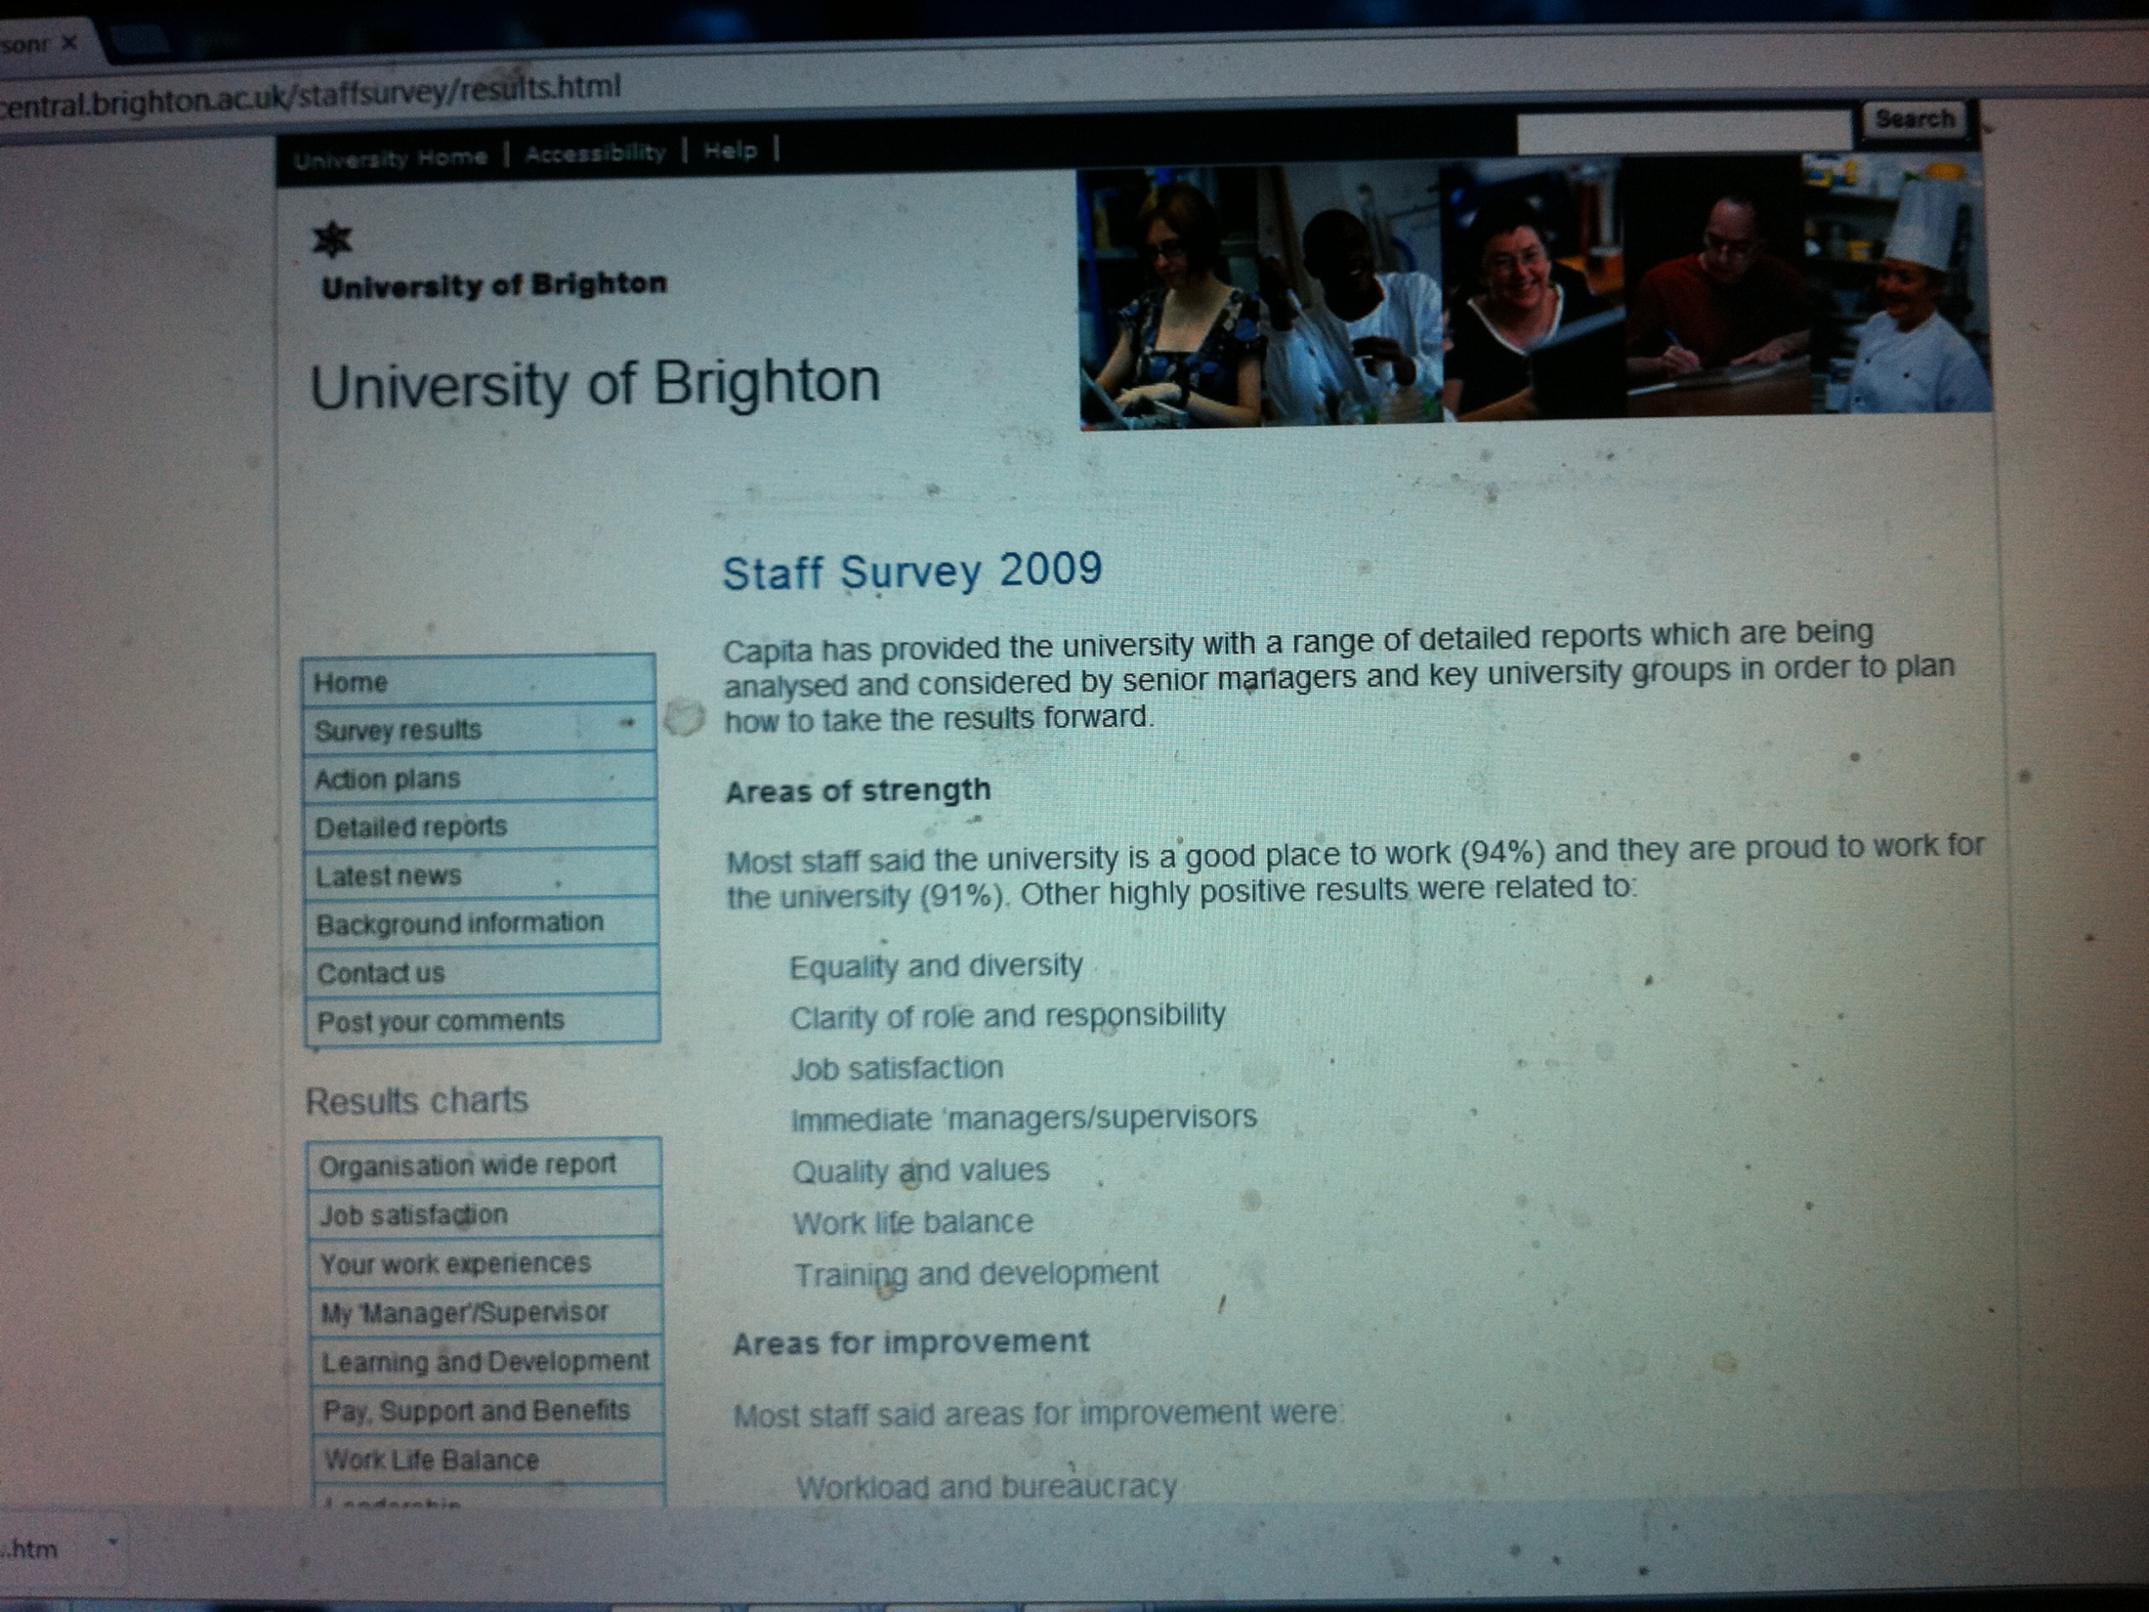

Slide 4
