Slide 1

Establishing data analysis and reporting systems based on NCAAA requirements.
Professor Gina Wisker
University of Brighton
g.wisker@brighton.ac.uk
Gabriel Jezierski
Cardiff Metropolitan University
gabrieljezierski@gmail.com

Slide 2
Workshop Learning Outcomes
This training program will enable participants to:
Select appropriate data to use for QA management purposes.
Provide support to meet NCAAA requirements and complete templates.
Appreciate the challenges and find solutions for the collection and use of data in quality assurance management.
Explain to peers the major issues, principles, methods and best practices related to data collection and analysis.

Slide 3
Workshop - Overview
Day 1
1. Data Analysis and Reporting Systems
2. Data Systems and Process
3. Business Systems and Process
Day 2
4. NCAAA Data Reporting
5. Strategic Planning: KPIs
6. Action Plans and Conclusions

Slide 4
Data Analysis and Reporting Systems

Slide 5
Strategy Alignment
Government Higher Education Strategy
NCAAA= Quality bridge
University Strategic Plan
College’s strategy

Slide 6
NCAAA Quality Planning and Review 5 Year Cycle
Define/Review
Mission/Goals
Five yearly Review
Environment Scan
Review Performance
Action Plan
Set Objectives
Yearly
Monitor Results
Implement Plan
Develop Plan
Notes:
Anyone know where this from?
Handbook for QA and Accreditation in KSA Part 2 on Internal QA arrangements.
Improving QA is an ongoing process.
Two ongoing cycles:
Annual – monitor and review
5 year review – this brings in larger picture. Should coincide with external review/accreditation by NCAAA
Planning and Review takes place at different levels – at institution/academic and/or admin unit/individual or groups of programs. All 3 levels should contribute towards overall picture. Should consider external and internal factors and address itself to student learning experience.
Should do at least TWO annual reviews as preparation/source of data for accreditation.

Slide 7
DATA
Warm up Task:
Spend 2 minutes doing a mindmap using ‘data’
DATA

Slide 8
DATA
Warm up Task:
Spend 2 minutes doing a mindmap using ‘data’
In pairs, WHY do you collect data?
DATA
Group Feedback

Slide 9
The Quality Cycle
KPIs
EVIDENCE
IMPROVEMENT
DATA
REPORT
DISCUSSION
ANALYSE

Slide 10
NCAAA STANDARD 3
QUALITY
MONITORING
EVALUATION
IMPROVEMENT
DECISION
MAKING
WHY are you
collecting it?
Meet YOUR NEEDS?
Meet NCAAA NEEDS?
DATA &
EVIDENCE

Slide 11
FOR WHAT?
KEY
PERFORMANCE
INDICATORS
WHAT do
you do with
it all?
WHAT ?
COLLECT
ANALYSE
REPORT
DATA &
EVIDENCE

Slide 12
Data analysis & reporting: the bigger picture
Some key issues:
- Analysing (data and reports) and acting (on findings)
- Linking data processes and academic structures
Known problems (UK):
- Assessment and feedback (relationship between what is happening in your university and the national picture)
- Progression
- Year 1
Moving from Quality Assurance to Quality Improvement

Slide 13
NCAAA report templates
Annual Course report
Annual Program report
Field Experience report
Periodic Program Self Study
Institutional Self Study

Slide 14
11 NCAAA Quality Standards
Mission and Objectives
Student Administration and Student Services
Facilities and Equipment
Employment Processes
Institutional Relationships with the Community
Governance and Administration
Learning Resources
Financial Planning and Management
Research
Workshop focus on:
Management of Quality Assurance and Improvement
Learning and Teaching

Slide 15
Standard 3: Management of Quality Assurance and Improvement
3.1 Institutional commitment to Quality
Improvement
3.2 Scope of Quality Assurance Process
3.3 Administration of Quality Assurance Processes
3.4 Use of Indicators and Benchmarks
3.5 Independent Verification of Evaluation
3.6 Evidence and Performance Indicators

Slide 16
NCAAA Standard 4:
Learning and Teaching
4.1 Institutional Oversight of Quality of Learning and Teaching
4.2 Student Learning Outcomes
4.3 Program Development Processes
4.4 Program Evaluation and Review Processes
4.5 Student Assessment
4.6 Educational Assistance for Students
4.7 Quality of Teaching
4.8 Support for Improvements in Quality of Teaching
4.9 Qualifications and Experience of Teaching Staff
4.10 Field Experience Activities
4.11 Partnership Arrangements with Other Institutions

Slide 17
Activity 1: Demonstrating standards
What evidence would you use to demonstrate that your Program is meeting Standard 4?

Slide 18
Data Systems and Process

Slide 19
BUSINESS PROCESSES (Strategic)
ADMIN SYSTEMS
(Registry)
QUALITY SYSTEMS
(Quality Unit)
ACADEMIC ACTIVITY (Colleges)
Collecting data
from?
WHAT
EVIDENCE?

Slide 20
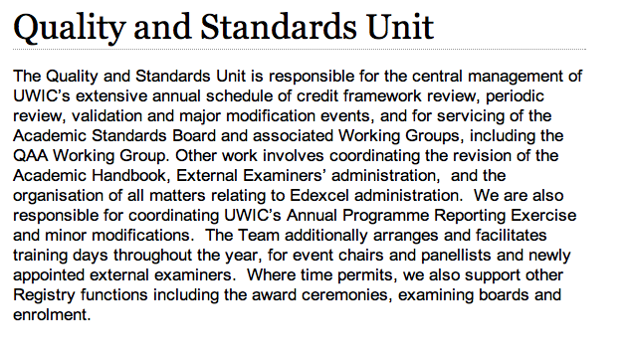

Slide 21
Data types
Quantitative data:
Information that can be counted or
expressed numerically, e.g. statistics.
Qualitative data:
Information that can be captured but is not
numerical, e.g. surveys

Slide 22
Data type characteristics/issues?
Quantitative data:
Accuracy
Informative
Reliability
Qualitative data:
Open/closed questions
Response rates
Representative samples

Slide 23
Data analysis (UK)
Quantitative data
  Legal (HESA returns)
  Funding Council (returns)
  Enrolment (data)
  Progression (data)
  Awards (data)
  Exit (data)
Qualitative data
  Annual Course Monitoring
  National Student Survey
  External Examiner
  PTES / PRES

Slide 24
UK sources of Quantitative Data
UCAS
Student Records
Institutional Repository/Student Registry
Human Resources
Alumni Office
Research Office

Slide 25
Quantitative Data in Context:
The Data Framework
Management
Defining data requirements
  Modelling
Understanding Processes & Procedures
  Business processes (Mapping to the academic)
  Student Life-Cycle (Mapping to the student)
Designing/ Buying database system
  Enterprise /corporate (University)
    Finance
    Student Records (In-house/off the shelf)
Reporting systems (End user)
  Quality
  and academic structures: reports for what and whom?
  and administrative processes
Analysing: data mining; interpreting data
Action planning
Data → Query → Report

Slide 26

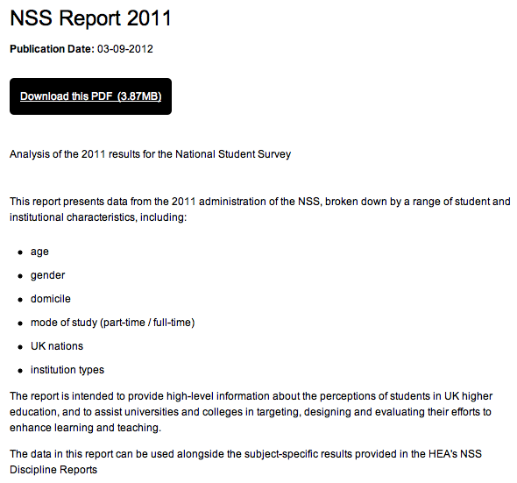
Qualitative data: UK examples

Slide 27
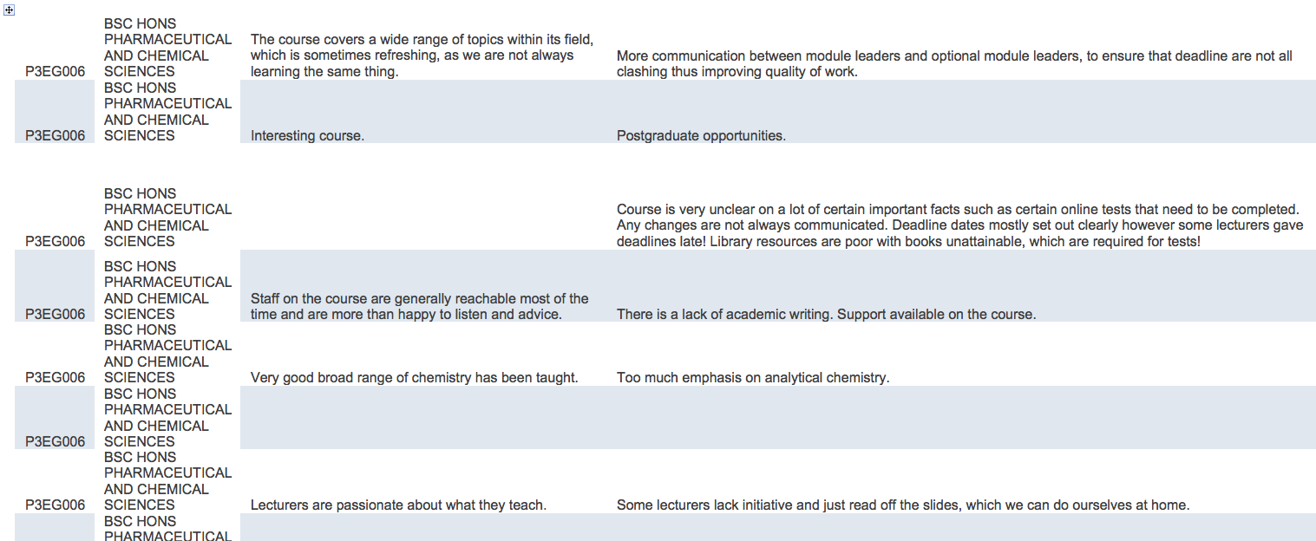
Qualitative data: UK examples

Slide 28
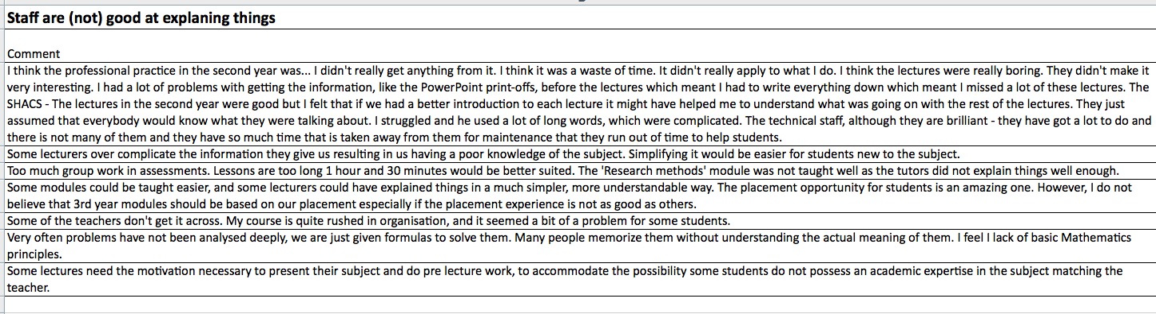
Qualitative data: UK examples

Slide 29
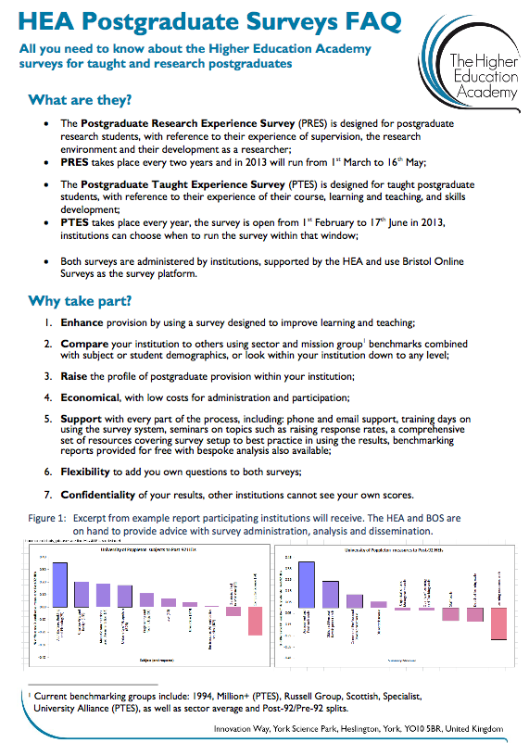
UK example: PRES

Slide 30

UK example: PTES

Slide 31
Activity 2: Data management
Who provides Quantitative data in your university?
Are there any issues?
3. What are the main challenges when dealing with Qualitative data?

Slide 32
Complete Data Picture
Quantitative Data
Qualitative Data
VENN DIAGRAM
Two types of evidence are supportive and complementary

Slide 33
Balanced Quality Data Picture
QUALITY
Assurance
Enhancement
(Improvement)

Slide 34
Business Systems and Processes

Slide 35
BUSINESS PROCESSES (Strategic)
ADMIN SYSTEMS
(Registry)
QUALITY SYSTEMS
(Quality Unit)
ACADEMIC ACTIVITY (Colleges)
Collecting data
from?
WHAT
EVIDENCE?

Slide 36
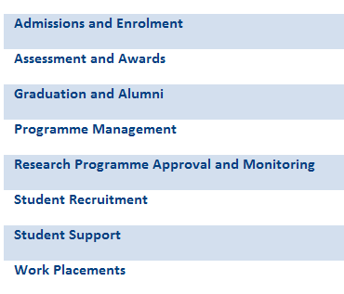
Business Processes and Systems
CASE STUDY (UK)

Slide 37
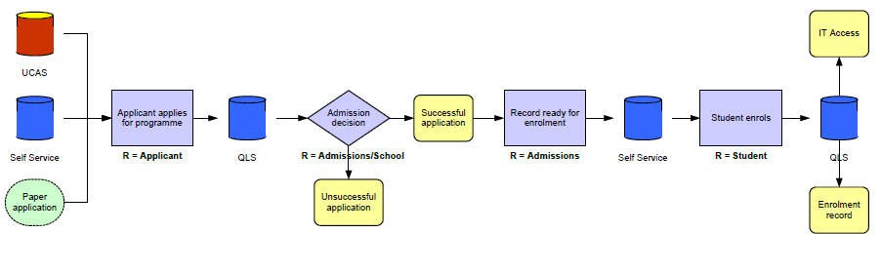
Admissions to Enrolment
CASE STUDY
Student Life – Cycle: Overview

Slide 38
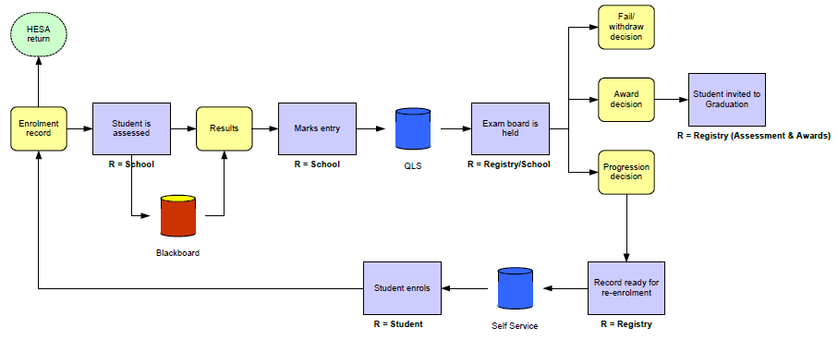
Assessment and Awards
CASE STUDY
Student Life – Cycle: Overview

Slide 39
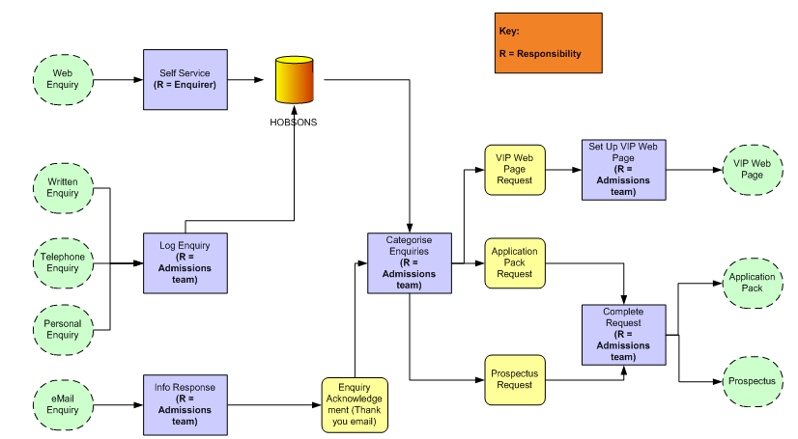
Admin systems: Enquiries
Customer Relationship Management software (Hobsons)
CASE STUDY

Slide 40
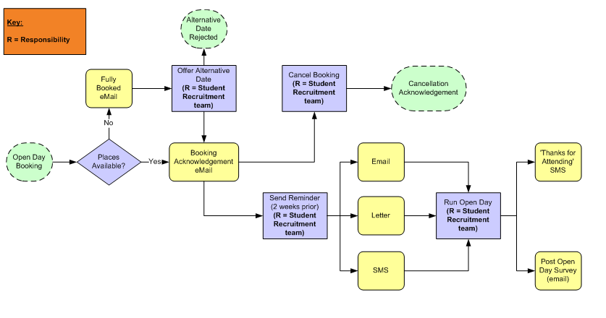
Admin systems: Open Day Enquiry
CASE STUDY

Slide 41
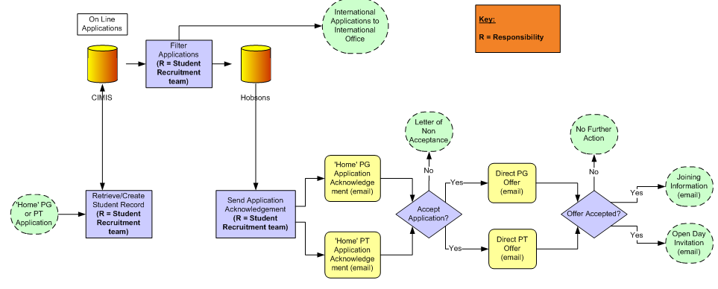
Admin systems: PG and PT Enquiry
Customer Relationship Management software (Hobsons) (or ‘in-house’ system)
CASE STUDY

Slide 42
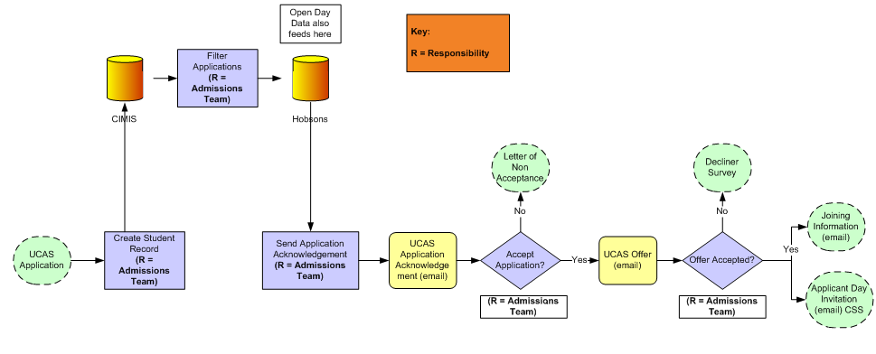
Admin systems: UCAS Admissions
Customer Relationship Management software (Hobsons) (or ‘in-house’ system)
CASE STUDY

Slide 43
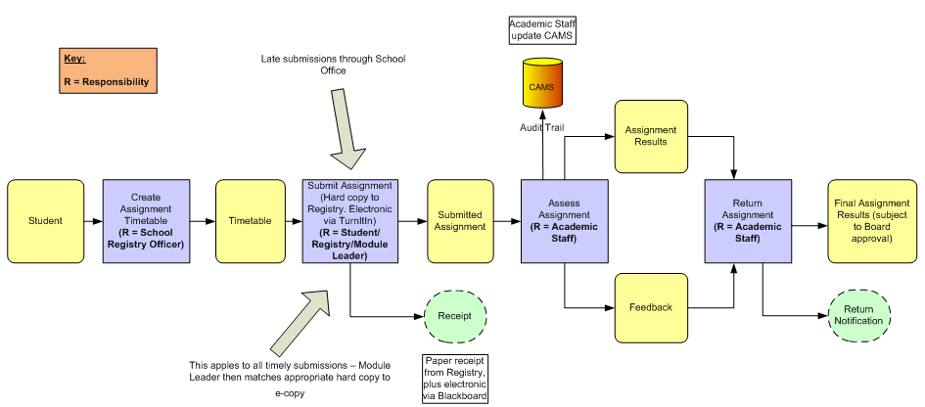
Admin systems:
Assignment submissions
CASE STUDY

Slide 44
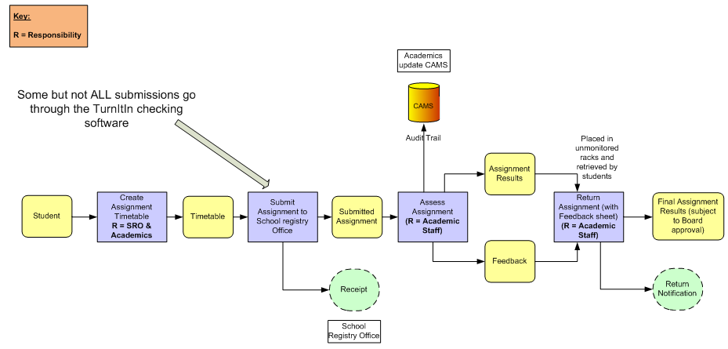
Admin systems:
Assignment submission (School of Engineering)
CASE STUDY

Slide 45
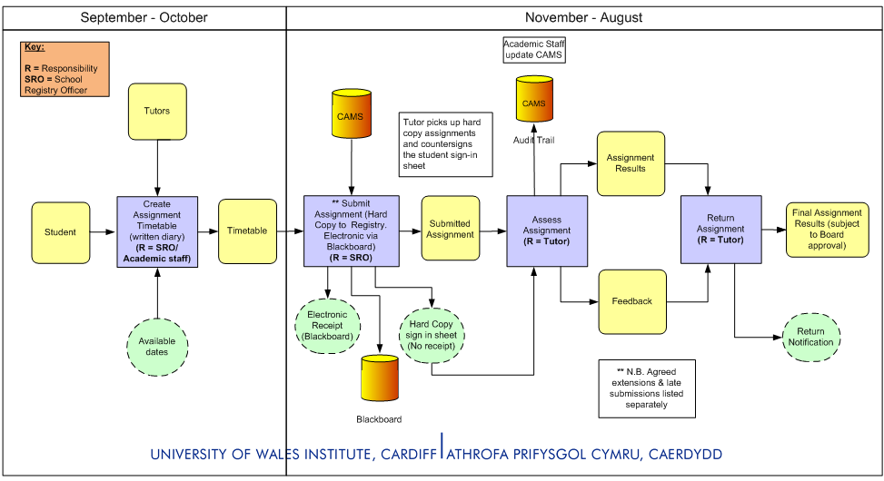
Admin systems:
Assignment submission (School of Visual Arts)
CASE STUDY

Slide 46
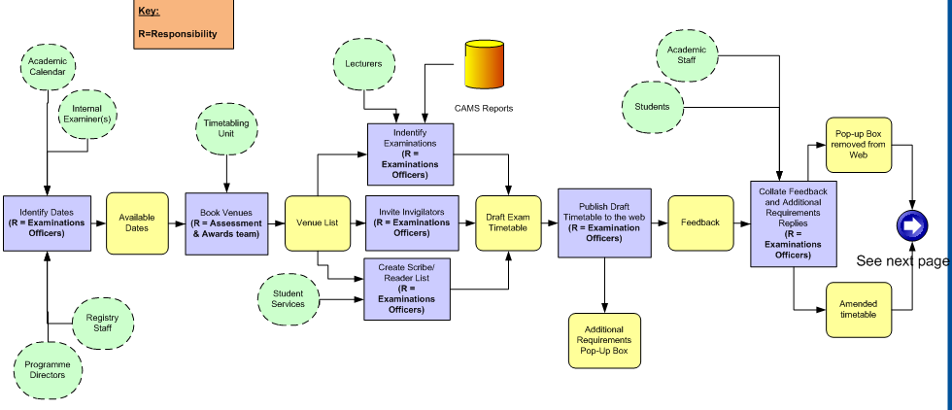
Admin systems: Exam Scheduling
CASE STUDY

Slide 47
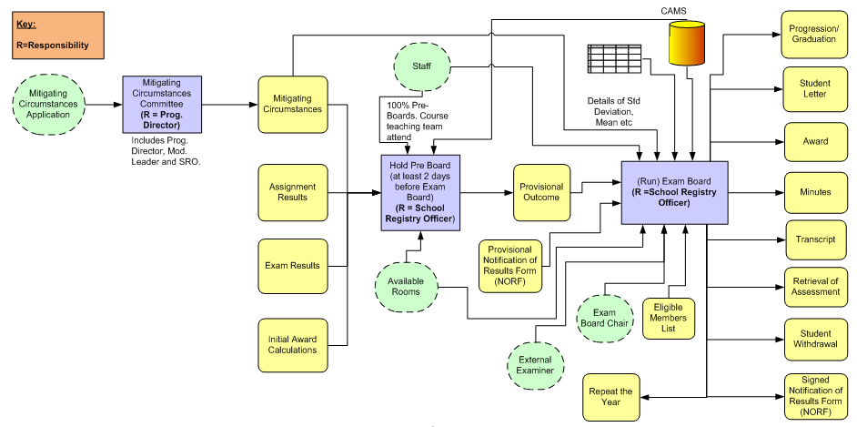
Admin systems:
Exam Board School of Health Sciences (Psychology)
CASE STUDY

Slide 48
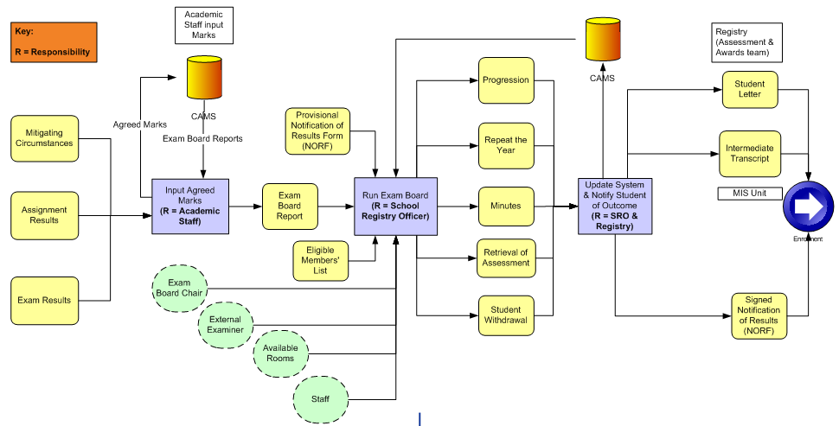
Admin systems:
Exam Board (School of Education: Progression)
CASE STUDY

Slide 49
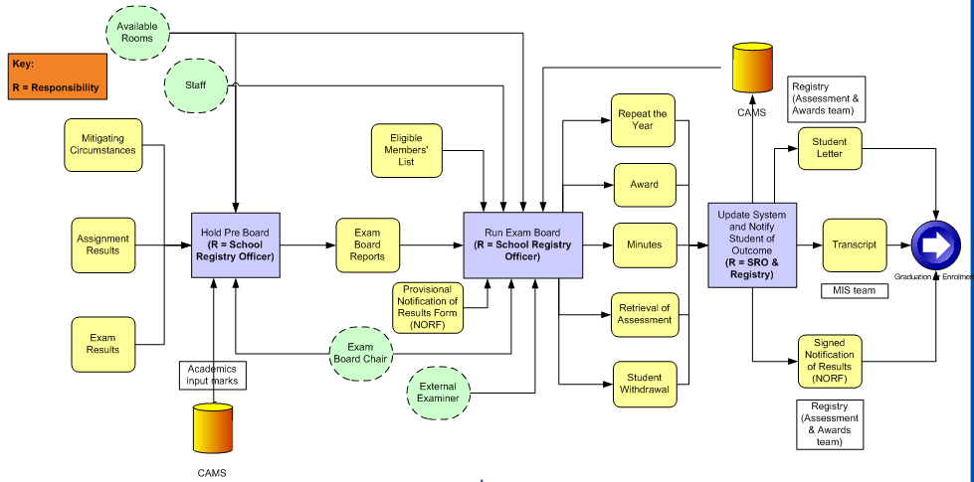
Admin systems:
Exam Board (School of Education: Final Year)
CASE STUDY

Slide 50
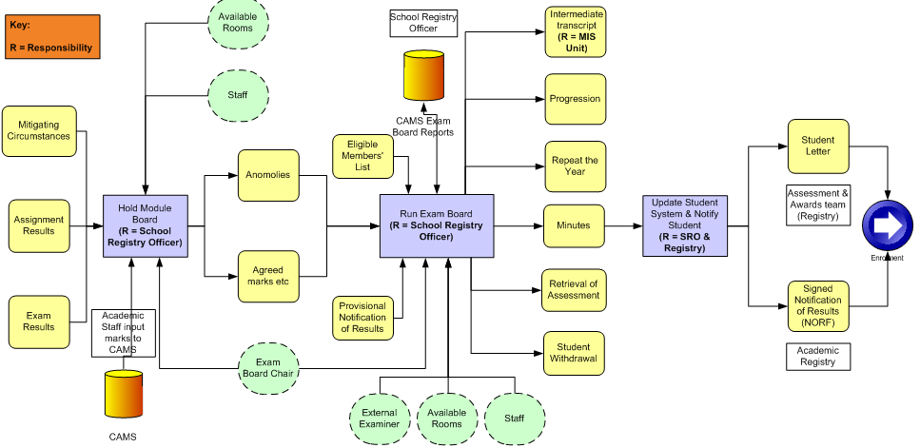
Admin systems:
Exam Board (School of Agricultural Science: Progression)
CASE STUDY

Slide 51
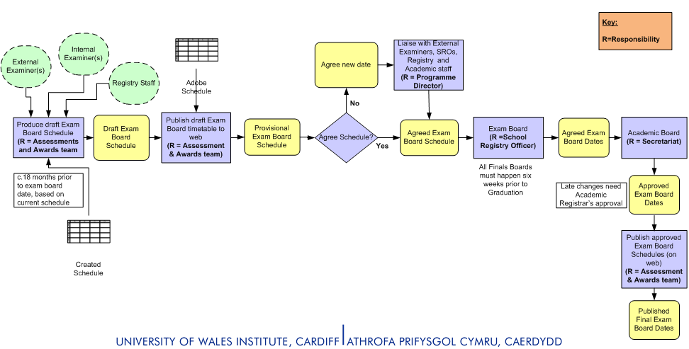

Admin systems:
Exam Board (Scheduling)
CASE STUDY

Slide 52
Activity 3: Quality systems
Focus on one aspect of Quality Assurance
in your university.
Create a flow chart to illustrate the
systematic steps that are taken to ensure
smooth completion of the quality process.

Slide 53
Annual monitoring of taught courses in x Gather data on-
student numbers,
progression,
pass rates
External examiner reports
Student evaluation comments including NSS
Changes and improvements made
Information considered by
Course committee
Academic standards
Quality assurance agency in the 5 yr cycle

Slide 54
Workshop - Overview
Day 1
1. Data Analysis and Reporting Systems
2. Data Systems and Process
3. Business Systems and Process
Day 2
4. NCAAA Data Reporting
5. Strategic Planning: KPIs
6. Action Plans and Conclusions

Slide 55
DAY 2
What was useful yesterday?
Do you have any questions from yesterday?

Slide 56
Useful things and questions
Data is useful to feed into taking strategic decisions
How we can get the data and produce flow charts to produce a record of it and analyse and use it
Flow charts help systematise visually
Data needs to be both quant and qualitative and there needs to be triangulation upon which you can compare and make decisions\
Sources of quant and qual, how to analyse and systematic steps in quality cycle to use it
Evidence to demonstrate standard 4

Slide 57
Describing and analysing and making sense of the data and saying so what/ what does this mean/?
NCAAA standard 4 what evidence can you use ?eg for improvement of quality in teaching
What do we mean by data mining? And analysis?going deeply into research data and finding the important elements which help prove something, develop arguments,(1)finding generalisable trends, and (2) proof of specific important issues

Slide 58
Application of the data – calculating drop out rate in a shifting context eg students moving courses (might need to express this in a complex way that explains both the methodology and the way the patterns have been developed)
Recommended packages for managing this data (I’ll ask! Penny ****)
Quality control -Quality assurance- Quality enhancement

Slide 59
QA- establishing the standards ,compliance with and checking on standards
QE informed by the information on quality (the achievement of the standards) how do you improve? Develop? And then see how well it is working?(QA will check if it is working)working (systems, processes?) QE improves

Slide 60


Slide 61
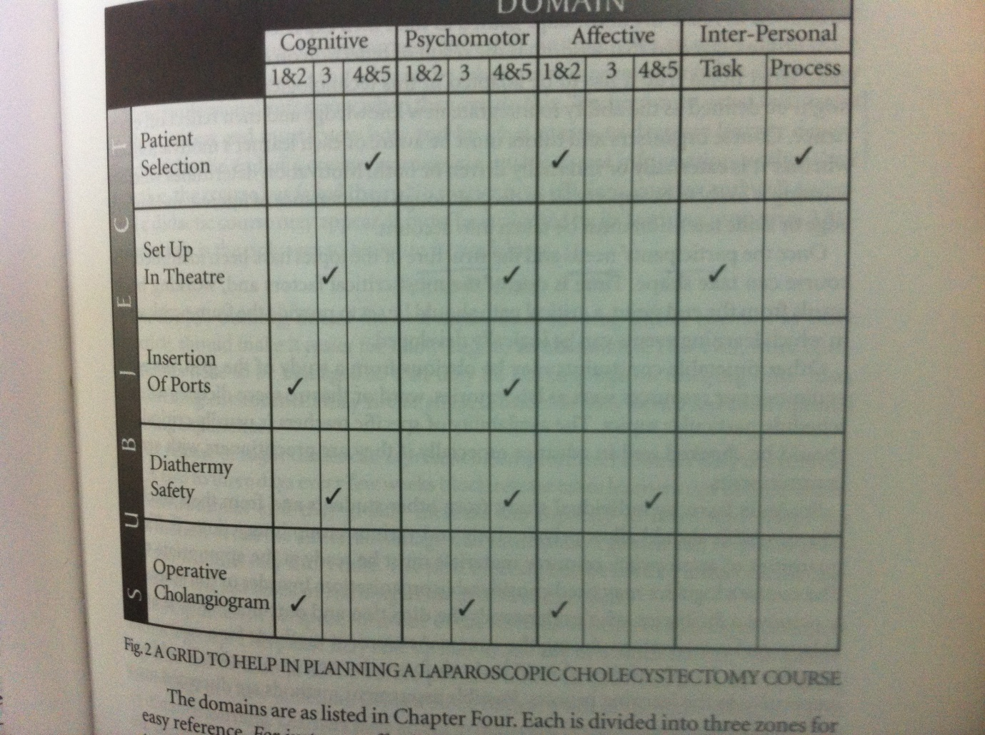

Slide 62
NCAAA Data Reporting

Slide 63
DATA
Task:
In pairs, WHAT data do you collect?
WHAT do you do with it?
Group Feedback

Slide 64
DATA ANALYSIS
Breakdown
Examine
Understand
DATA REPORTING
WHAT do you
do with it?
REPORT TO WHO?
(Reporting structures)
WHY are you reporting?
EVIDENCE

Slide 65
Using the data - Designing reports
WHAT reports?
What are they for?
Who are they for?
What information do you require?
What does it tell you?
How does data aid decision making?
IDENTIFY: e.g. to meet NCAAA Standards
Annual Course Report: ACR
Annual Program Report: APR
Periodic Program Self Study: PPSS
Institutional Self Study: ISS
Student Evaluation Surveys: CES/SExS/PES

Slide 66
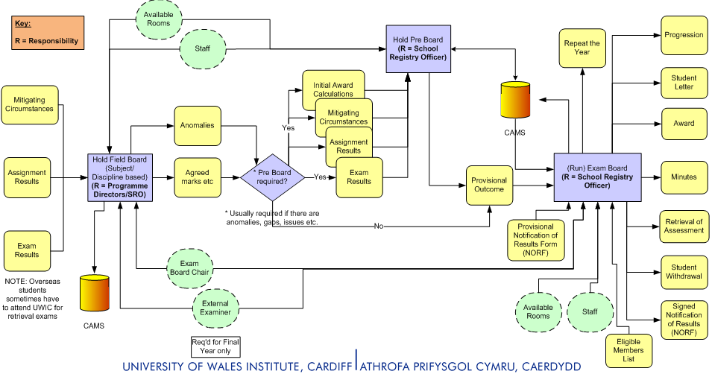
Academic Quality Standards Processes – Progression: Exam Board School of Management (BA Business)
CASE STUDY

Slide 67
We have looked at gathering and using the data
And at the reporting processes flow chart

Slide 68
Sandwich of decisions and actions
1 Data- identify problems etc discussion- decision making (meetings)
2 Action- who acts on the decisions? Course leaders? Staff? Information people? (sometimes with committee nothing happens after the decisions are made!!!) implementation ,responsibility , measures
3 Report back on and evaluate effectiveness of actions based on the decisions

Slide 69
Now please look at both sets of reporting documents
1)(2c)APR annual programme report
2)(2g)ACR annual course report
What would you do with these reporting
forms and systems? Who fills the forms out?
  Where do you get this data?
  What data is it?
  What is it for?
  How useful can it be and why?

Slide 70
Where from entry-registry admin , historical -info tech, grad destination- alumni office student surveys – course reports all will go to an info centre
Also need external independent verification, opinion

Slide 71
Where does this data and where do the the reports go next?
What is done with it???
analyse trends etc etc and SWOT
Suggest professional development for improvement\
Then check it happened

Slide 73
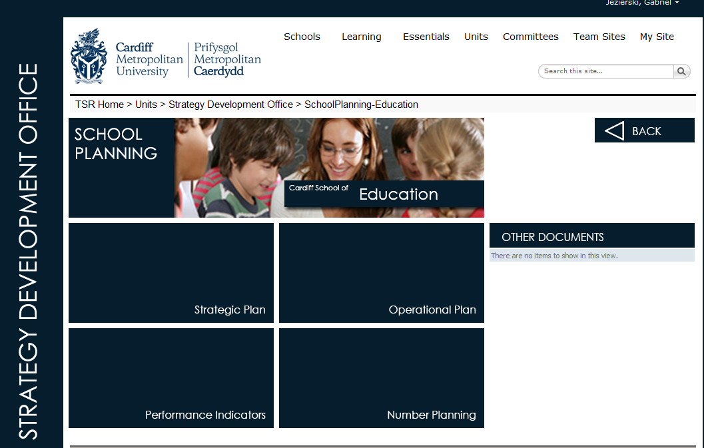

Slide 74


Slide 75
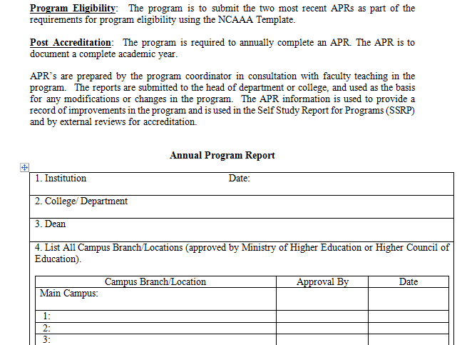
NCAAA PROGRAM ANNUAL REPORT

Slide 76
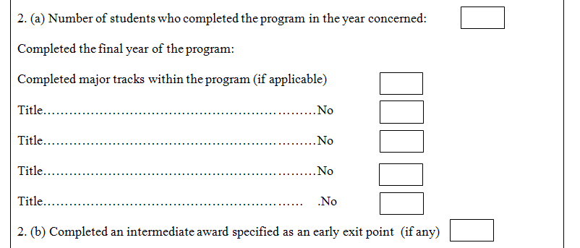
NCAAA PROGRAM ANNUAL REPORT

Slide 77
Annual Course Monitoring (ACR)
Who?
The centre?
The Course Team?
Compliance?
Process should be owned by course teams through
the Programme Review Meeting; fostering the notion
that quality assurance is done by staff, rather than to, or for, them
External Examiner Reports
Programme
Student feedback
Statistics

Slide 78
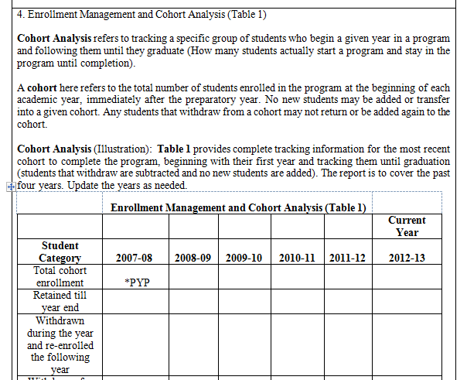
Annual Program Report / cont …

Slide 79
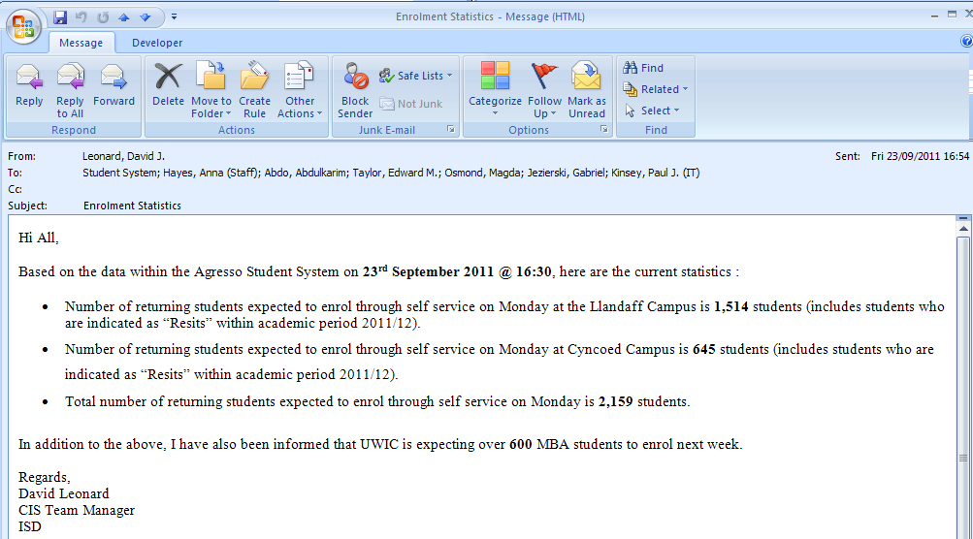
Progression statistics
CASE STUDY

Slide 80
Enrolment/Progression
BA (Hons) Art and Design: Enrolment/Progression
 | Year 1 | Year 2 | Year 3
2008/2009 | 86 | 75 | 75
2009/2010 | 120 | 104 | 102
2010/2011 | 126 | 114 | 114

Slide 81
Enrolment/Progression

Slide 82
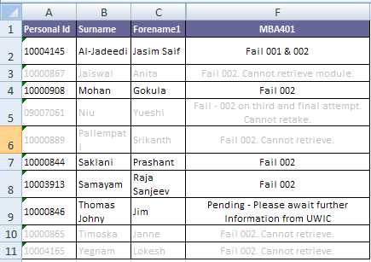
Sample data for Progression rate reporting
CASE STUDY

Slide 83
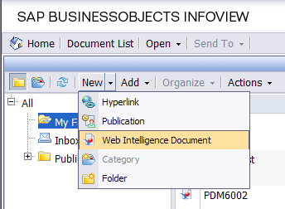
Creating a report

Slide 84
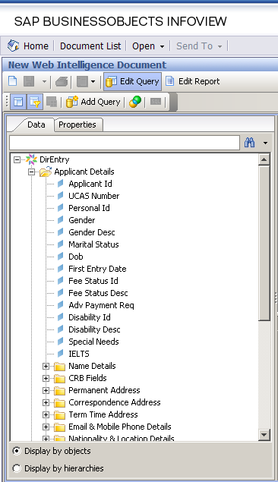
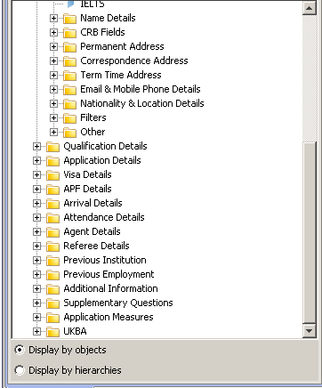
Creating a report

Slide 85
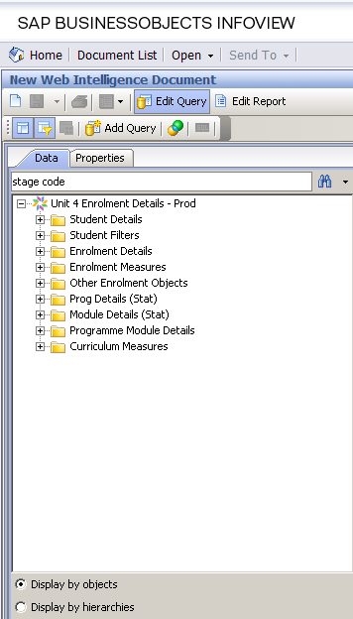
Curriculum details

Slide 86
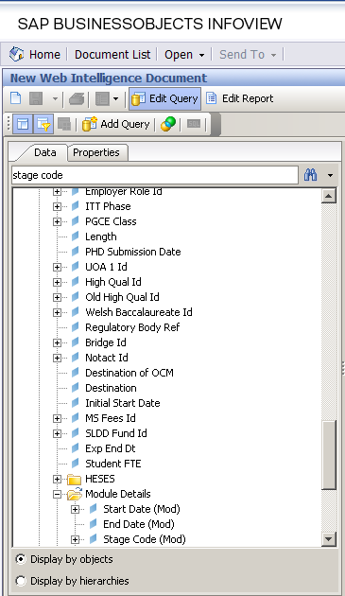

Slide 87
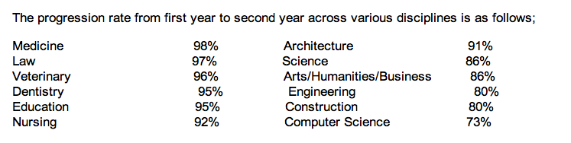
Progression Rate from First to Second Year
Questions
From the above statistics are progression rates a problem?
What do you do to follow up student drop out after the first year?
CASE STUDY

Slide 88
Reporting statistics
EXTRACT FROM TEACHING AND LEARNING COMMITTEE MINUTES
The Committee noted that the HESA measure of non-continuation of first year students rose in the four years to 2010, reaching 14.7% compared to a benchmark of 10.9%. Internal figures showed a slight decline in the following two years. Differences in attrition rates between subjects/faculties in part reflected national differences between subjects but a large number of subjects within the University had attrition rates above the national average.
The Committee noted that the progression rate of full-time students at the end of first year was 74.2% in 2008/9 with 82% of second year students progressing to year 3. Approximately 60% of first year students passed all their modules and a further 20% failed one module each semester. There was a lower failure rate in modules assessed by coursework compared to those involving an examination.
The report provided information on a range of factors which did not appear to influence retention or progression, as well as those which did. While highlighting the issues affecting progress, many of these were not under the University’s influence. It was therefore considered that the most effective course of action would be to seek to enhance the first year experience for all students in order to promote academic and social engagement with the University, which was widely recognised as necessary to promote student success. The Committee noted the suggestions for future initiatives, which would be incorporated appropriately into the new Teaching and Learning Strategy.

Slide 89
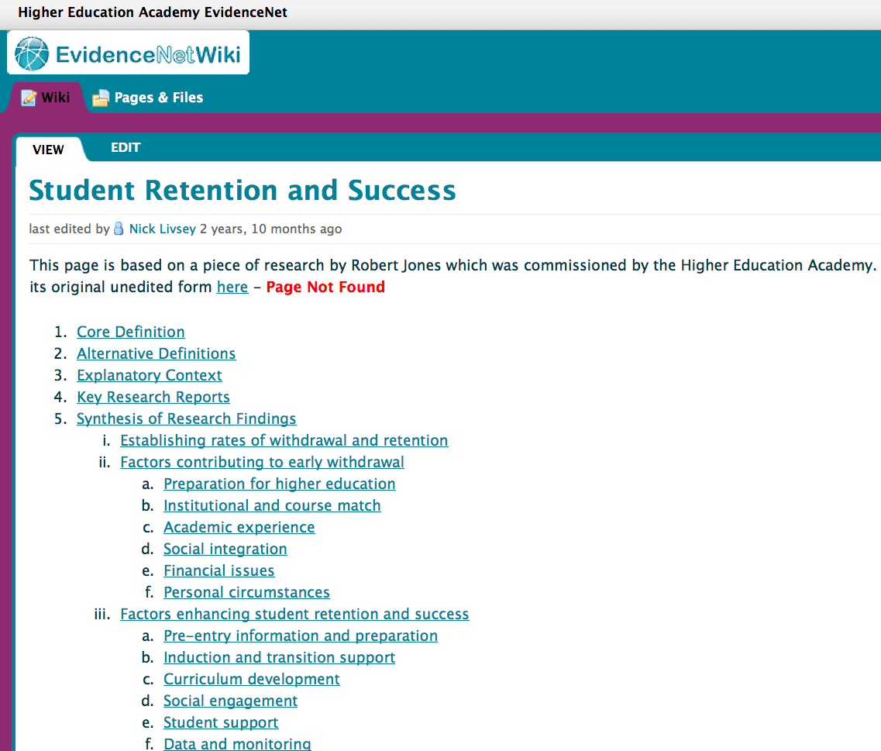
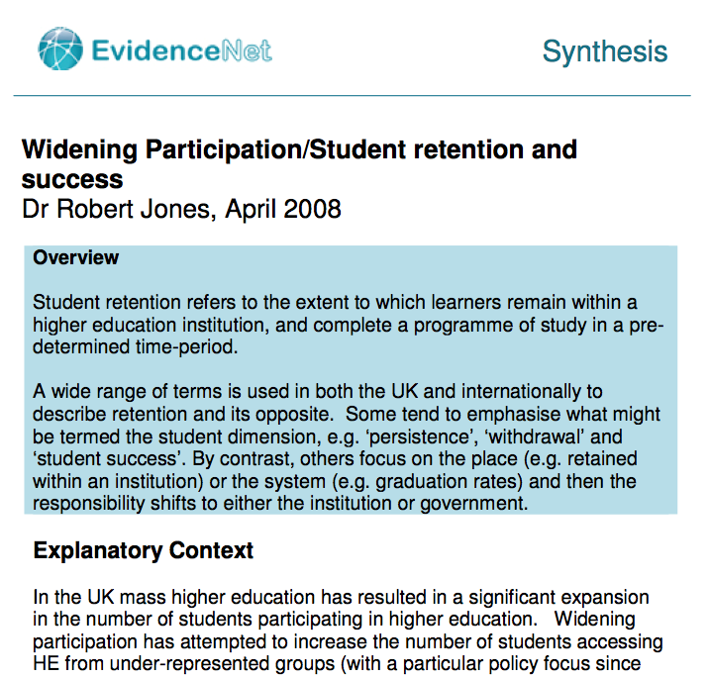

Non continuation .. (UK)

Slide 90
Activity 4: Using data effectively
How will you use data to improve quality and performance at Program level?
How will you use data to improve quality and performance at Institutional level?
What is the role of your Quality Standards Unit ?

Slide 91
Strategic Planning: KPIs

Slide 92

Standard 2: Governance and Administration: Strategic Planning
Notes:
Otherwise stand still
Standards made up of a range of QA practices and measures
Must be operationally viable and able to put into practice

Slide 93
Strategic Planning:
objective is continual quality improvement
must be measured against recognised Quality Assurance Standards i.e NCAAA
is constructed and developed through QSystems, QPractices and QProcesses
drives better students performance
Balance between central and devolved process?
Enables benchmarking
Notes:
Otherwise stand still
Standards made up of a range of QA practices and measures
Must be operationally viable and able to put into practice

Slide 94
QUALITY & (BASELINE – THRESHOLD) NCAAA STANDARDS?
STANDARD 3 & 4

Slide 95
QUALITY & (BASELINE – THRESHOLD) STANDARDS?
QUESTION 2 HOW DO YOU CONTINUE TO IMPROVE THE QUALITY?
NCAAA
QUESTION 1 HOW DO YOU ACHIEVE THIS?

Slide 96
It is important to note
that Benchmarking is a process
for organizational improvement

Slide 97
KEY DATA: KPIs
Data and performance - Measuring Performance
Task:
WHAT KPIs do you have at
Ibn Sina National College for Medical Studies
i) At the Institutional level?
ii) At the program level?
Group Feedback

Slide 98
Key Performance Indicators
What is a Key Performance Indicator (KPI)?
KPIs provide measurable data that
can evidence quality and provide a base for
Benchmarking.
Effective use of KPIs provides an excellent
marketing tool.

Slide 99
NCAAA KPIs
“The key performance indicators specified
by the NCAAA are intended to provide
specific quantifiable data that can be used to
help monitor the quality of the total system
of higher education in the Kingdom.”
NCAAA explanatory notes on Key Performance Indicators

Slide 100
NCAAA 36 Key Performance Indicators
Intended to provide specific quantifiable data to support university monitoring systems in the Kingdom.
KPIs should be considered with other evidence, e.g. high Program completion rates: good teaching or poor assessment standards?
KPIs are a reference point for best practice comparison with national/international standards.

Slide 101
NCAAA KPIs
3.1. Students overall evaluation on the quality of their learning experience
4.1. Ratio of students to teaching staff
4.4. Percentage of students entering programs who successfully complete first year
9.2. Proportion of teaching staff participating in professional development activities

Slide 102
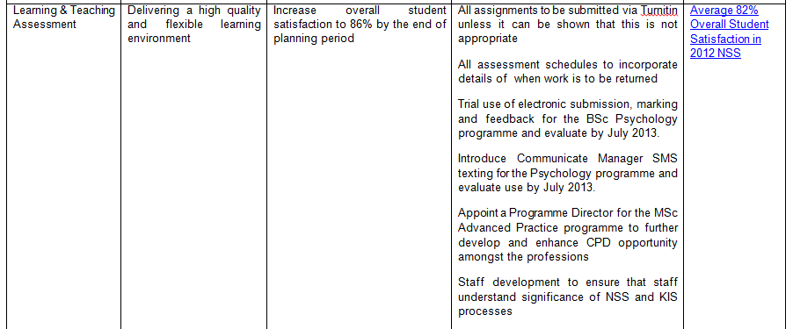
Target Benchmarks: Goals

Slide 103
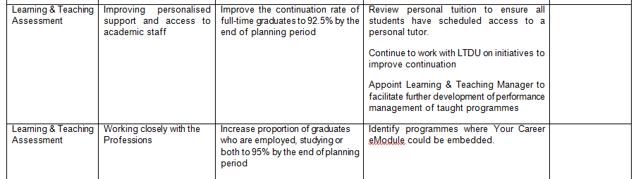
Target Benchmarks: Goals

Slide 104
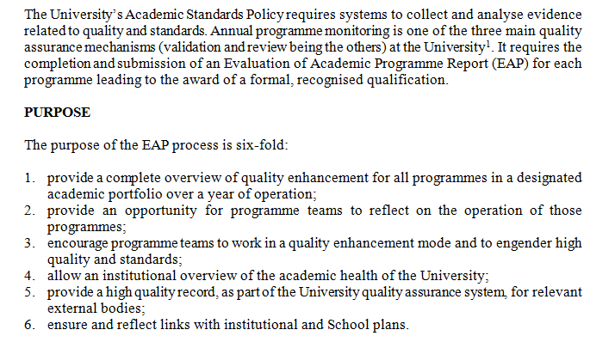
Annual Course Review (APR)

Slide 105
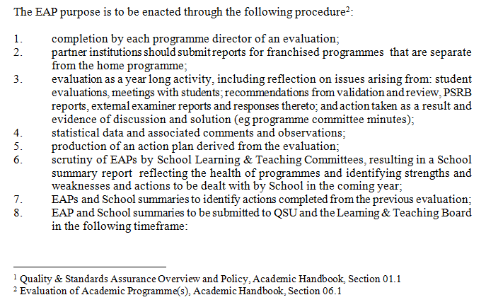
Annual Course Review (APR)

Slide 106
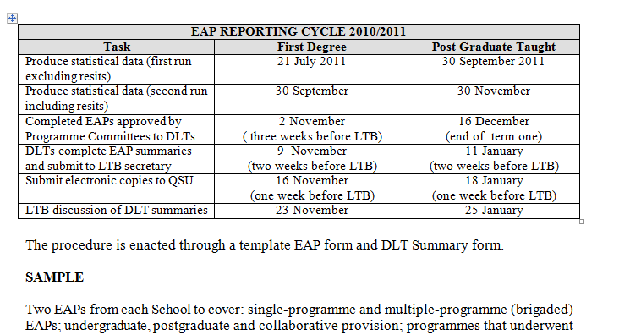
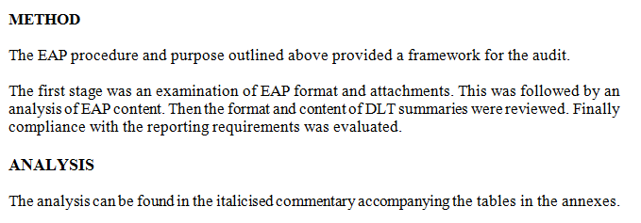

Slide 107
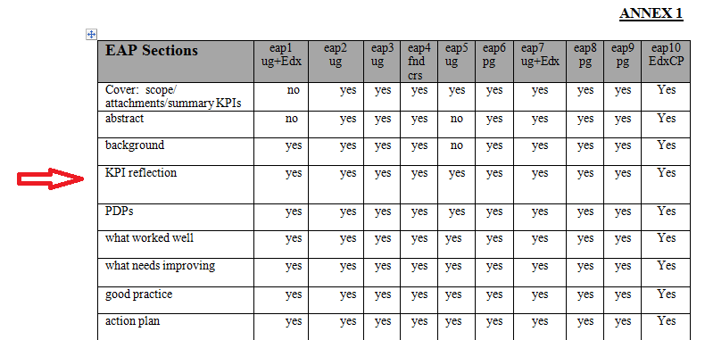
Annual Course Review (APR)

Slide 108
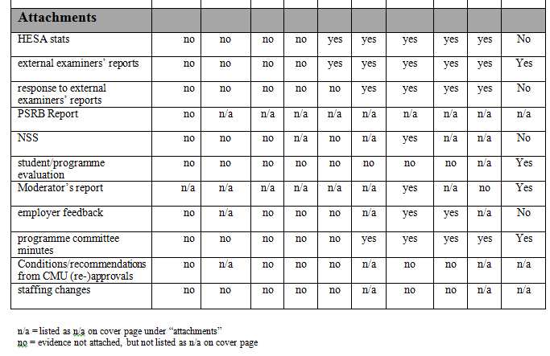
Annual Course Review (APR)

Slide 109
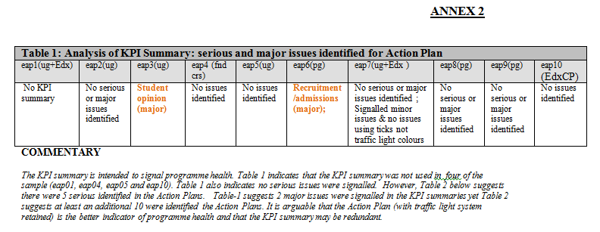
Annual Course Review (APR)

Slide 110
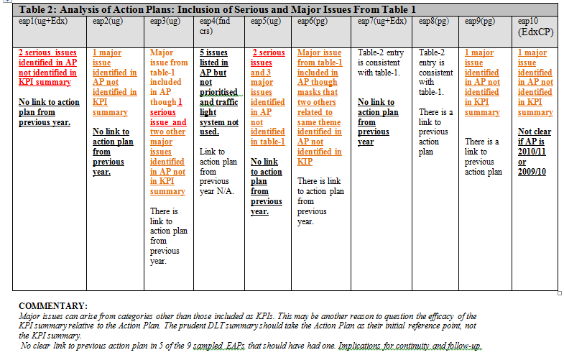
Annual Course Review (APR)

Slide 111
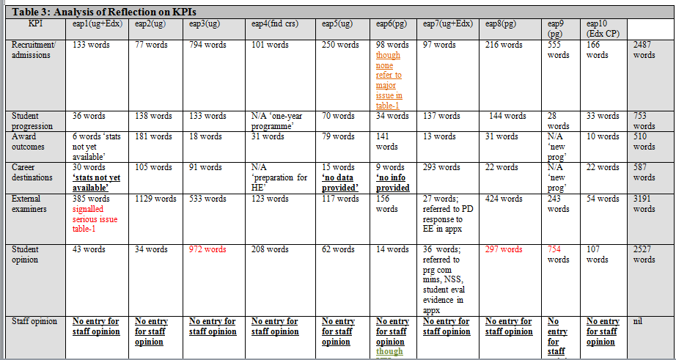

Slide 112
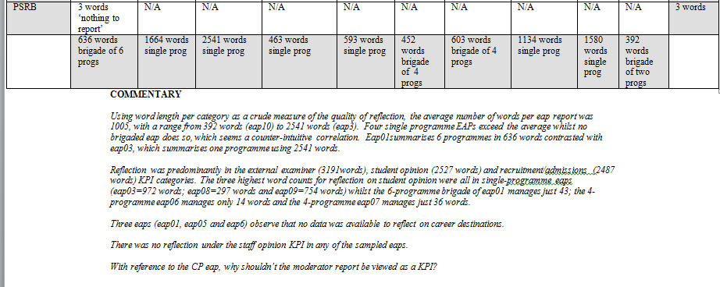

Slide 113
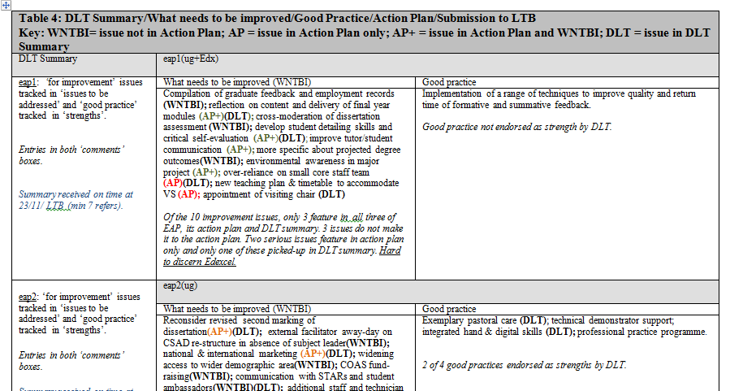
Annual Course Review (APR)

Slide 114
University of Brighton Learning and Teaching Strategy KPIs
Strategic Plan-
KPIS from the strategic plan feed into
LT strategy

Slide 115
KPI(curriculum fit for purpose)
All undergraduate courses will offer, as part of the curriculum, the opportunity for forms of external engagement such as work placements, community engagement or equivalent.
All undergraduate courses will offer, as part of the curriculum, focus on sustainability internationalisation, social justice, global citizenship, critical professionalism .

Slide 116
To reduce home non-continuation to 9% by 2015, achieving a position at or below our HESA benchmark (Currently 12.2%)
To meet our Access Agreement targets for recruitment and retention
92% employment rate for first degree leavers in the 2015 DLHE tables at or above sector average.
Evidence of interactive teaching and active learning, out of class and socially purposeful learning in discipline contexts in all curricula.

Slide 117
Professionalisation of learning KPI:
By 2015 all academic staff will have, or be working towards, a University teaching qualification or institutionally recognised equivalent, with an embedded digital literacy component.’
What steps would you take to ensure this happens?
What data would you collect to show it happens?
Who would you report this data to?

Slide 118
Annual monitoring of taught courses in x
Gather data on-
student numbers,
progression,
pass rates
External examiner reports
Student evaluation comments including NSS
Comment reported back to course teams Changes and improvements made to document and courses
Data reported to : Information considered by
Course committee
Academic standards
committee
QAA Quality assurance agency in the 5 yr cycle

Slide 119
Examples of Benchmarks
1. 83% satisfied with the teaching on my course
5. 23 students for each 1 teaching staff. (SSRs)
84% successfully complete 1st year
100% independent verification of standards of student achievement by people external to the institution (UK)
25. 77% teaching staff participating in professional development

Slide 120
Target Benchmarks: Goals
KPI | Finding: Initial Benchmark | Internal Target Benchmark | External Comparable Benchmark | Action Plan
Quality of learning experience | 3.6 | 4.0
Staff : Student ratio | 23 | 18 | 20
% students completing year 1 | 73 | 80 | 84
% independent verification of standards of student achievement by people external to the institution |  |  | 100 (UK)

Slide 121
University Benchmarks (UK)
Comparable institutions: wide range of data must be returned to national funding bodies (e.g. HESA)
National level benchmarks: NSS scores; national league tables
Professional bodies: accredited status in subject specific areas

Slide 122

Examples of Benchmarks (UK)
National Student Satisfaction Survey

Slide 123

Examples of Benchmarks (UK)
National Student Satisfaction Survey

Slide 124
Staff – student ratios
The staff: student ratio is a key identifier for the general "quality" of interaction you will have whilst at university. The higher the ratio the more unlikely you are to see your tutor.
“We have 1 member of staff for every 8.9 students, whereas the UK university average is 1 member of staff to every 17.6 students.”
The University of Buckingham

Slide 125


The 1st year ..

Slide 126

The 1st year

Slide 127

The 1st year

Slide 128
NCAAA Standard 3: Use of Indicators and Benchmarks
3.4 Use of Performance Indicators and Benchmarks Specific indicators must be identified for monitoring performance and appropriate benchmarks selected for comparative evaluation of the achievement of goals and objectives and quality of performance more generally. 3.4.1 Information is provided regularly on key performance indicators that are selected for all programs in the institution. 3.4.2 Additional performance indicators relevant to the particular program are also identified and regularly reported on. 3.4.3 The additional benchmarks for the program should be approved by the appropriate senior committee or council within the institution (senior academic committee, university council) as part of its program approval decision. 3.4.4 Benchmarks for comparing quality of performance (for example with past performance or comparisons with other institutions) are established and achievements in relation to those benchmarks is regularly monitored. 3.4.5 The format for indicators and benchmarks is consistent with that adopted for the institution as a whole.
Overall Assessment Comment_________________________________________________________________ _________________________________________________________________________ Priorities for improvement____________________________________________________ _________________________________________________________________________ Independent Opinion Comment_________________________________________________________________ _________________________________________________________________________

Slide 129
Activity 5:
What KPIs would you use to measure Standard 4: Learning and Teaching?
What Benchmark would you set for each KPI?

Slide 130
Action Plans and Conclusions

Slide 131
Action Plans: General
Actions plans should be SMART
  S – Specific
  M – Measurable
  A – Achievable
  R – Responsible
  T – Time line
Good action plans:
  Have specific completion date.
  Identify staff responsible for action(s).
  Identify resources needed for successful outcome.
  Are evaluated and fed into SSR

Slide 132
Action plan example
Action | Date for completion | Responsible | Resources | Notes
1.

Slide 133
Activity 6: Action Planning
Either:
Develop a phased Action Plan to improve
academic staff’s understanding and use of
KPIs.
Or:
Develop a phased Action Plan to improve
the process of data collection and analysis
in your university.

Slide 134
Following through...
Establishing effective data analysis and
reporting systems requires:
good initial selection of appropriate data.
familiarity with NCAAA requirements.
an appreciation of the challenges, and an interest in finding solutions, for the collection and use of data
a sense of responsibility and interest in discussing QA principles and issues with colleagues

Slide 135
Following through...
BUSINESS INTELLIGENCE
(BI)

Slide 136
And finally...
Three examples of UK quality management
tools to support and develop more effective
processes and systems:
Balanced Scorecard
Dashboard
‘Institutional Research’

Slide 137


Balanced scorecard

Slide 138

Balanced scorecard

Slide 139

Balanced scorecard

Slide 140

Balanced scorecard

Slide 141

Balanced scorecard

Slide 142

Balanced scorecard

Slide 143

Dashboards

Slide 144

Dashboards

Slide 145

Dashboards

Slide 146

Dashboards

Slide 147
Higher Education Institutional Research (HEIR)
http://www.heir2011.org.uk/
http://www.uky.edu/IRPE/
http://www.facebook.com/group.php?gid=131463133547565

Slide 148
Summary
NCAAA Standard 3 ‘Management of Quality Assurance and Improvement’ provides sound framework
3.3 Administration of Quality Assurance Processes clearly sets out the institutional arrangements
3.3.10 sets out the Statistical data
3.4 sets out the ‘Use of (performance) Indicators and Benchmarks

Slide 149
Summary ..
Saudi universities are developing a Quality Assurance culture with a sound evidence base.
Establishing sound data analysis and reporting systems + good management of Quality Assurance will lead to continual Quality Improvement and Quality Enhancement
Saudi universities Quality Assurance centres will ensure process and practice is ‘fit for purpose’
NCAAA has established the Saudi framework for quality improvement

Slide 150
THANK YOU!
Gabriel Jezierski: gabrieljezierski@gmail.com
Gina: mmcnorto@glam.ac.uk
THANK YOU!
Gabriel Jezierski: gabrieljezierski@gmail.com
Gina Wisker: gwisker@brighton.ac.uk

Slide 151
Useful references (UK)
Quality Assurance Agency
Higher Education Academy
Higher Education Statistics Agency (HESA)
National level benchmarks:
  National Student Survey
  National League tables
Professional bodies
Destination of Leavers from Higher Education (DLHE) survey

Slide 152


Slide 153


